Slide 1
EPIC UV Albedo Calibration
O3, SO2, Reflectivity, & AI (Aerosol Index) retrievals are based on albedo measurements(Earth_Radiance/Solar_Irradiance)
EPIC uses NPP OMPS NADIR Mapper (NM) for in-flight calibration.
Prelaunch Lab Radiance and Irradiance Calibrations Are Traceable To NIST Standards with Uncertainty 7% and 8%, respectively. Specs for Uncertainty in Ratio of Radiance to Irradiance is 2%.
NPP OMPS NM Counts/Second Sensitivity Has Been Stable Within 0.5% Since Launched in 2011.
We used Coincidence Albedo Comparisons between EPIC and NM, also between EPIC and OMI.

Slide 2
EPIC UV Albedo Calibration
EPIC Solar Irradiance at 1 AU
Channel Wavelenght(nm) Irradiance
1 317.478 819.0
2 325.035 807.7
3 339.858 995.8
4 387.923 1003.3
5 442.397 1956.0
Derived from EPIC Filter Transmission Profiles and OMPS’ Reference Solar Spectrum
Dobbers & Voors, Solar Phys (2008) 249: 281–291

Slide 3
EPIC UV Albedo Calibration
Select OMPS NM Footprints (50km x 50km) with these Coincidence Criteria Against EPIC Pixels:
Backscattering Angle Difference < 1^{O}
Solar Zenith Angle Difference < 2^{O}
Satellite Zenith Angle Difference < 2^{O}
Time Difference < 15 minutes
Same Geolocation by Fitting smaller EPIC Pixels inside the larger NM Footprint
Require Scene Uniformity Characterized by STDV of EPIC Counts in NM Footprint Weighted by 1/STDV².
Difference in Solar/View Angles Are Accounted using radiative transfer with TOMRAD.

Slide 4
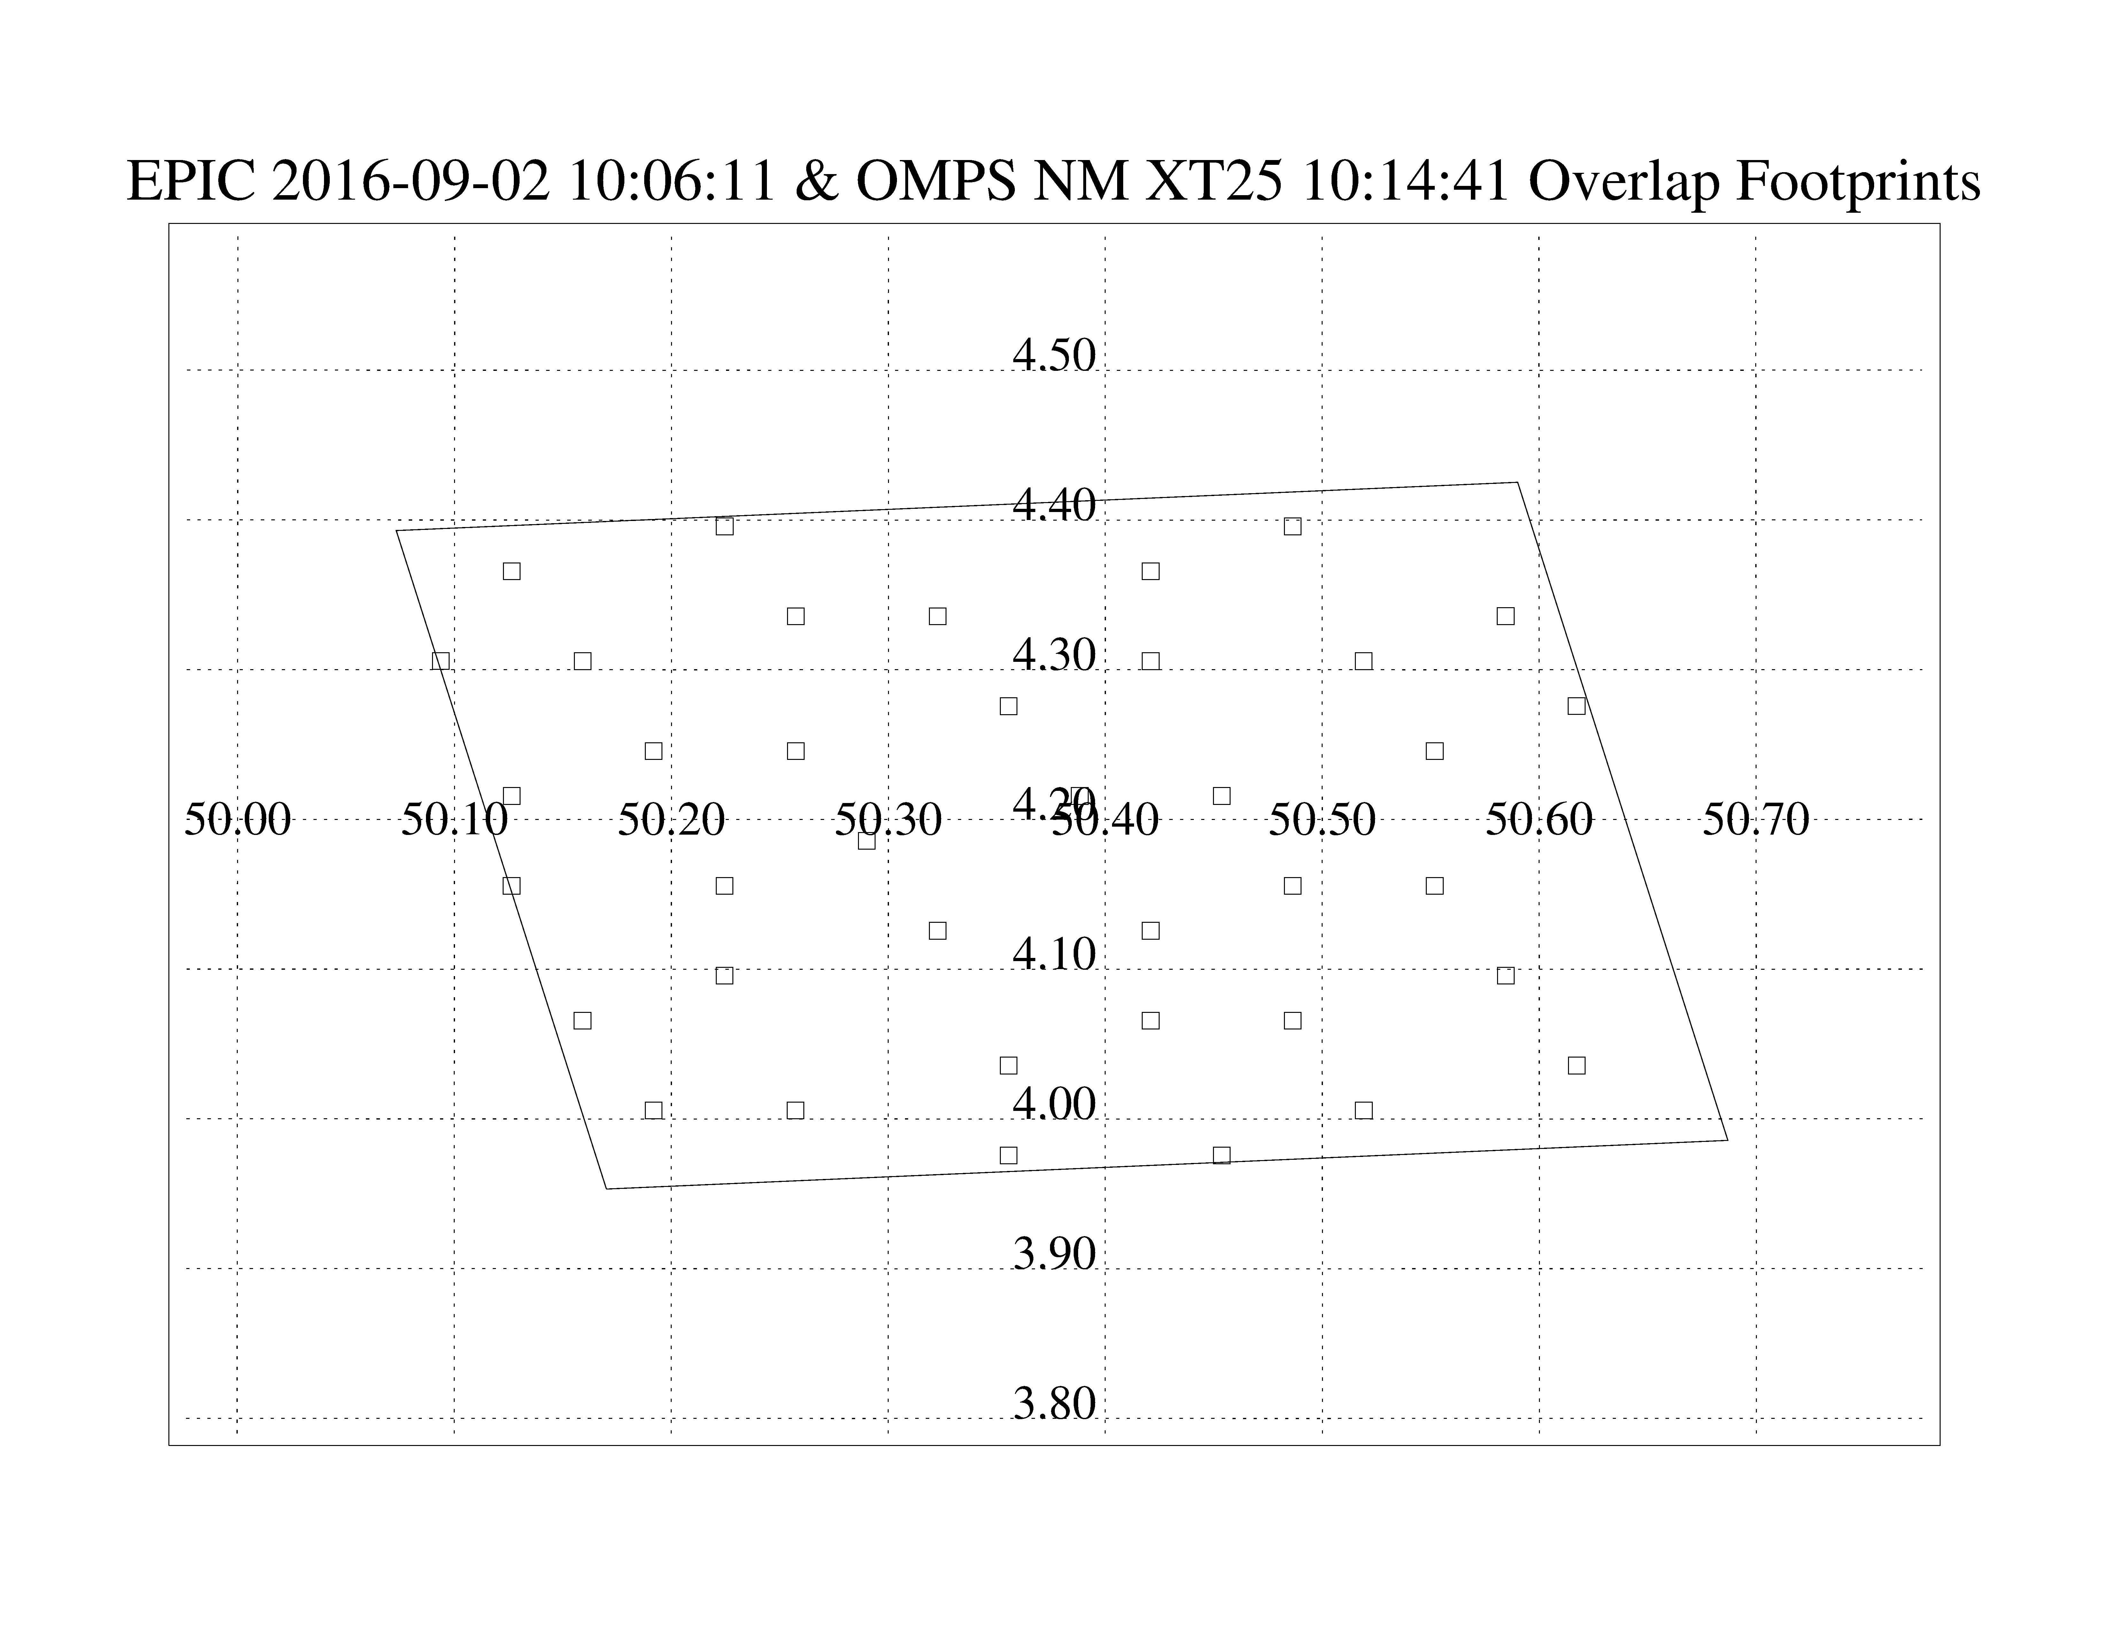

Slide 5
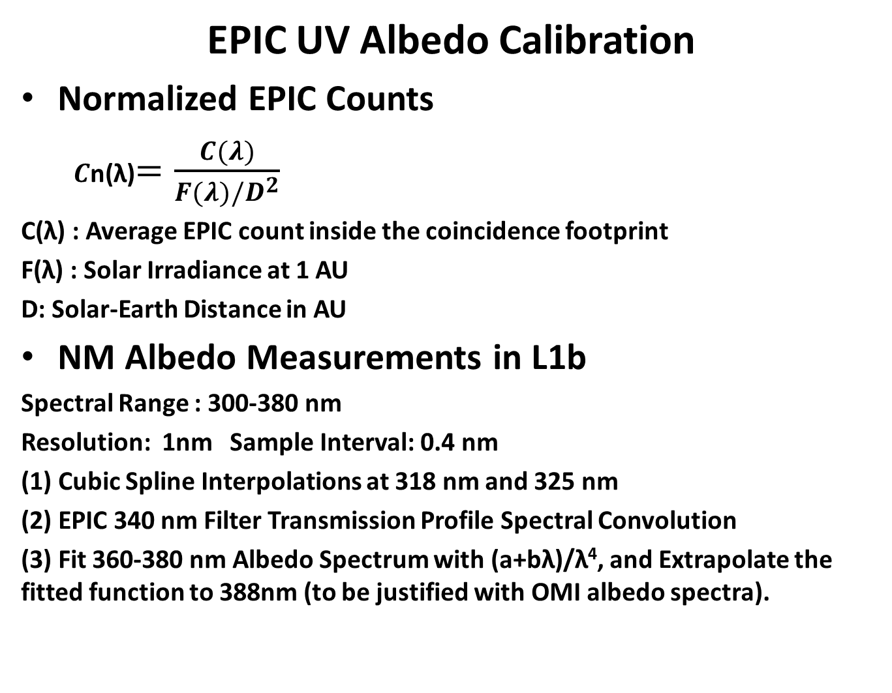
EPIC UV Albedo Calibration
Normalized EPIC Counts
$C$n(λ)$=\frac{C(λ)}{F(λ)/D^{2}}$
C(λ) : Average EPIC count inside the coincidence footprint
F(λ) : Solar Irradiance at 1 AU
D: Solar-Earth Distance in AU
NM Albedo Measurements in L1b
Spectral Range : 300-380 nm
Resolution: 1nm Sample Interval: 0.4 nm
(1) Cubic Spline Interpolations at 318 nm and 325 nm
(2) EPIC 340 nm Filter Transmission Profile Spectral Convolution
(3) Fit 360-380 nm Albedo Spectrum with (a+bλ)/λ⁴, and Extrapolate the fitted function to 388nm (to be justified with OMI albedo spectra).

Slide 6
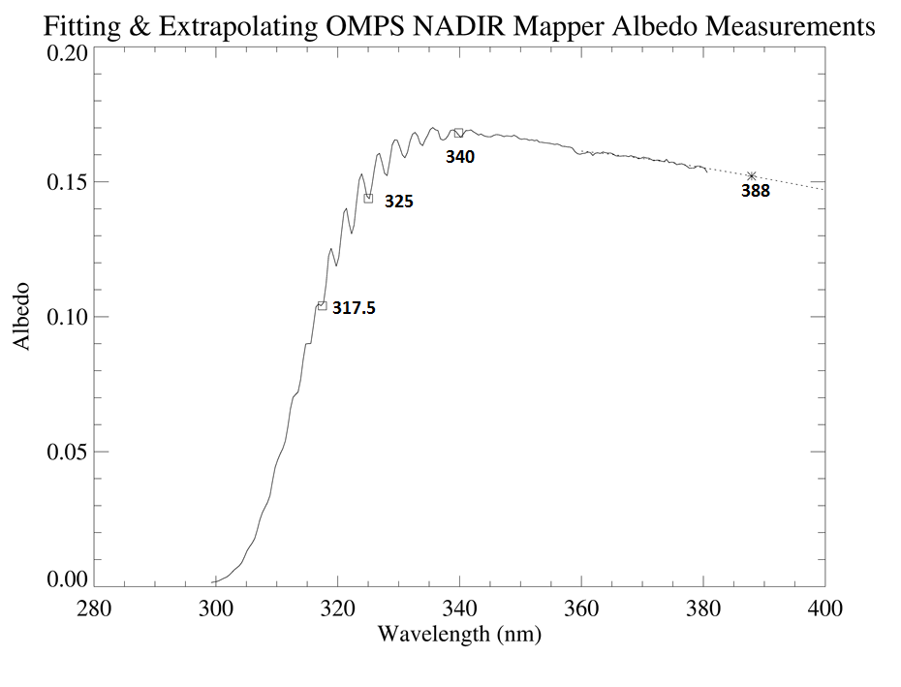

Slide 7
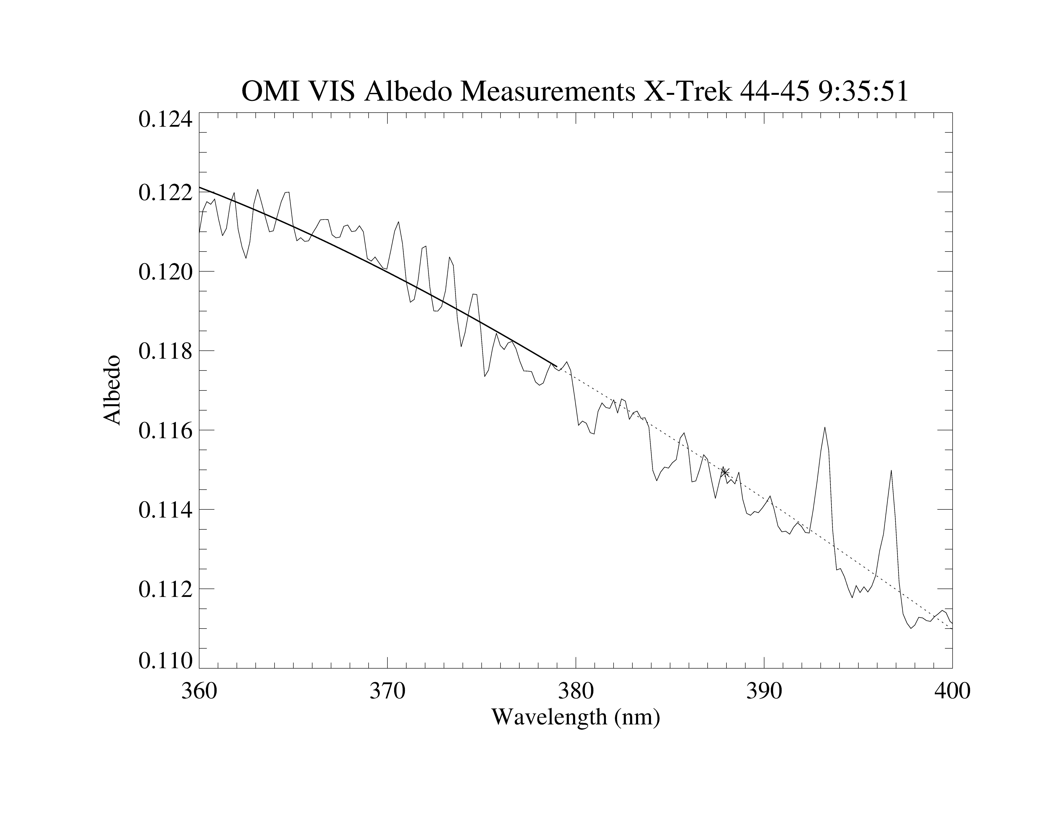
Extrapolation of OMPS Albedo to 388 nm using OMI as Validation
OMI
Spectra
Repeat this fitting for each OMI measurement (1000’s)
Calculate ratio of extrapolated values to measured values

Slide 8
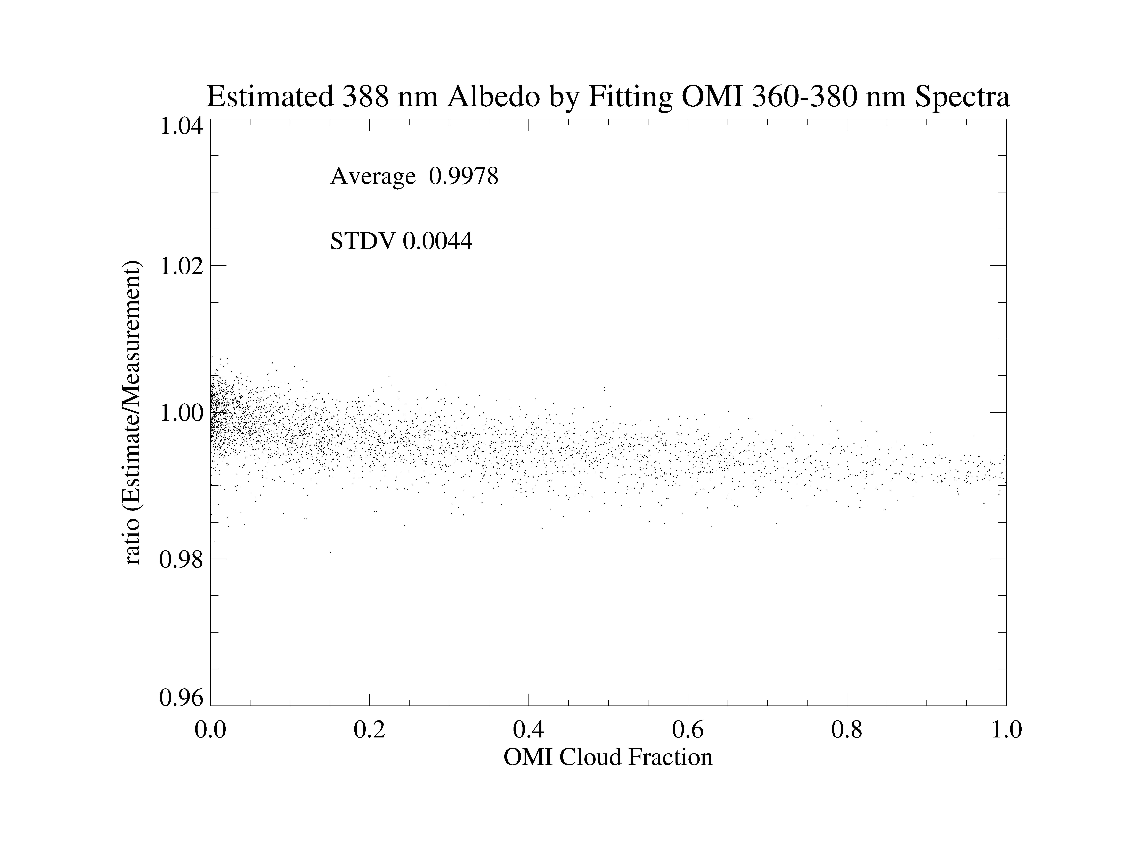

Slide 9
EPIC UV Albedo Calibration
EPIC Radiance Calibration Coefficients E(λ)
E(λ)=AOMPS(λ)/{Cn(λ)×[αOMPS(λ)/αEPIC(λ)]}
Where AOMPS(λ) Is Estimated Albedo Values from OMPS NM Measurements, αOMPS(λ) & αEPIC Are TOMRAD Albedos Computed with OMPS NM and EPIC geometric angles, respectively.
Derived E(λ) Are Weighted with 1/STDV² and Smoothed with Piece-wise Parabola Fitting.
Smoothed E(λ) Curve
E (λ,t)= E (λ,t=2016)×Acf(λ,t)
Are Tabulated in E (λ,t=2016) for Constant Radiance Coefficients at t=2016, and in Acf(t) for Time Dependence That Are Normalized at t= Jan 1, 2016.

Slide 10
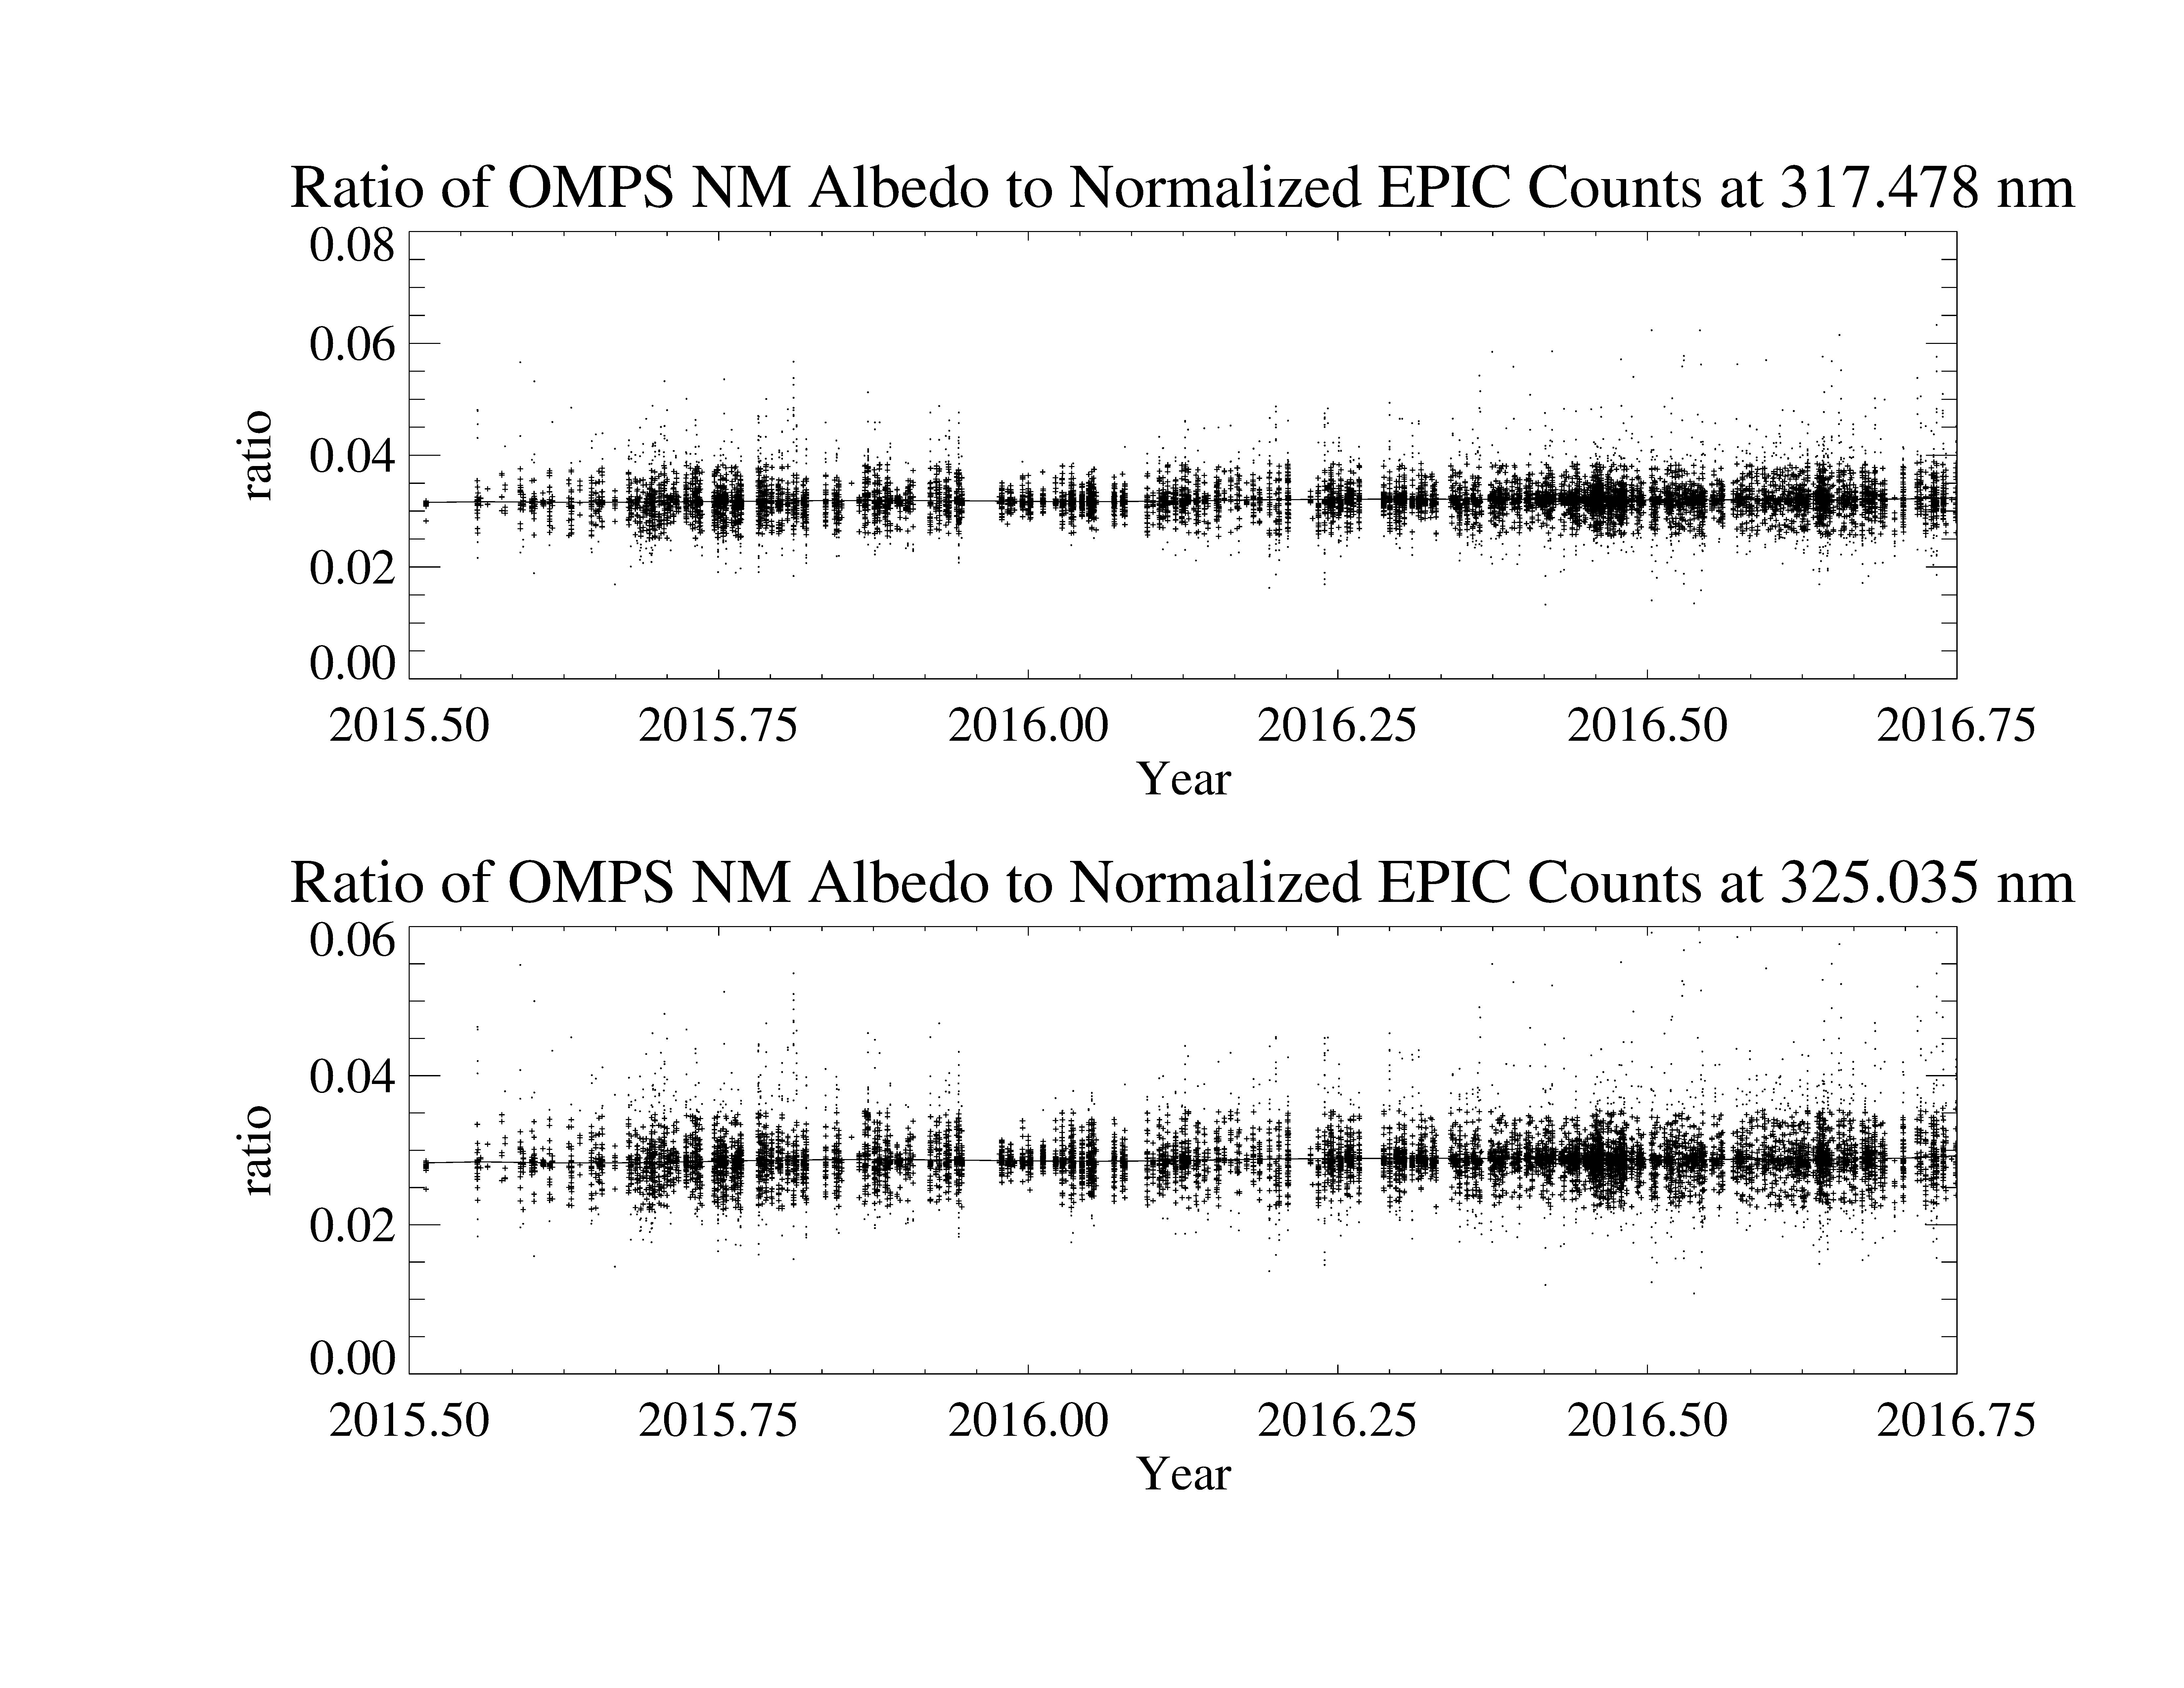

Slide 11
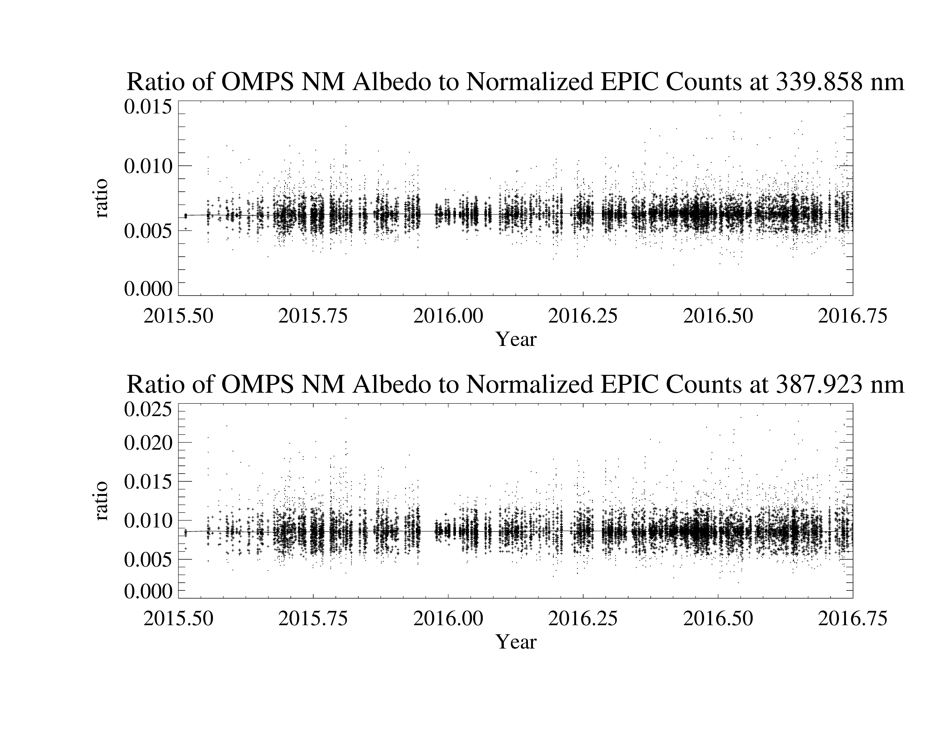

Slide 12
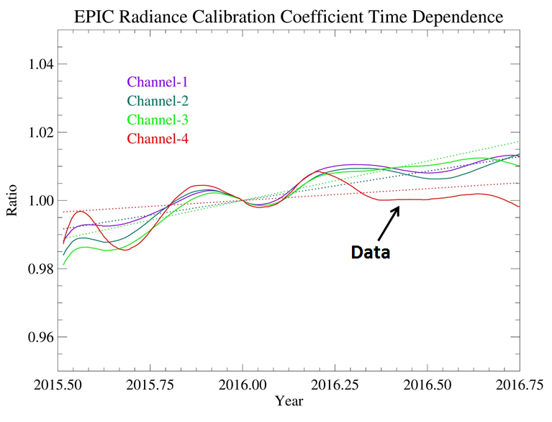
Linear fit is used for extrapolation into the future for operational processing
The linear fit will be replaced by the data curves in a reprocessing

Slide 13
EPIC UV Albedo Calibration
EPIC Radiance Calibration Coefficients At t=2016
Channel OMPS OMI OMI Ref Spec
λ(nm) E₀(NM) E₀(VIS) E₀(UV2) F(AU1)
1 317.478 3.172e-02 3.204e-02 819.0
2 325.035 2.857e-02 2.912e-02 807.7
3 339.858 6.259e-03 6.337e-03 995.8
4 387.923 8.575e-03 8.736e-03 1003.3
5 442.397 5.240e-03 1956.0
Albedo uncertainties are about 2% in absolute calibration. The uncertainties in relative calibration with the same spectrometer are about 1%.

Slide 14
EPIC TO3 Ozone Retrieval Algorithm
INPUT EPIC UV Albedo Measurements
N=-100log(Albedo)
Surface Reflectivity & Cloud Fraction at 388 nm
τ<1.5
Input EPIC Geo Location, Solar/View Angles
Initial Ozone Estimate Ω₀ Using 325 & 340 nm pair
325 nm 340 nm
318 nm
325 nm
Input Cloud Climatology & Terrain Pressure
Select Climatology Ozone Profiles/Lookup Table
Residue r=N_{m}-N_{c}
Sensitivity dN/dΩ dN/R
Input TOMRAD Lookup Tables
|ΔΩ|
<0.1DU
Triplet Formula ΔΩ
Ω= Ω₀ +ΔΩ
Done

Slide 15
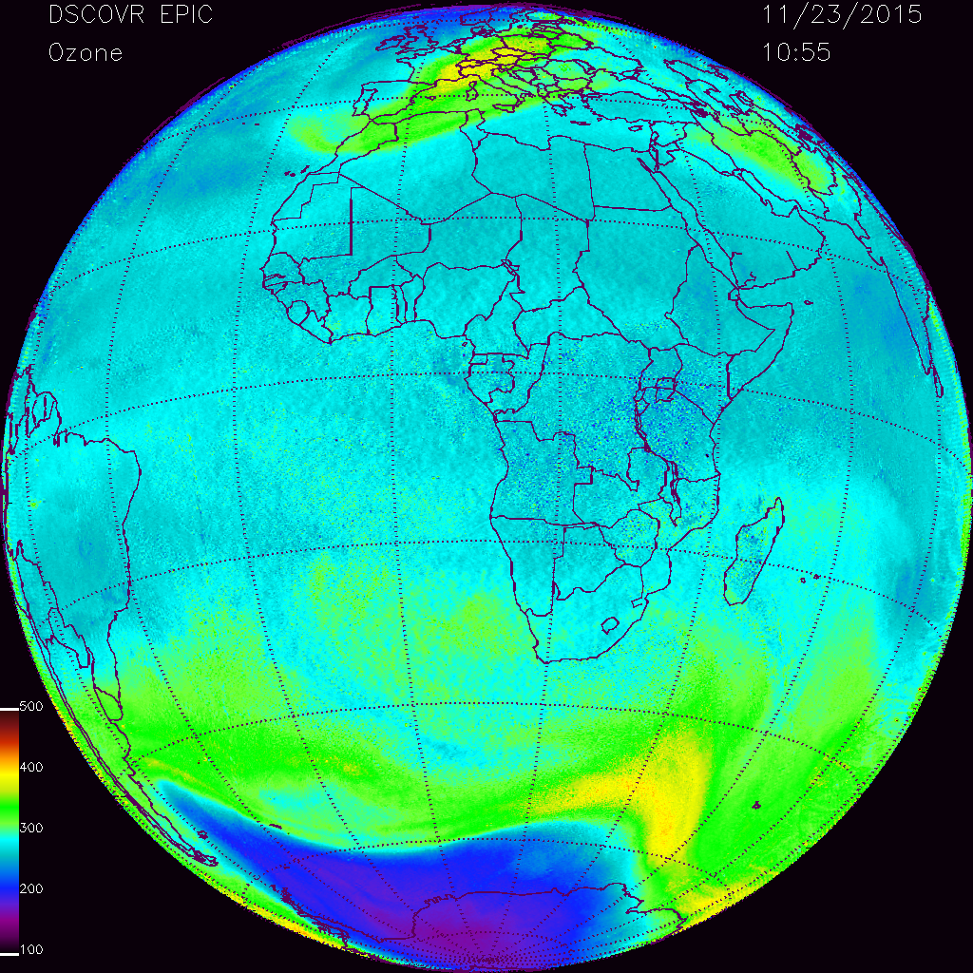

Slide 16
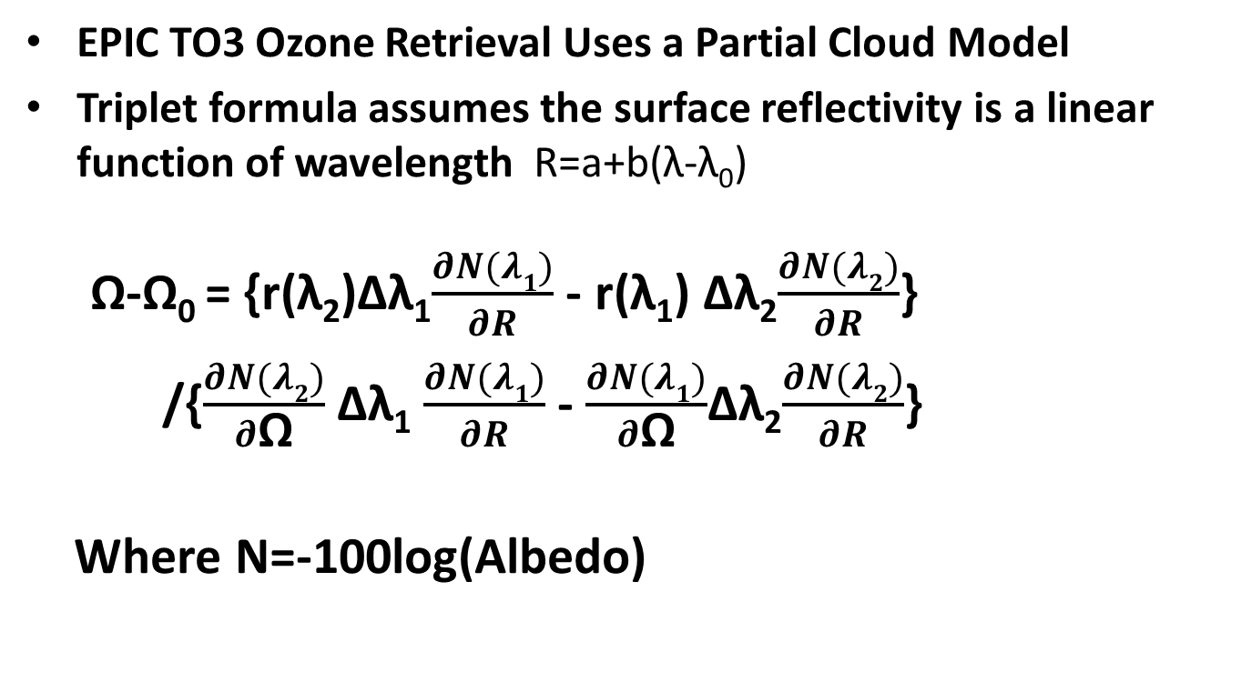
EPIC TO3 Ozone Retrieval Algorithm
EPIC TO3 Ozone Retrieval Uses a Partial Cloud Model
Triplet formula assumes the surface reflectivity is a linear function of wavelength R=a+b(λ-λ₀)
Ω-Ω₀ = {r(λ₂)Δλ₁$\frac{∂N(λ1)}{∂R}$- r(λ₁) Δλ₂$\frac{∂N(λ2)}{∂R}$}
/{$\frac{∂N(λ2)}{∂\text{Ω}}$Δλ₁ $\frac{∂N(λ1)}{∂R}$- $\frac{∂N(λ1)}{∂\text{Ω}}$Δλ₂$\frac{∂N(λ2)}{∂R}$}
Where N=-100log(Albedo)

Slide 17
EPIC TO3 Ozone Retrieval Algorithm
Work For Improvement
Update Cloud Climatology
Current TOMRAD Limitation: VZA < 70 degrees
Need better spherical correction than Chapman Approximartion
Better Albedo Calibration
“Soft Calibration” & Improved flat field calibration

Slide 18
Acknowledgment
Dr. Glen Jaross and Dr. Colin Seftor and OMPS team provided OMPS NADIR Mapper data and insider’s knowledge on OMPS NM prelaunch and orbital calibrations.
Dr. Colin Seftor provided the initial version of EPIC TO3 retrieval code.

