Slide 1


Climatology analysis of global properties of smoke and dust from MAIAC EPIC
Sujung Go^{1,2}, Alexei Lyapustin², Myungje Choi^{1,2}, Yujie Wang^{1,2}, Sergey Korkin^{1,2}
1) UMBC GESTAR-II, 2) NASA GSFC
DSCOVR Science Team Meeting, Oct. 16, 2023

Slide 2
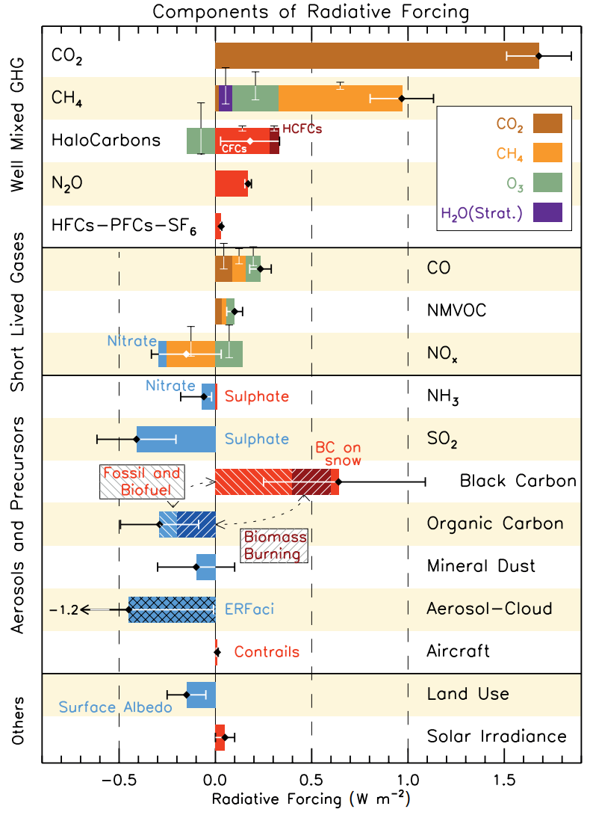
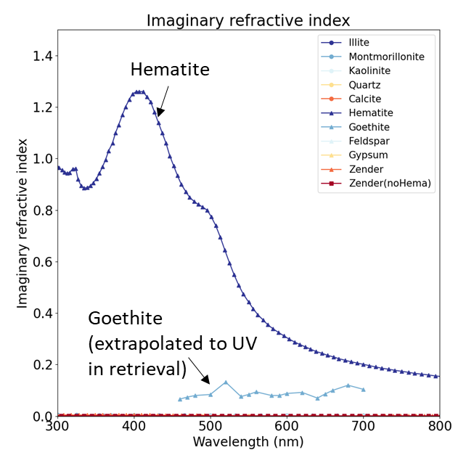
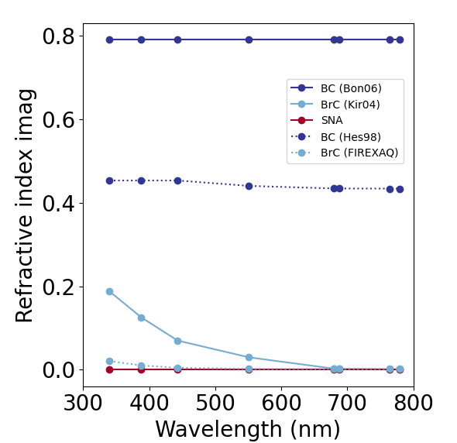
Why Single Scattering Albedo, composition important?
The estimation of aerosol radiative forcing is a major cause of uncertainty in the estimation of climate sensitivity and modeling. This uncertainty is mostly due to the lack of accurate measurements of the scattering and absorbing properties of aerosols [IPCC, 2013].
Knowledge of spectral aerosol absorption is a path to aerosol speciation. Measured apparent aerosol light absorption properties in UV-visible are determined by two light-absorbing components of black carbon (BC) and brown carbon (BrC) for smoke, hematite and goethite for dust.
Composition analysis of aerosol particles and investigation of toxicity and adverse health effects of different components is a central goal of the future NASA MAIA (Multi-Angle Imager for Aerosols) mission [Diner et al., 2018].
Components of Radiative Forcing
[IPCC, 2013 - WG1AR5 Fig. 8.17]
Imaginary refractive index of soil mineralogy component (left) and BC/BrC (right)
Hematite
BC
Goethite
BrC

Slide 3
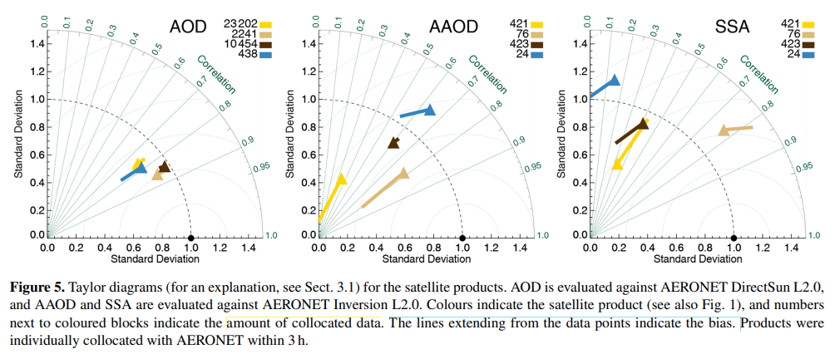
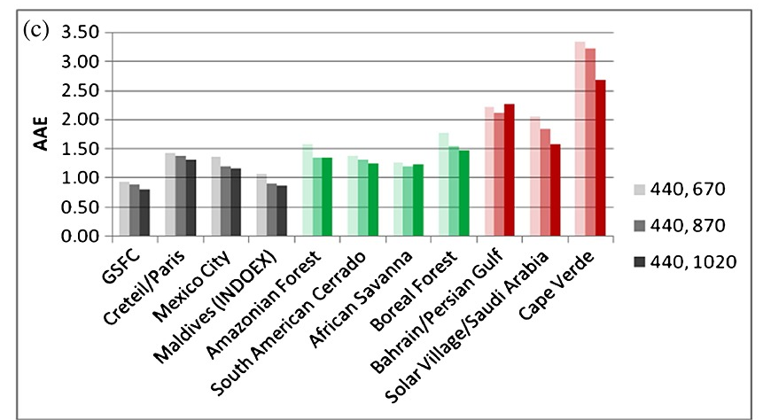
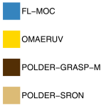
History of UV-Visible Aerosol Absorption
UV Aerosol Index
TOMS, OMI were the first instruments providing initially qualitative (AI) and later quantitative (SSA) information on aerosol absorption from pioneering works of Torres et al (Herman et al., 1997; Torres et al., 1998, 2002, 2018; Jethva et al., 2014).
Aerosol Absorption (SSA) from Current/Future Satellites
OMAERUV Algorithm on Aura/OMI, DSCOVR EPIC, OMPS on SNPP, S5p/TropOMI (Torres et al., 2020) and GEMS (Kim et al., 2020);
MISR SSA (+ AOD, size, shape) (Kahn et al., 2010; Kahn and Gaitley, 2015);
MODIS/VIIRS DB (Hsu et al., 2013) provides AOD and SSA;
GRASP from POLDER (e.g., Dubovik et al., 2011; Chen et al., 2020);
Expected multi-angle spectro-polarimetry (MAIA; EUMETSAT EPS-SG/3MI; PACE SPEXone and HARP2 etc.);
Russell et al., 2014, JGR, 119, doi:10.1002/2013JD021411
N. Schutgens et al., 2021, ACP - AEROCOM and AEROSAT AAOD and SSA study
Desert Dust
Biomass Burning
Urban/Industrial or Mixed

Slide 4
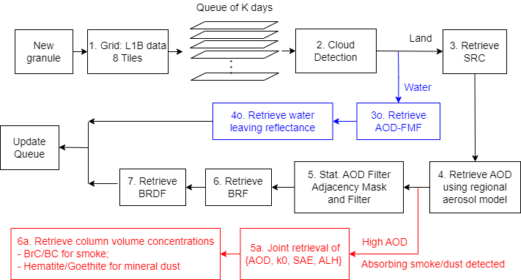
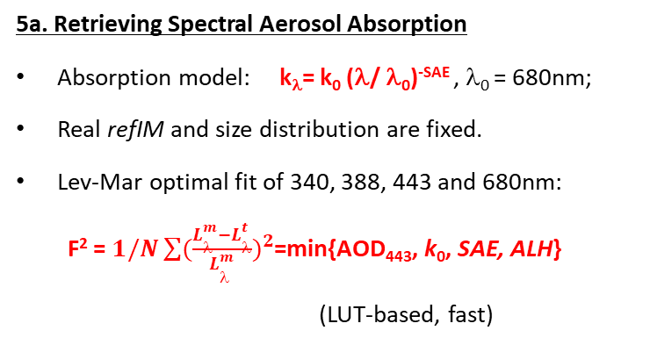

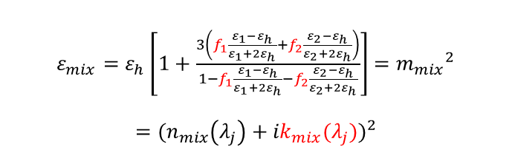
Block diagram of MAIAC EPIC algorithm
5a. Retrieving Spectral Aerosol Absorption
Absorption model: k_{λ}= k₀ (λ/ λ₀)^{-SAE} , λ₀ = 680nm;
Real refIM and size distribution are fixed.
Lev-Mar optimal fit of 340, 388, 443 and 680nm:
F² = $1/N\sum{({\frac{L_{λ}^{m}−L_{λ}^{t}}{L_{λ}^{m}})}^{2}}$=min{AOD₄₄₃, k₀, SAE, ALH}
(LUT-based, fast)
6a. Aerosol speciation from {AOD₄₄₃, k₀, SAE, ALH}
Maxwell-Garnett effective medium approximation
Assumption: major absorption caused by hematite and goethite (or BC and BrC), not host
$ε_{mix}=ε_{h}\left[1+\frac{3\left(f_{1}\frac{ε_{1}−ε_{h}}{ε_{1}+{2ε}_{h}}+f_{2}\frac{ε_{2}−ε_{h}}{ε_{2}+{2ε}_{h}}\right)}{1−f_{1}\frac{ε_{1}−ε_{h}}{ε_{1}+{2ε}_{h}}−f_{2}\frac{ε_{2}−ε_{h}}{ε_{2}+{2ε}_{h}}}\right]$ $={m_{mix}}^{2}$
$$={{(n}_{mix}\left(λ_{j}\right)+{ik}_{mix}(λ_{j}))}^{2}$$
* $ε$: complex dielectric function
* f₁, f₂: volume fractions of hematite, goethite

Slide 5
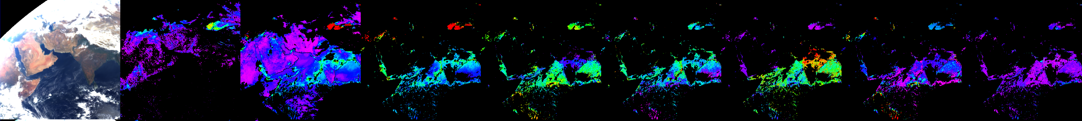
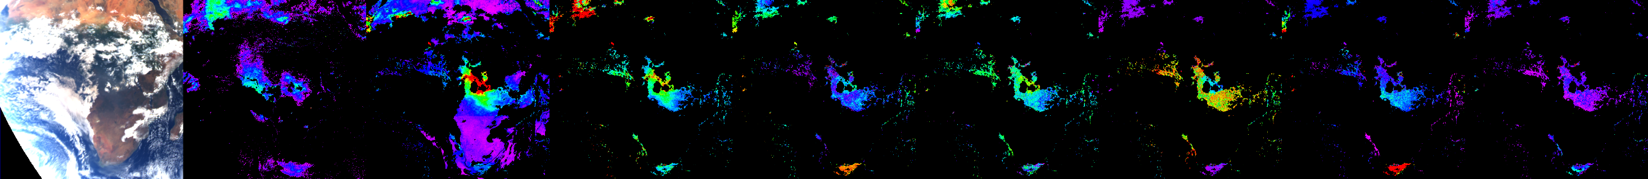
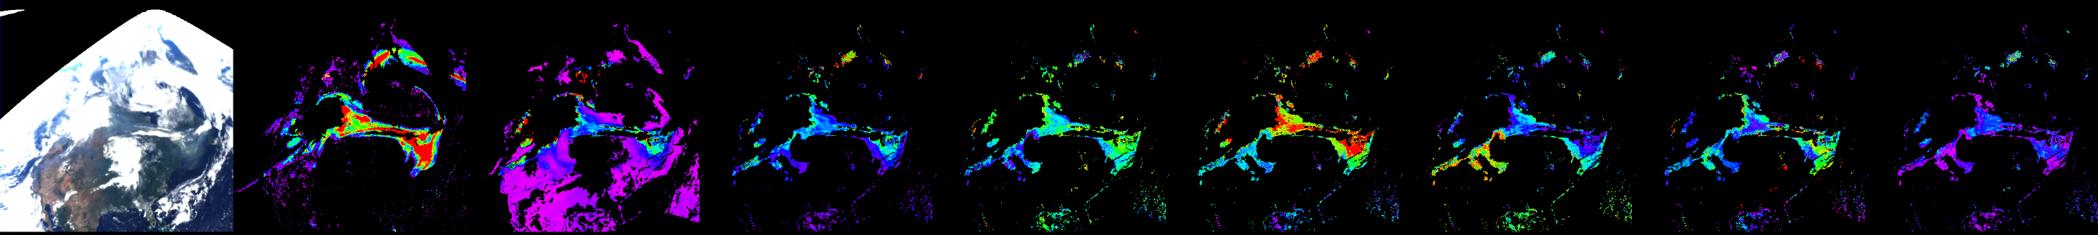
Contrasting Regional Aerosol Properties
TOA AI AOD_{Bkgr} AOD_{4D} SSA₄₄₃ SAE k₀ ALH (km) F_{min}
Mar. 4, 2018
Aug. 9, 2020
Aug. 24, 2018
2 6
0 6
0.85 1
0 4
0. 0.016
0 7
0 10%
USA; Forest wildfires: moderate abs., SSA~0.9-0.94, high SAE (BrC), low-moderate k₀ (BC), ALH can be very high.
India, South Africa; biomass burning: bush- and grasslands, agriculture crop residue etc. (low energy fast burning):
high absorption, SSA~0.85-0.88, low-moderate SAE (BrC), high k₀ (BC), ALH is low (<1-1.5km).

Slide 6
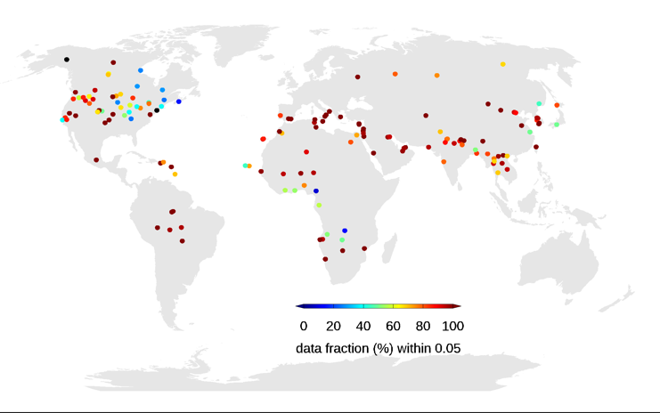
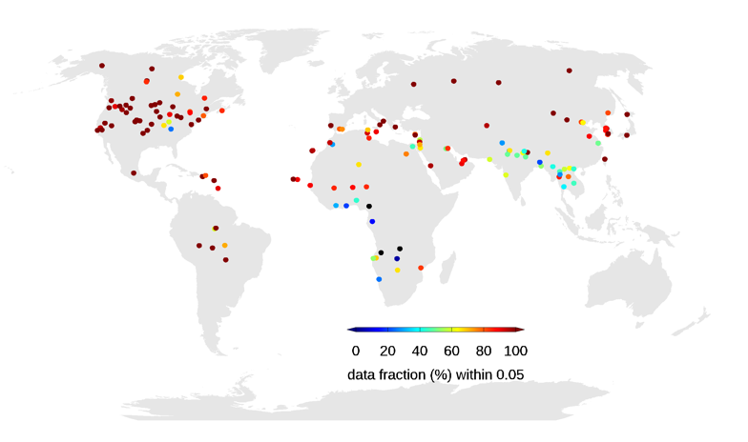
Validation of MAIAC EPIC AOD and SSA against AERONET
<Global SSA 443nm Validation at Hª=1km (left), 4km (right) >
Spatio-temporal range
  AOD: ± 20km, ± 30min
  SSA: ± 30km, ± 3h
<Global AOD 443nm Validation>
R RMSE MBE

Slide 7
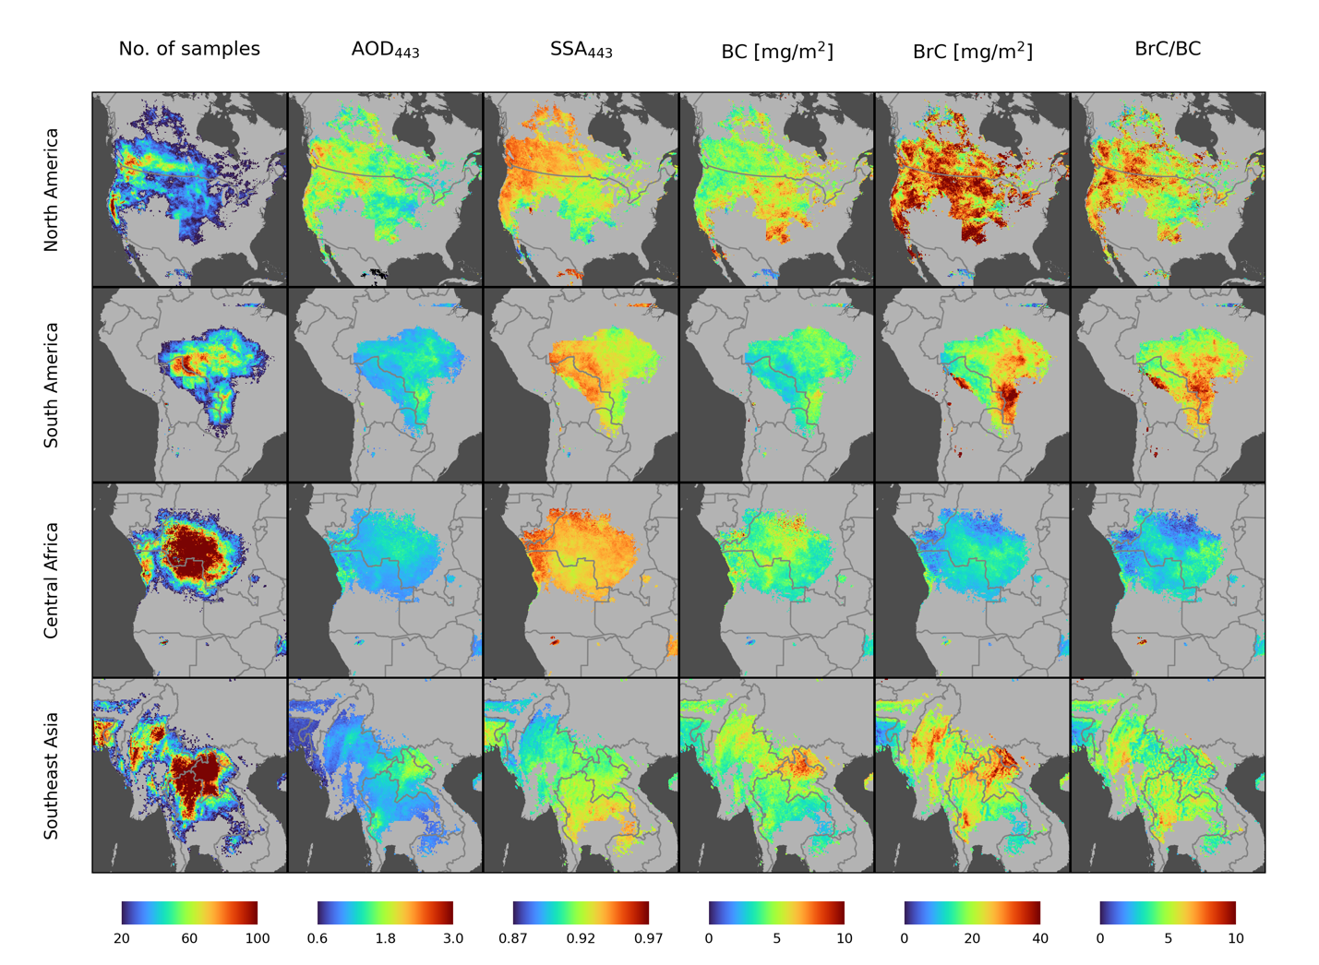
Climatology of smoke aerosol dominant regions
2015-2020, AOD > 0.6
North America
  High-frequency samples: western US, Canada, BC.
  High BrC/BC ratio over west US
South America
  Deforestation, climate (El Nino, ENSO related drought)
  Mean AOD: 1.0-1.8, SSA~0.95
  relatively low BC (3-5 mg/m²)
  Agreed with GRASP-component
Central Africa
  Massive source of smoke: wildfire, agricultural, industrial..
  High number of samples, high BC concentration → Agree with GRASP-component
  BrC concentration significantly low
Southeast Asia
  High AOD, BC, BrC over Laos
  → In line with other studies
5.2
4 km (Jul-Dec)
5.9
1 km (May-Oct)
4.9
1 km (May-Oct)
4.6
1 km (Dec-May)

Slide 8
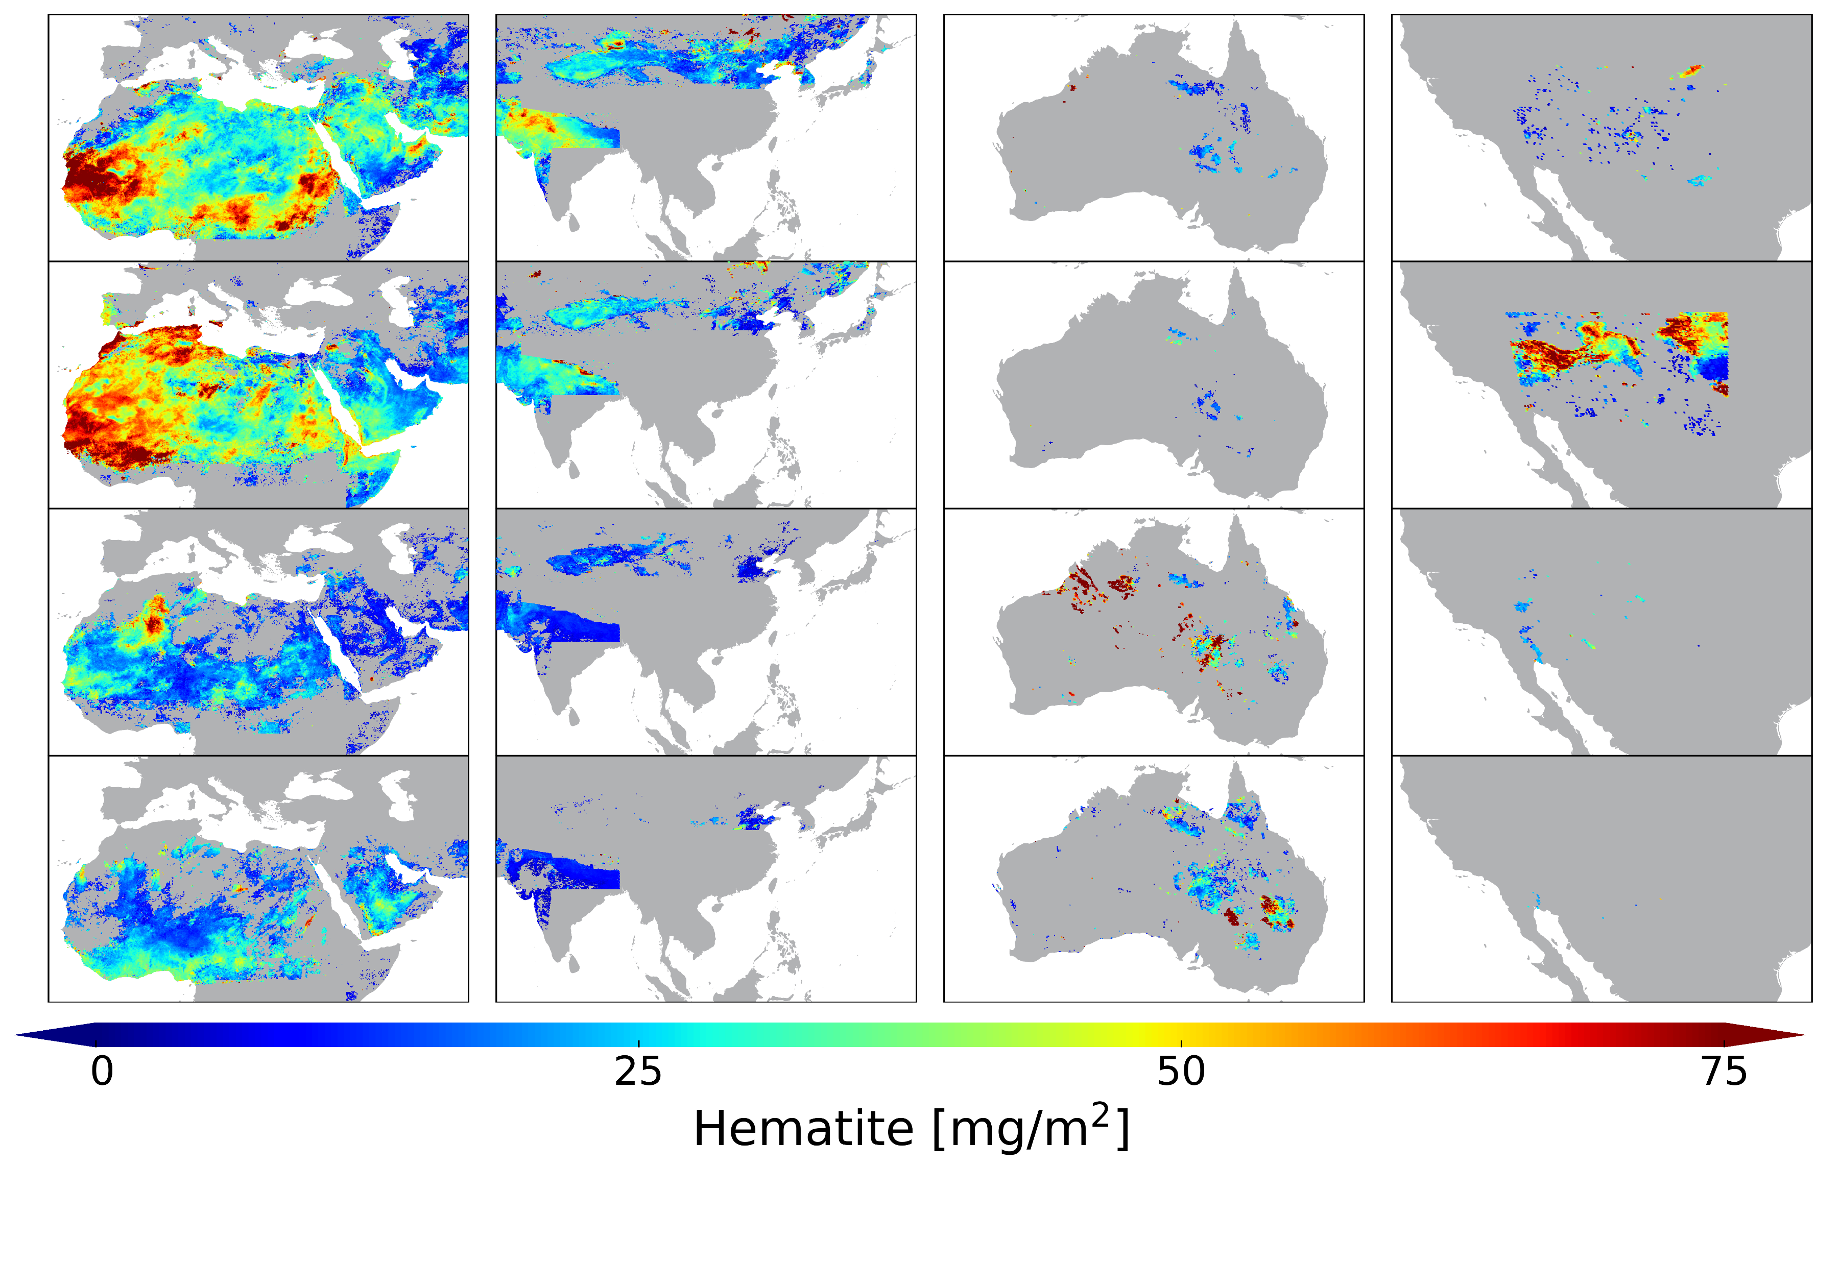
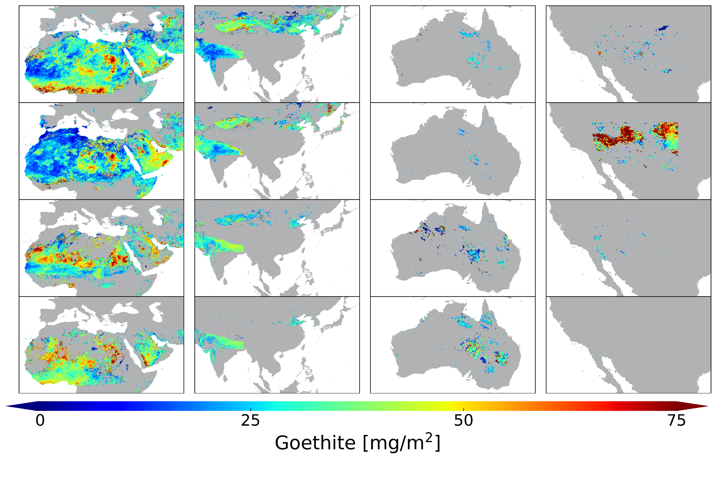
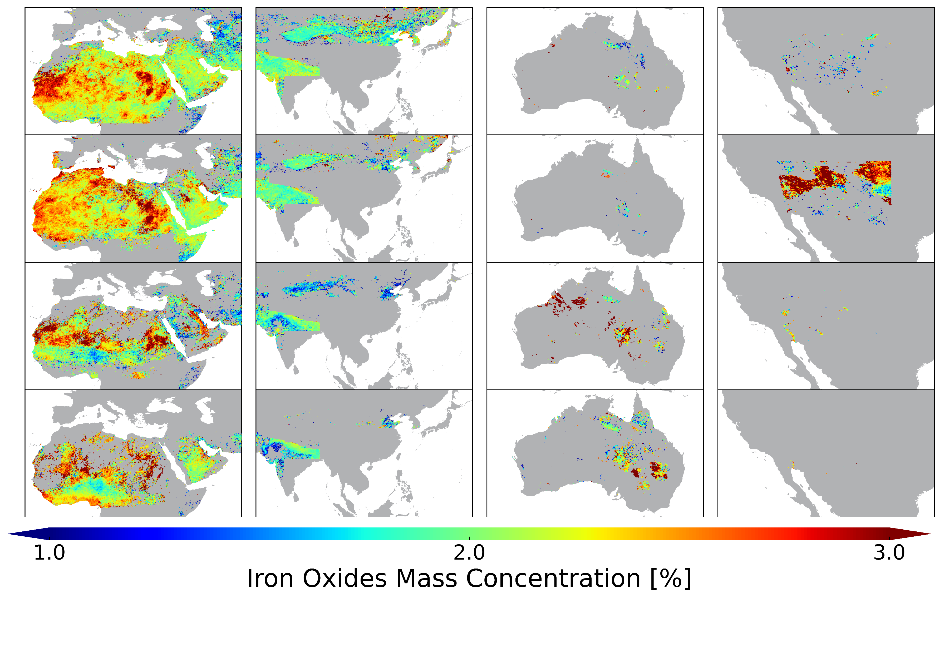
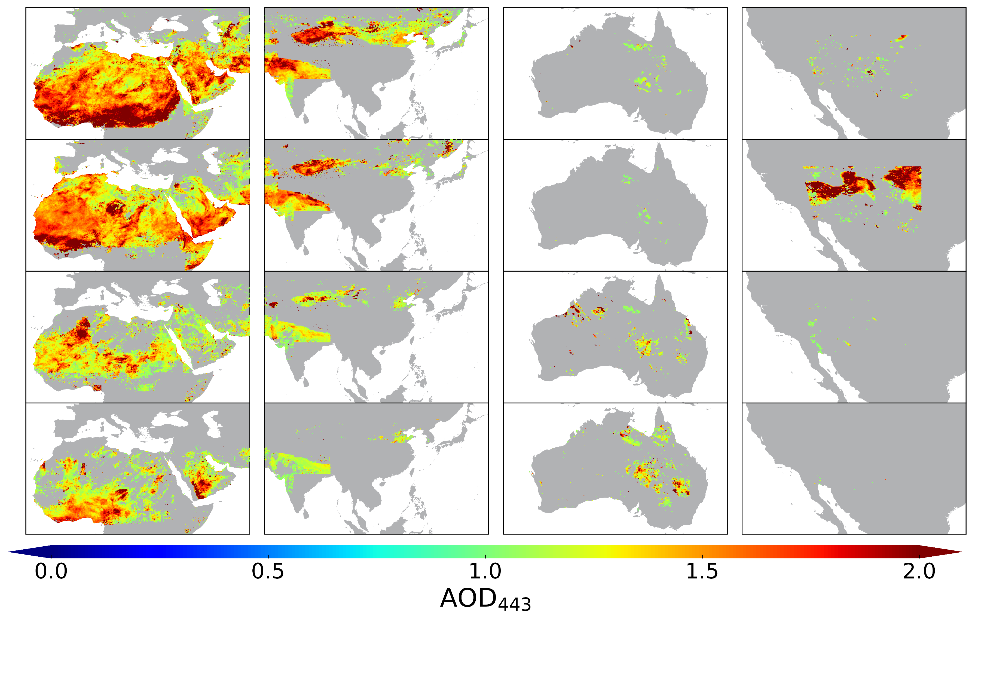
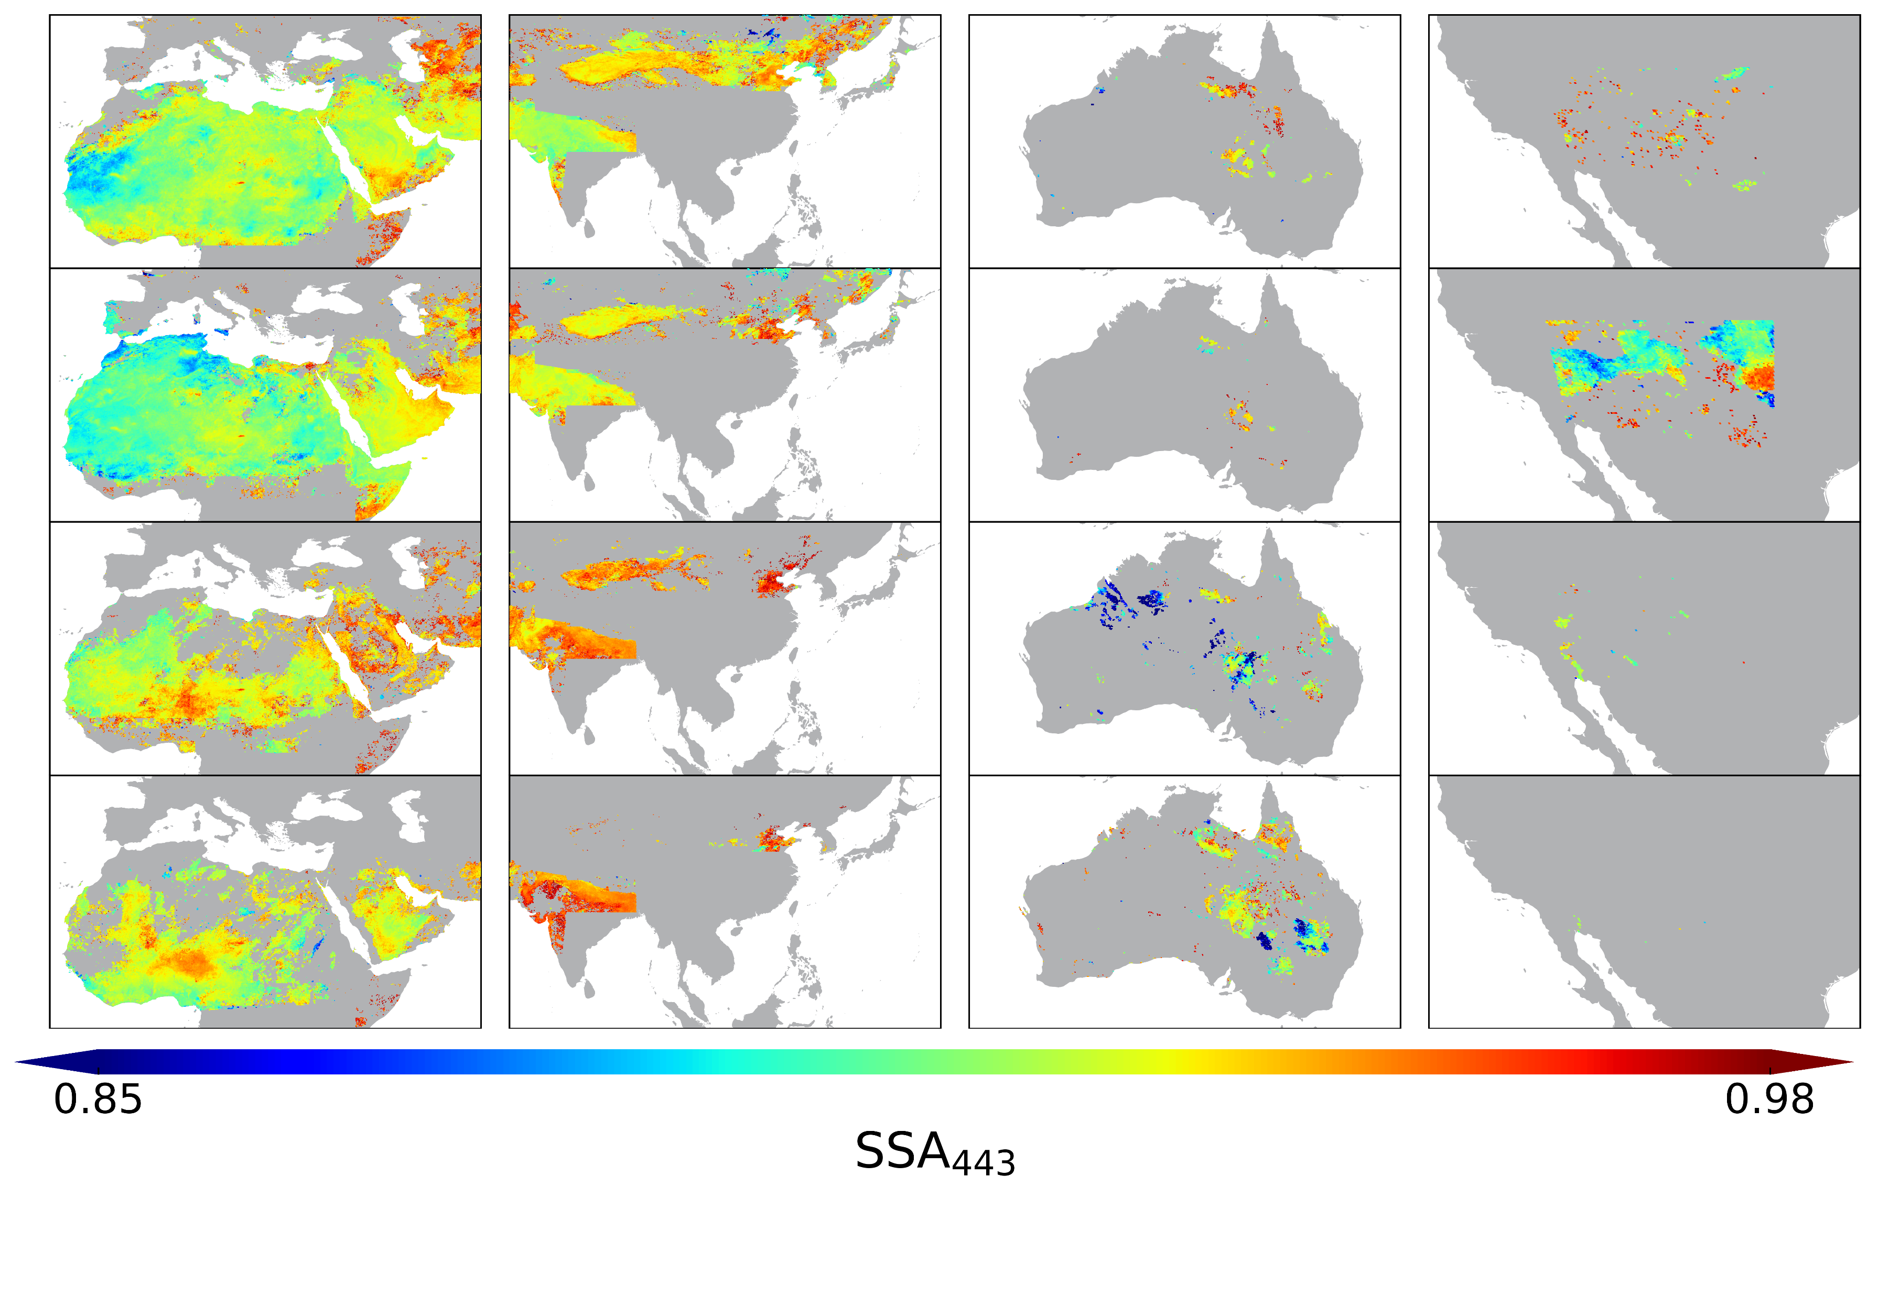
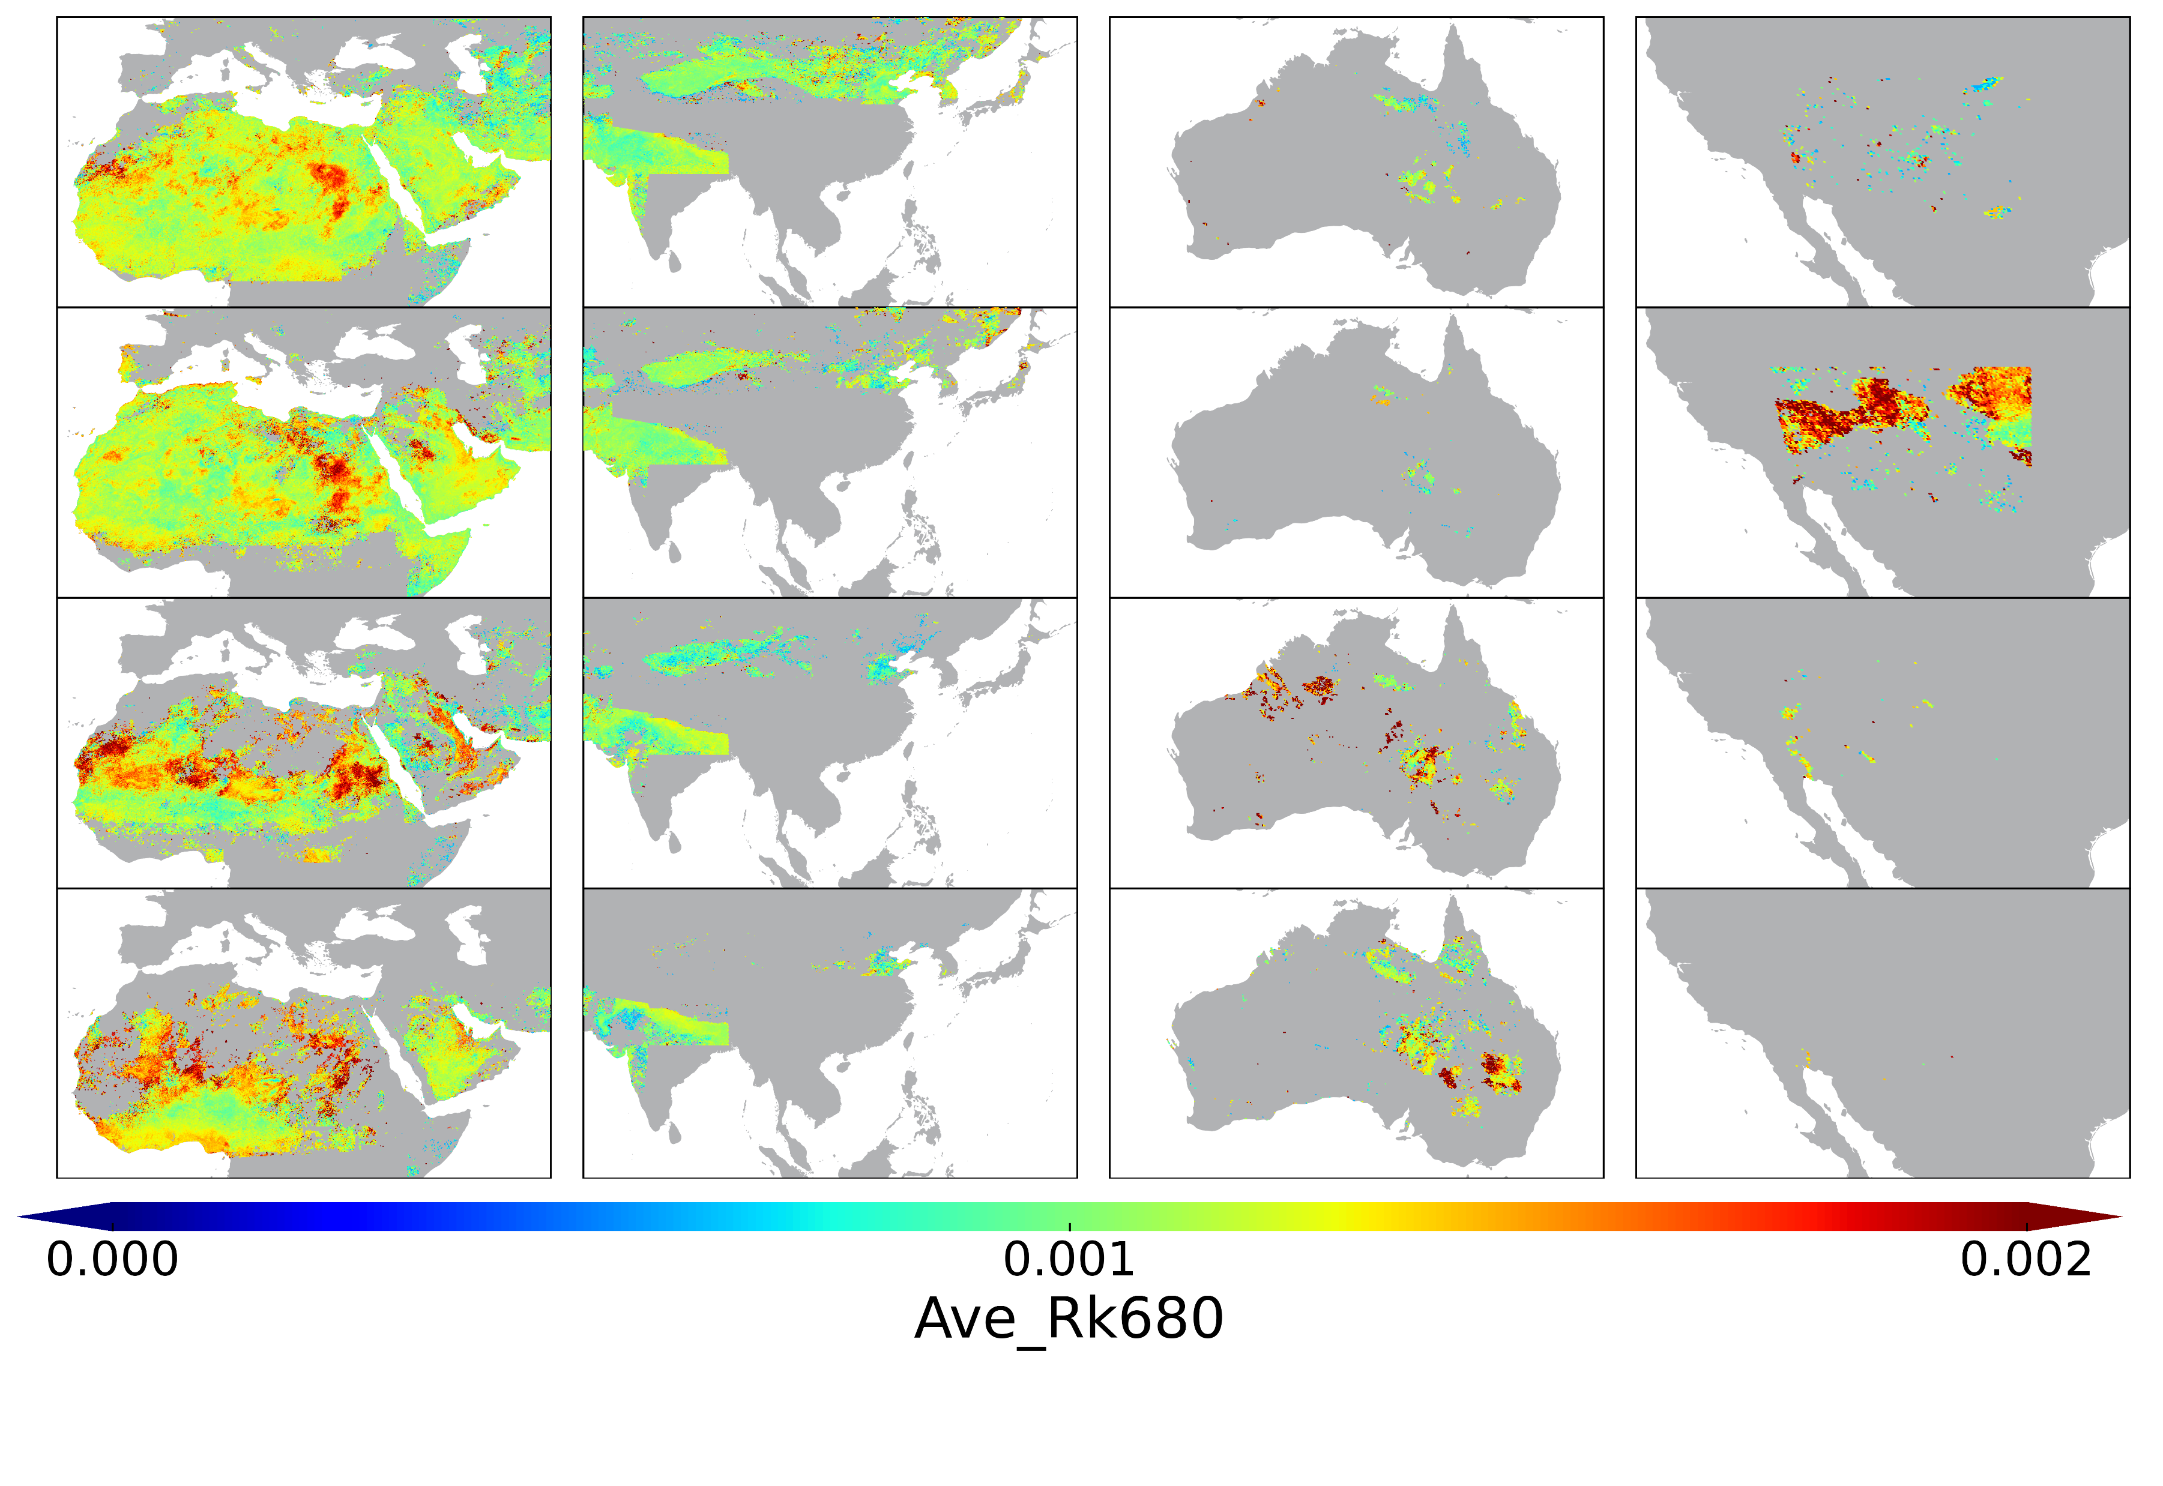
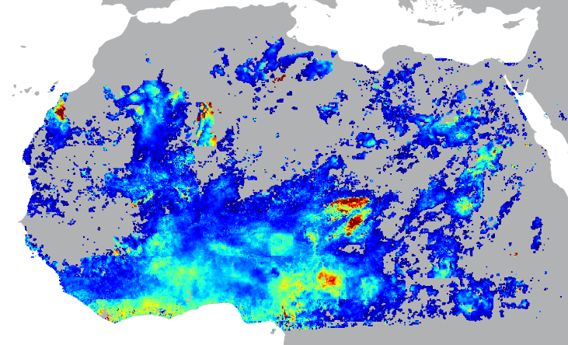
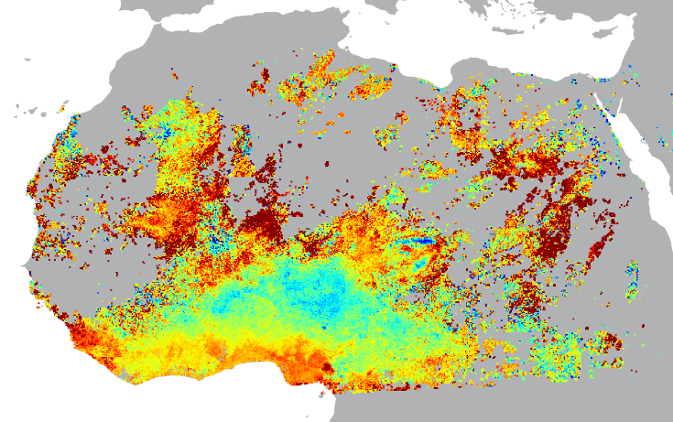
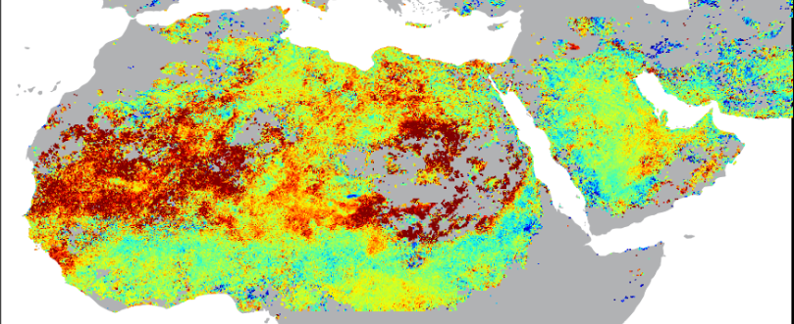
Climatology of dust species (Fe₂O₃, FeOOH)
Pixels of AOD>1.0 used only
01/01/2018 – 12/31/2018 (1 year)
MAM
JJA
SON
DJF
MAM
JJA
SON
DJF
(April)
(Dec.)
High Iron oxide over Sahel
High AOD > 2.0 (left) with low iron oxides (or hematite) content ~1% (right) throughout the year captured over Bodélé.

Slide 9
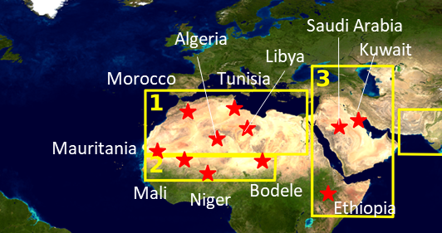
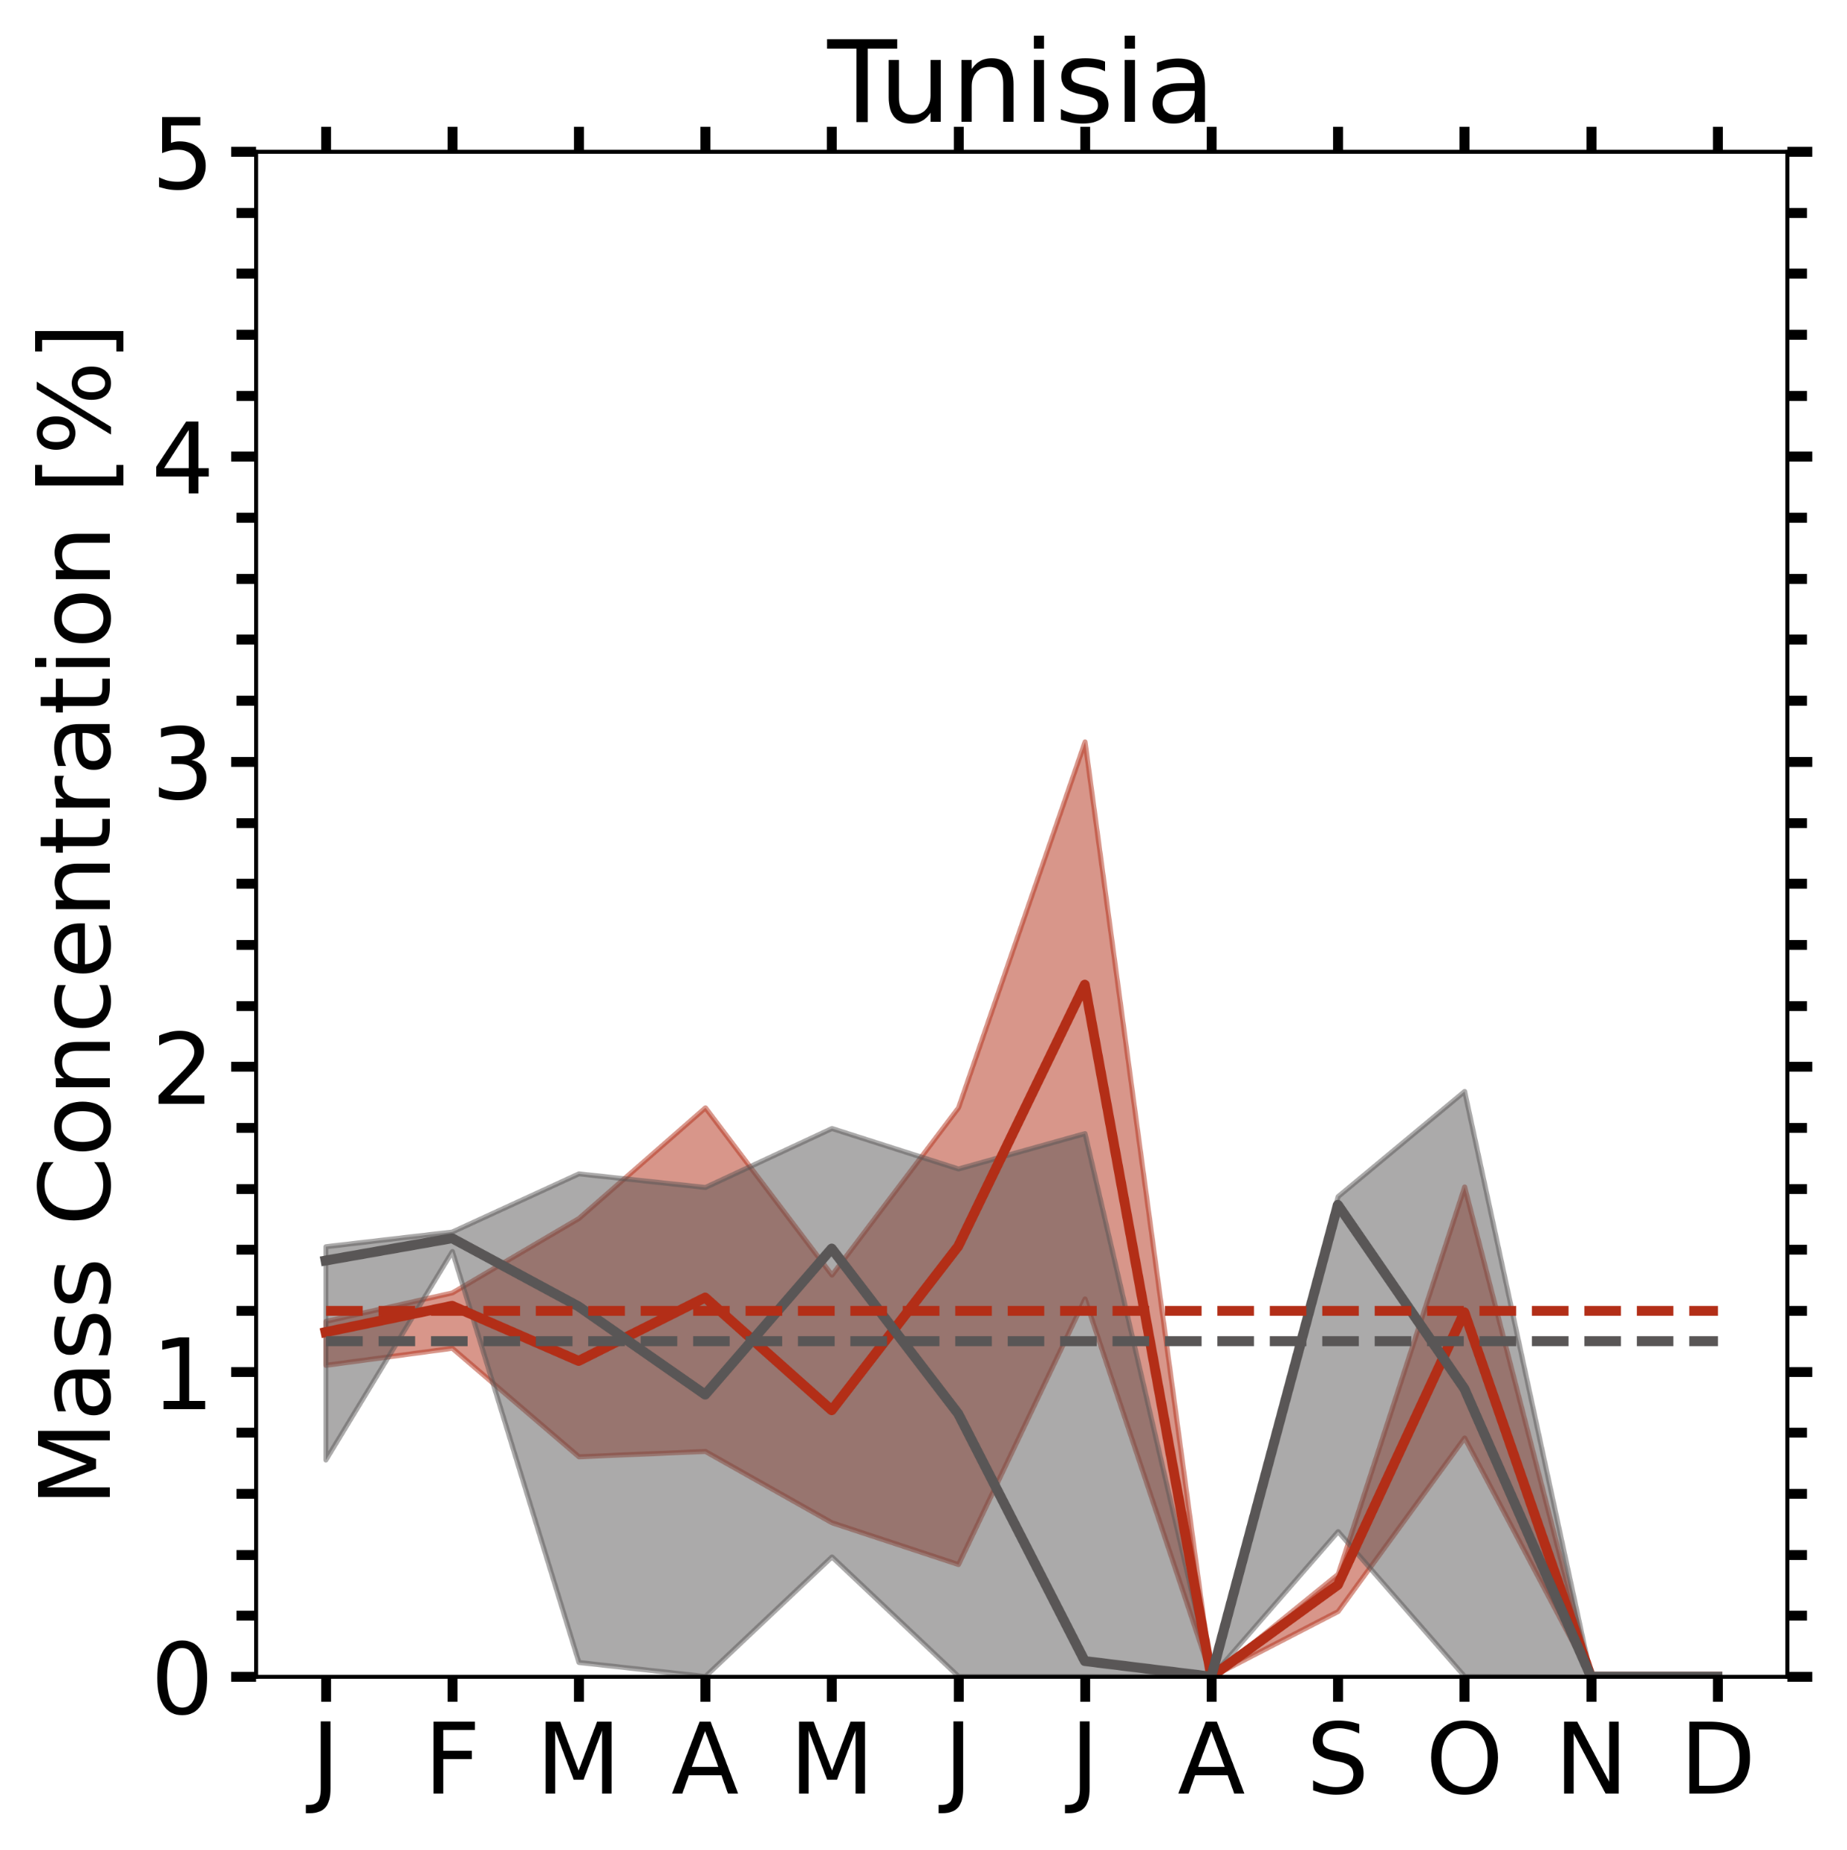
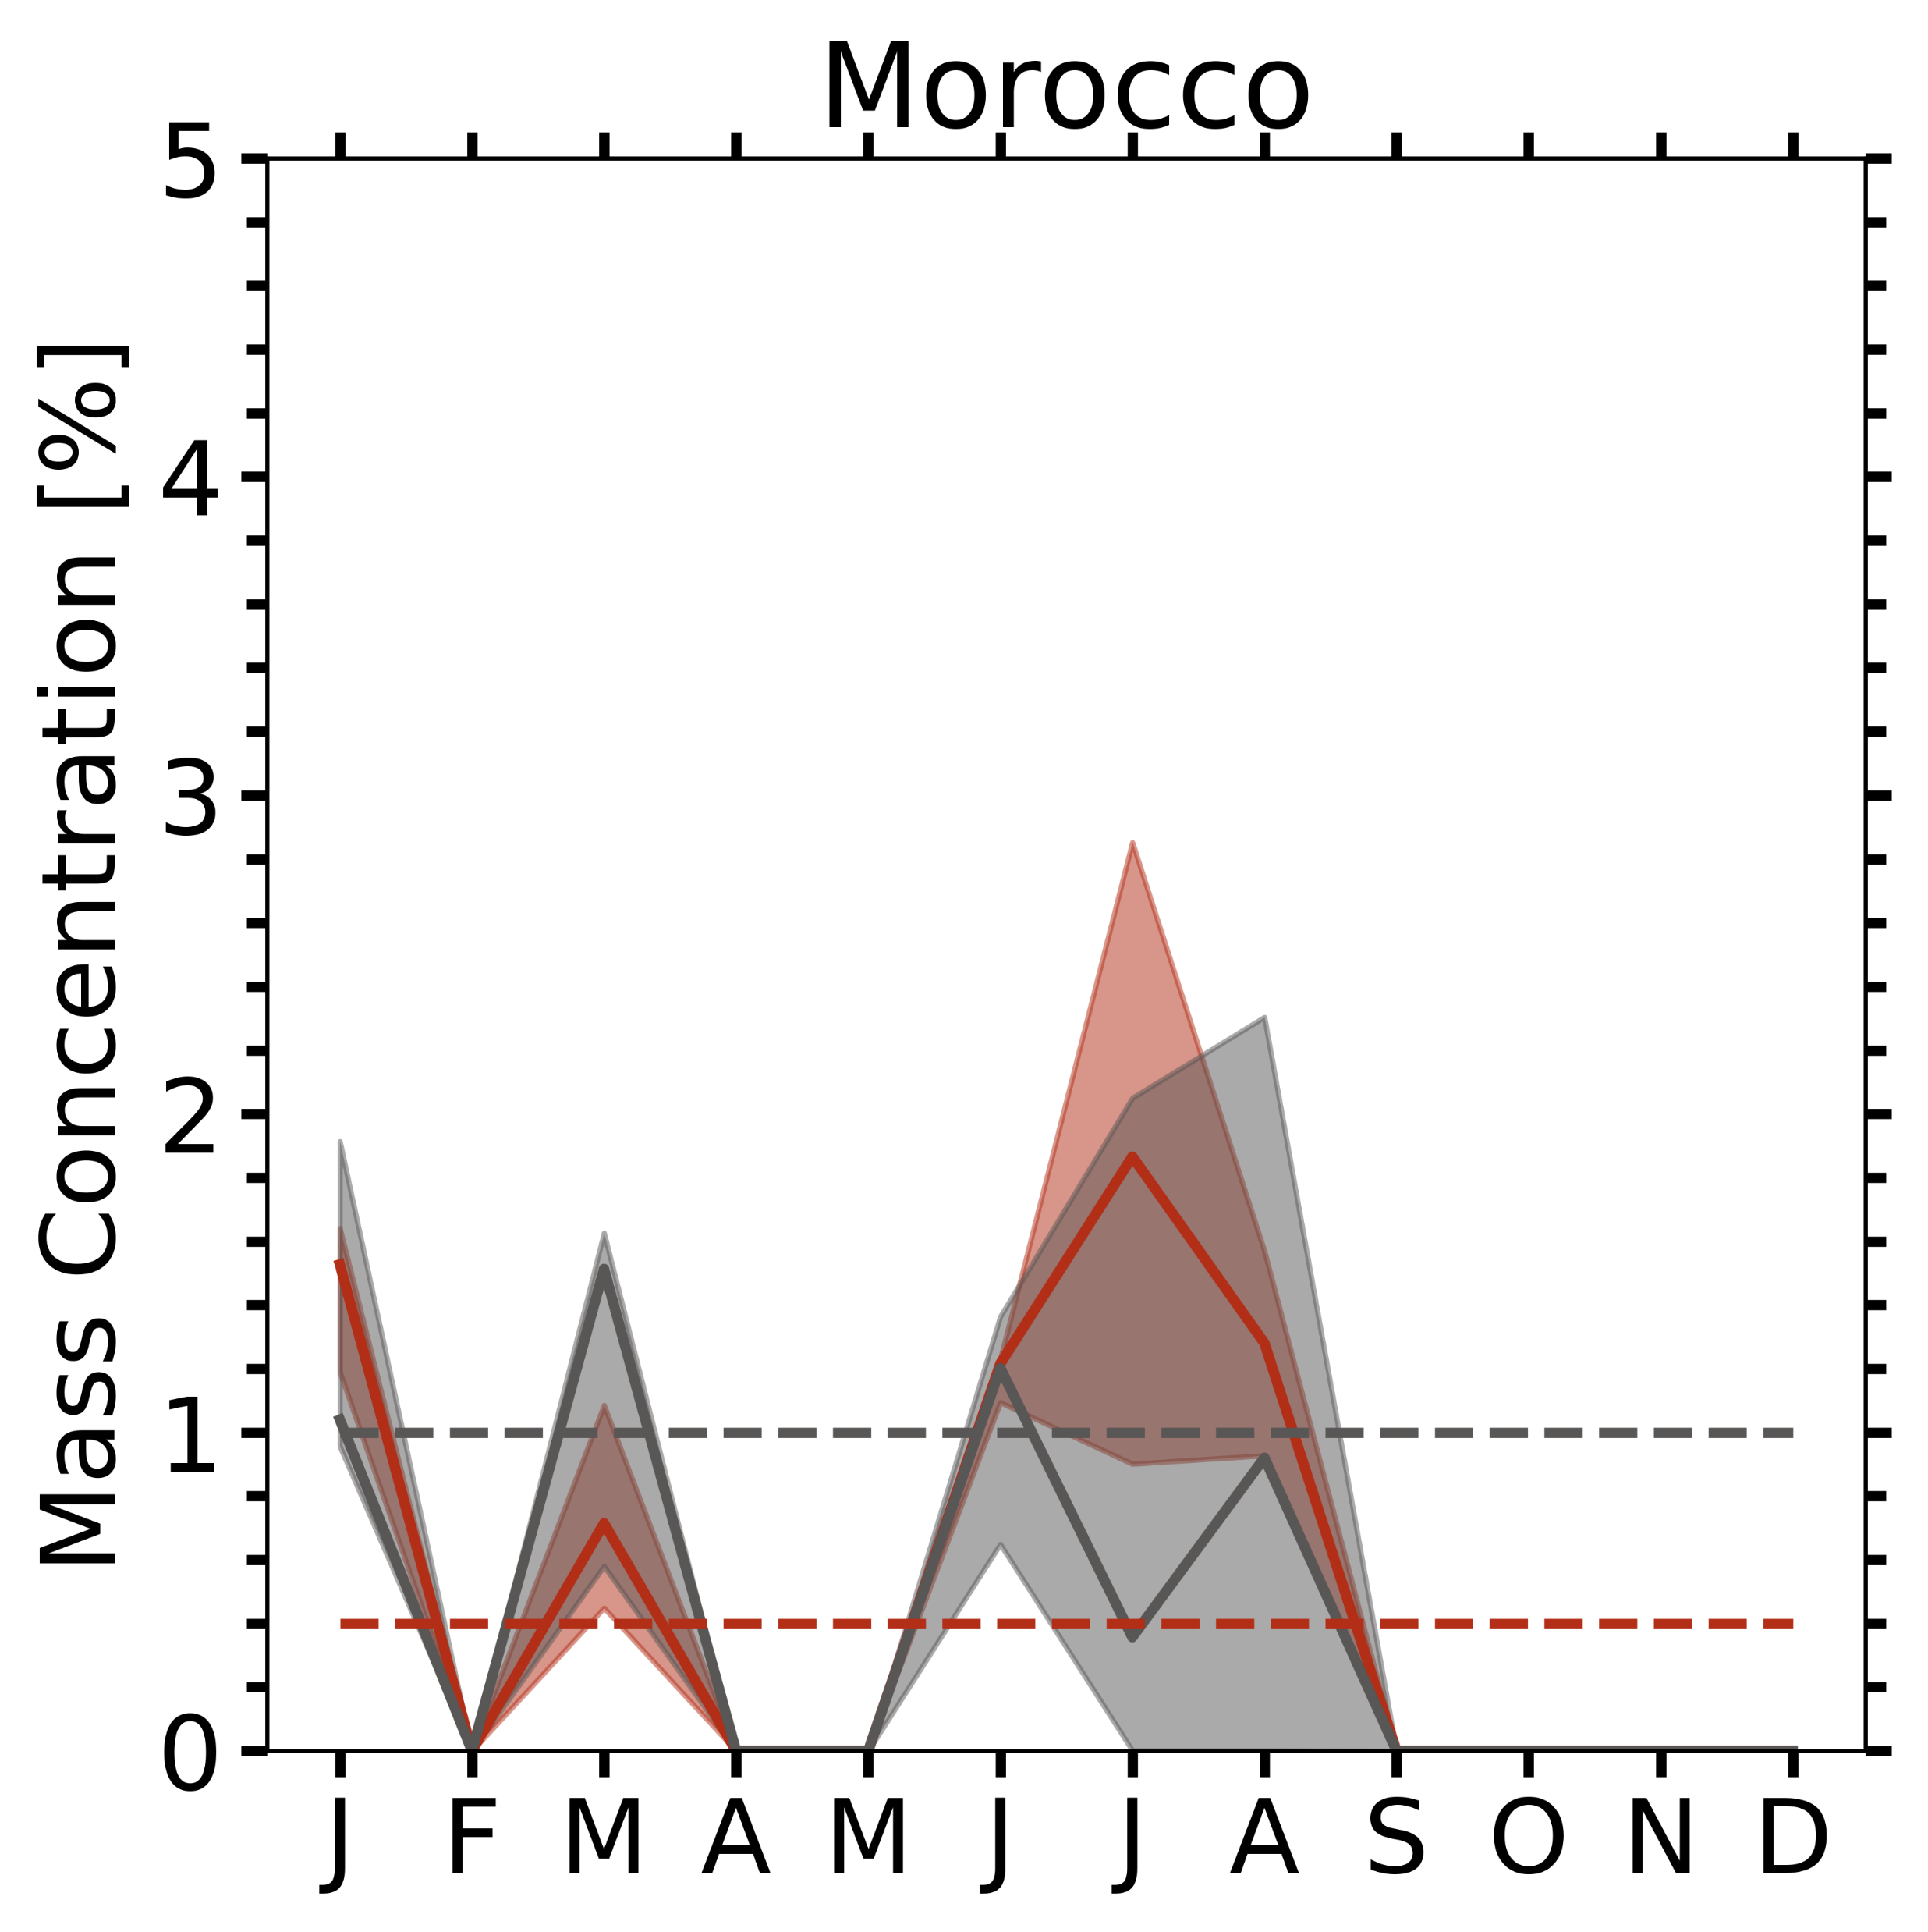
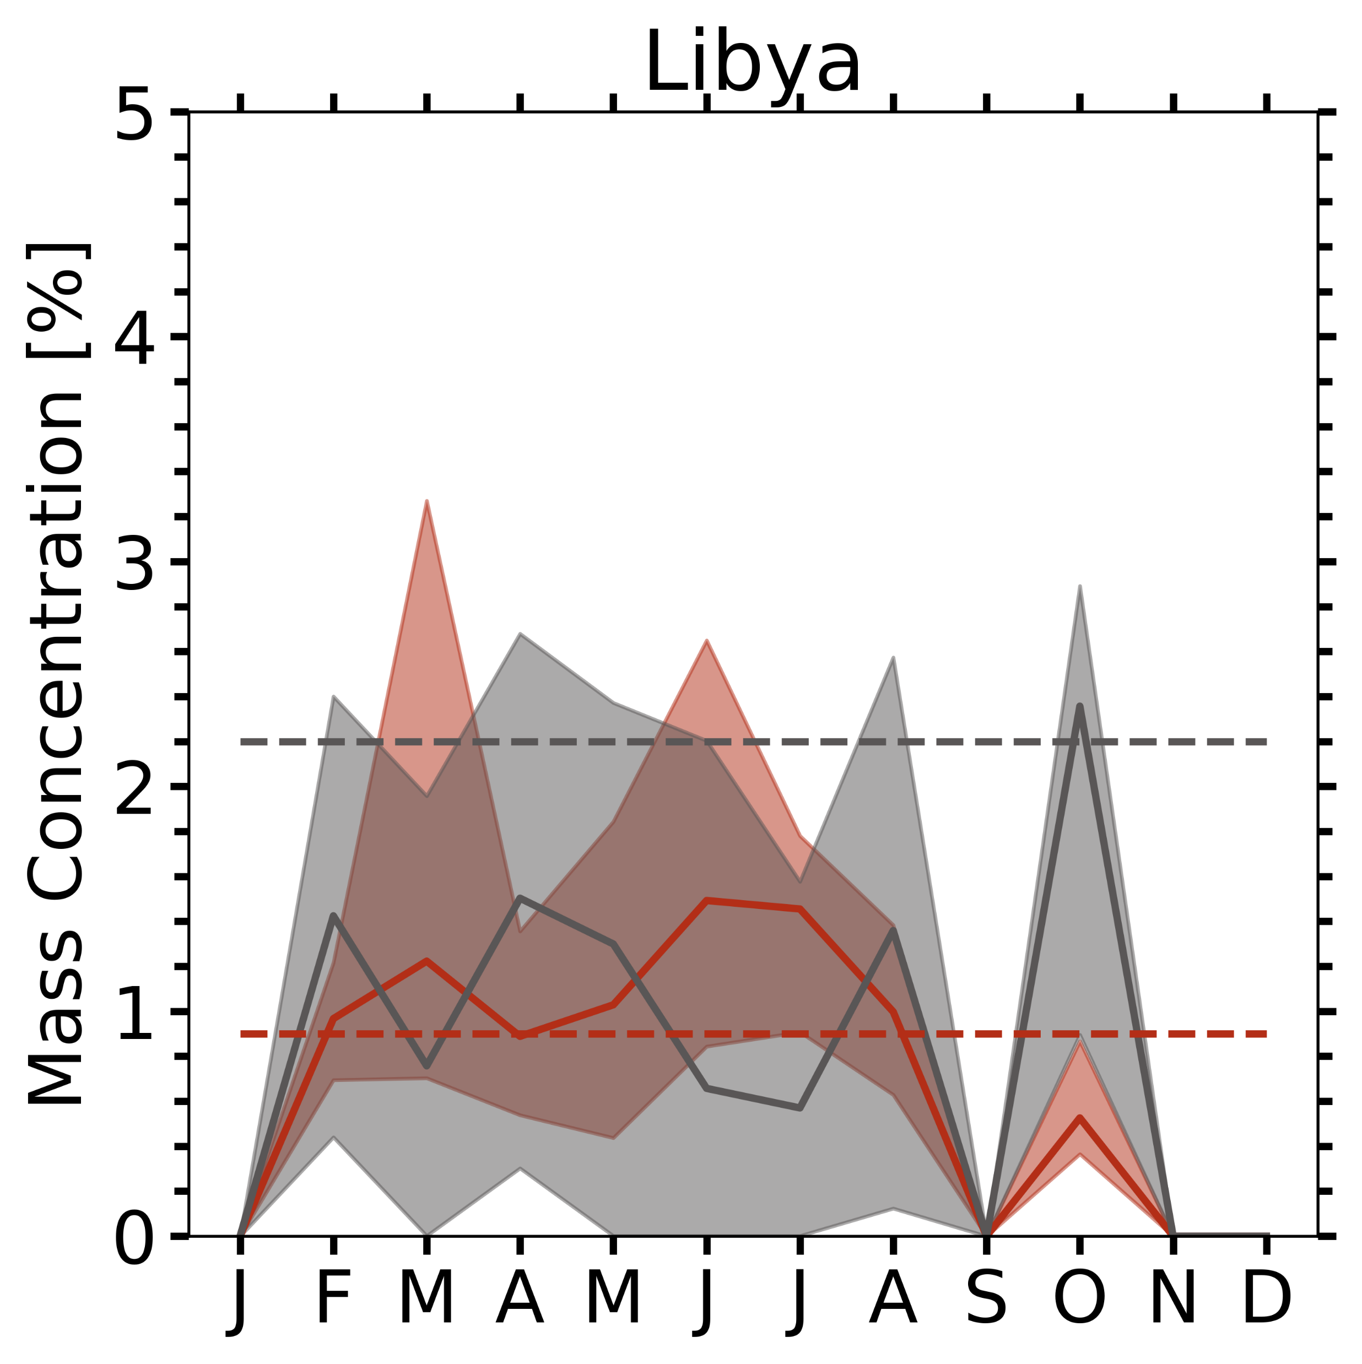
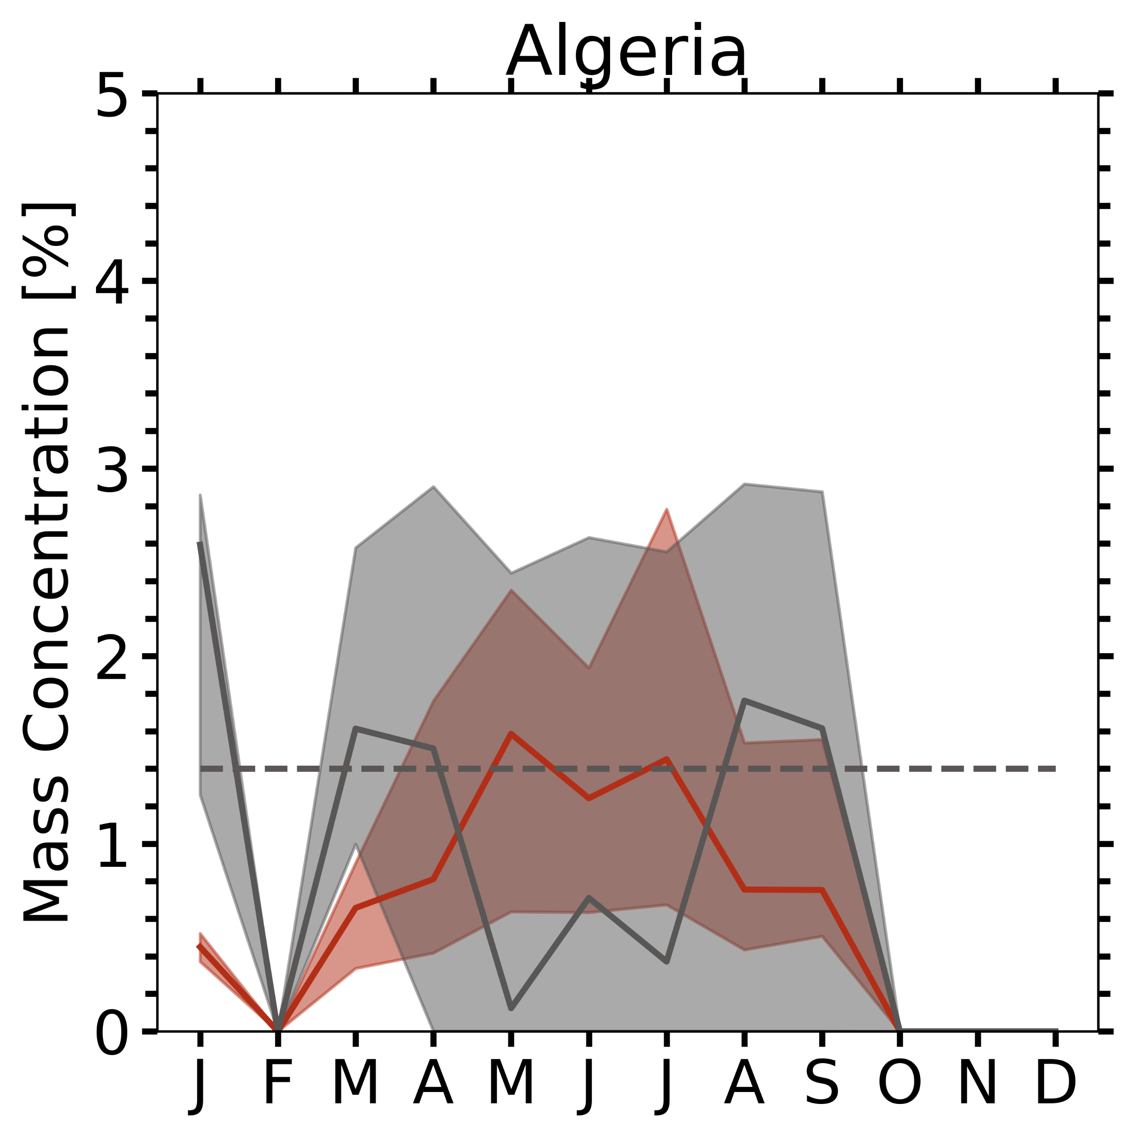
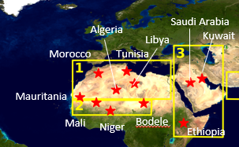
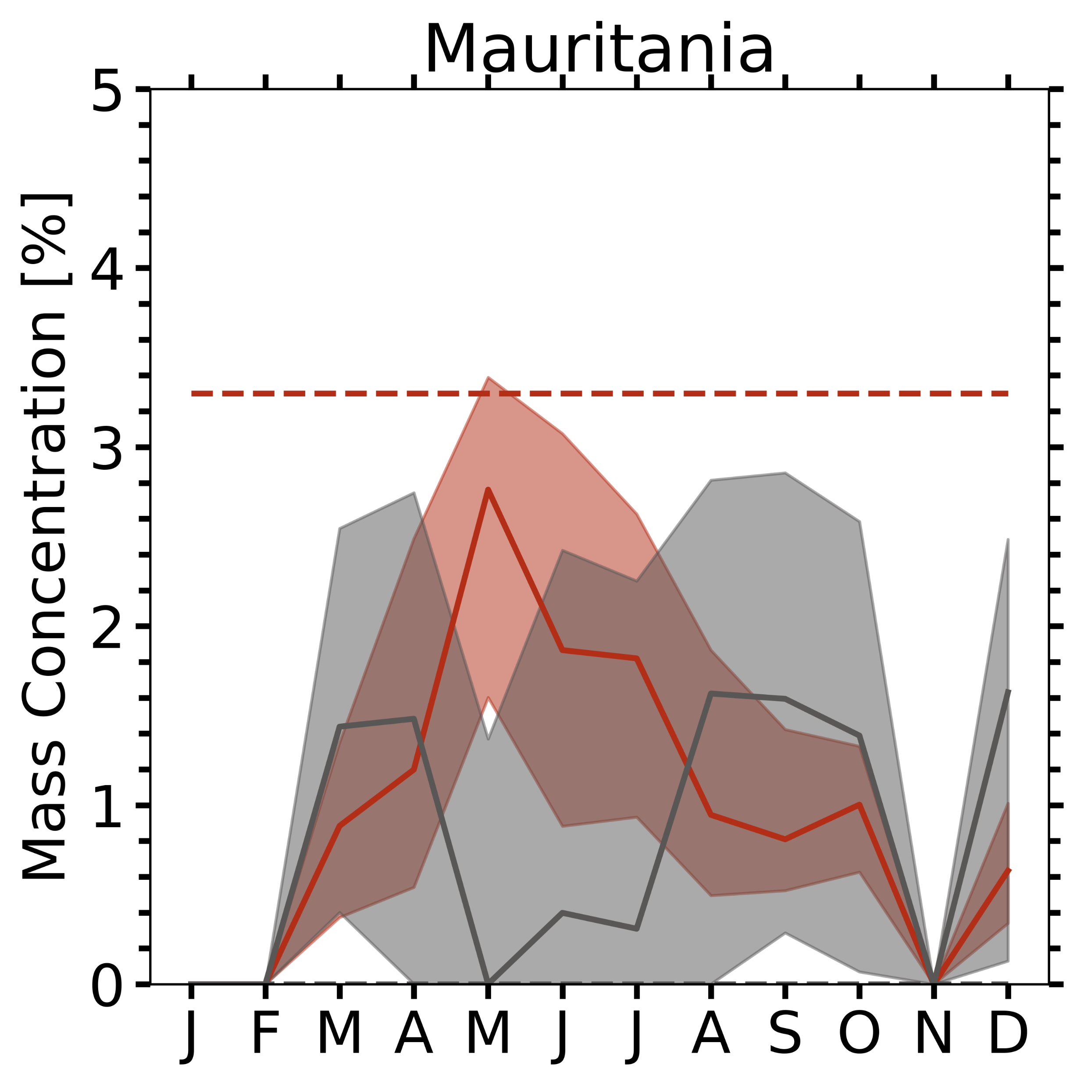
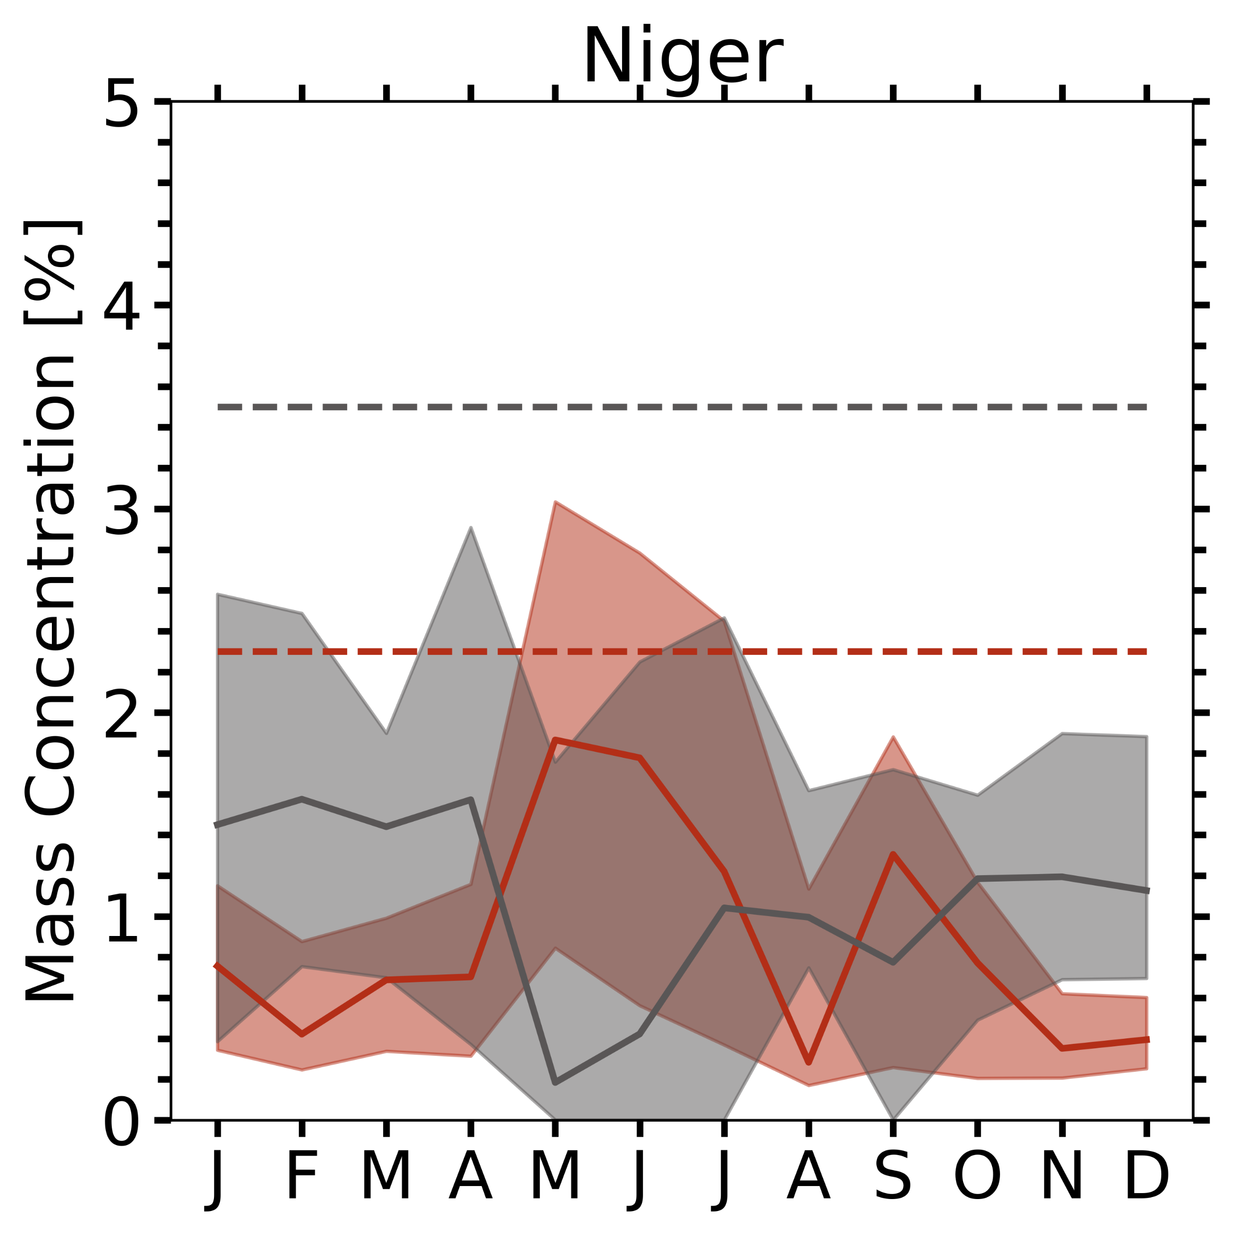
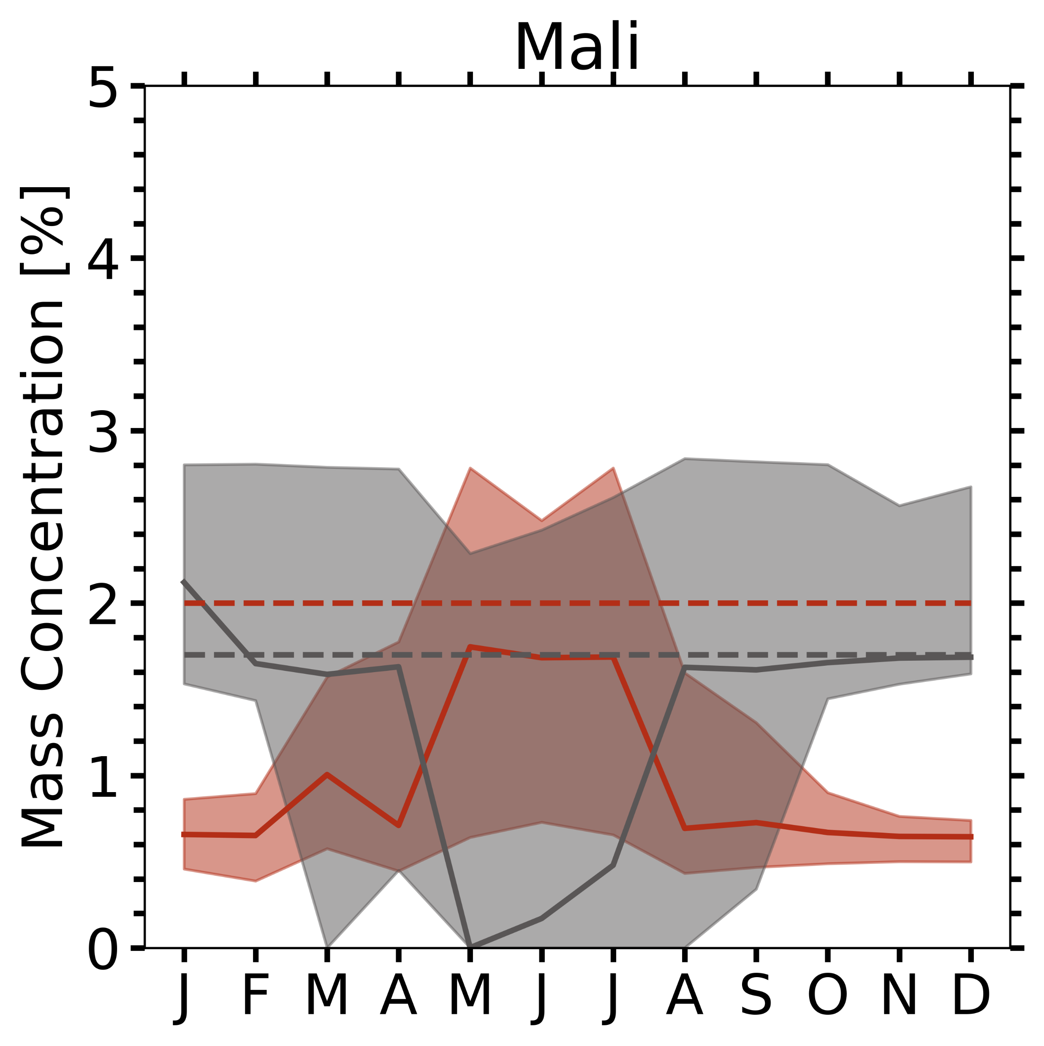
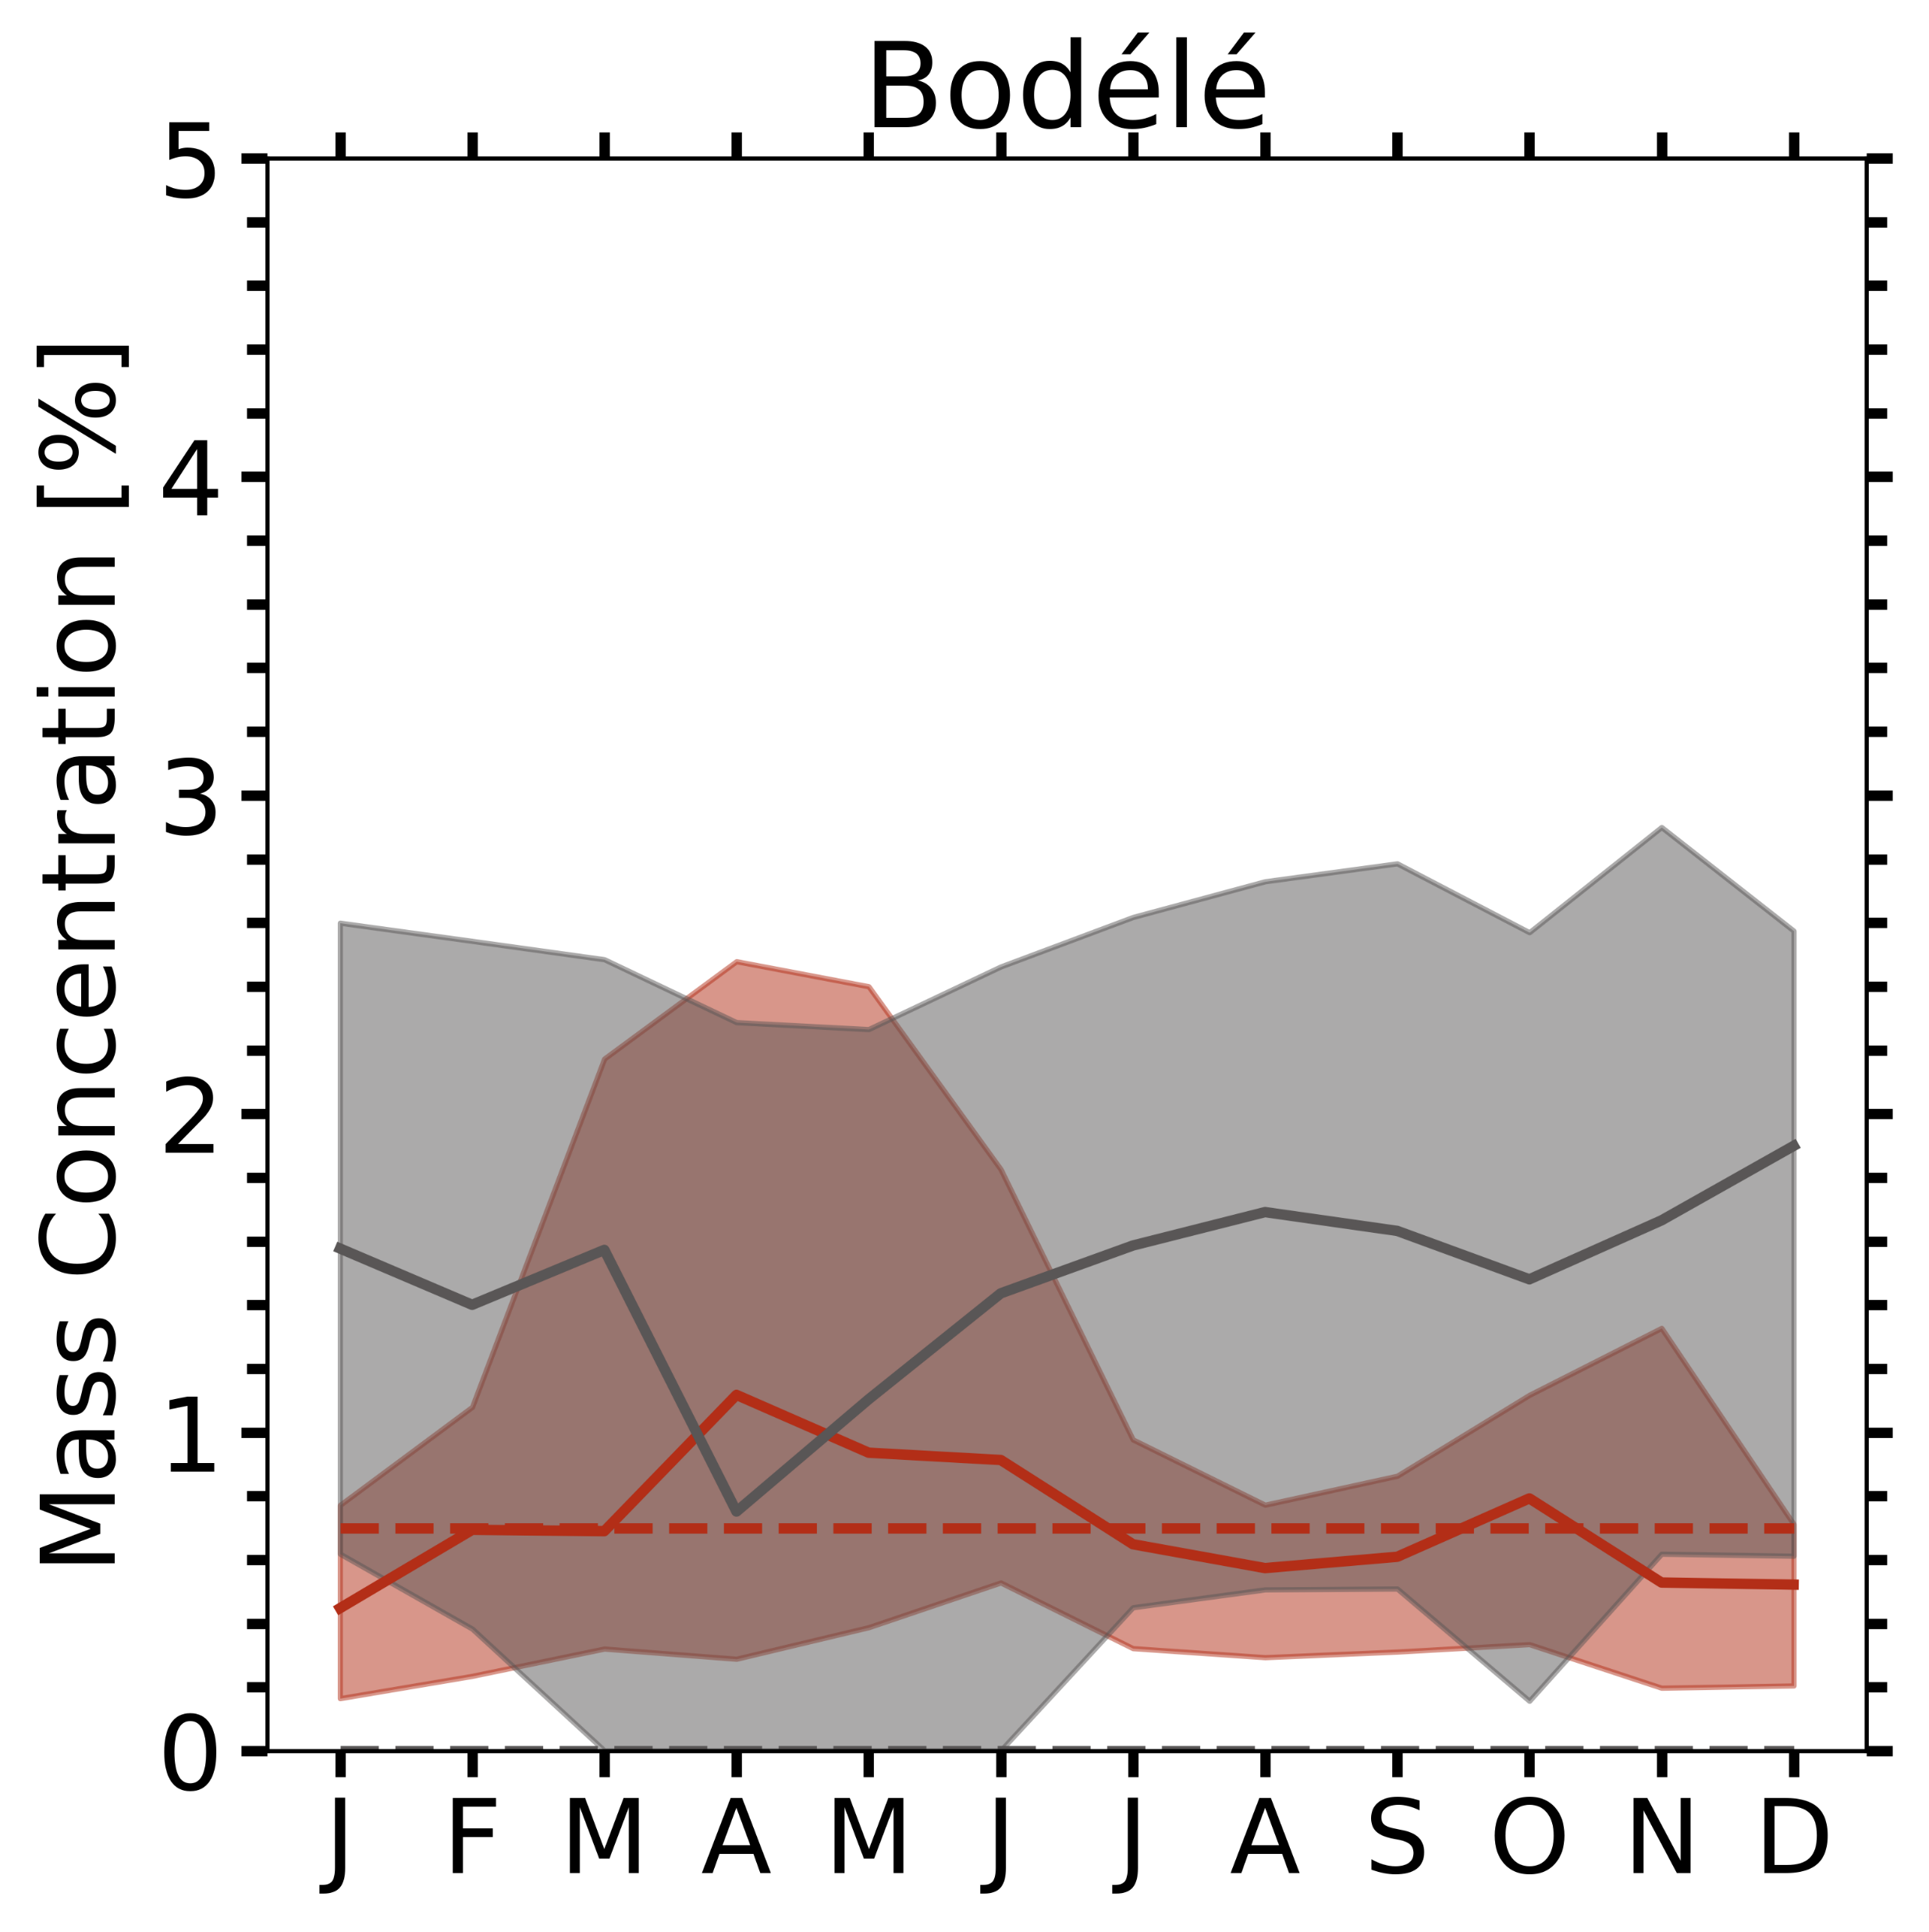
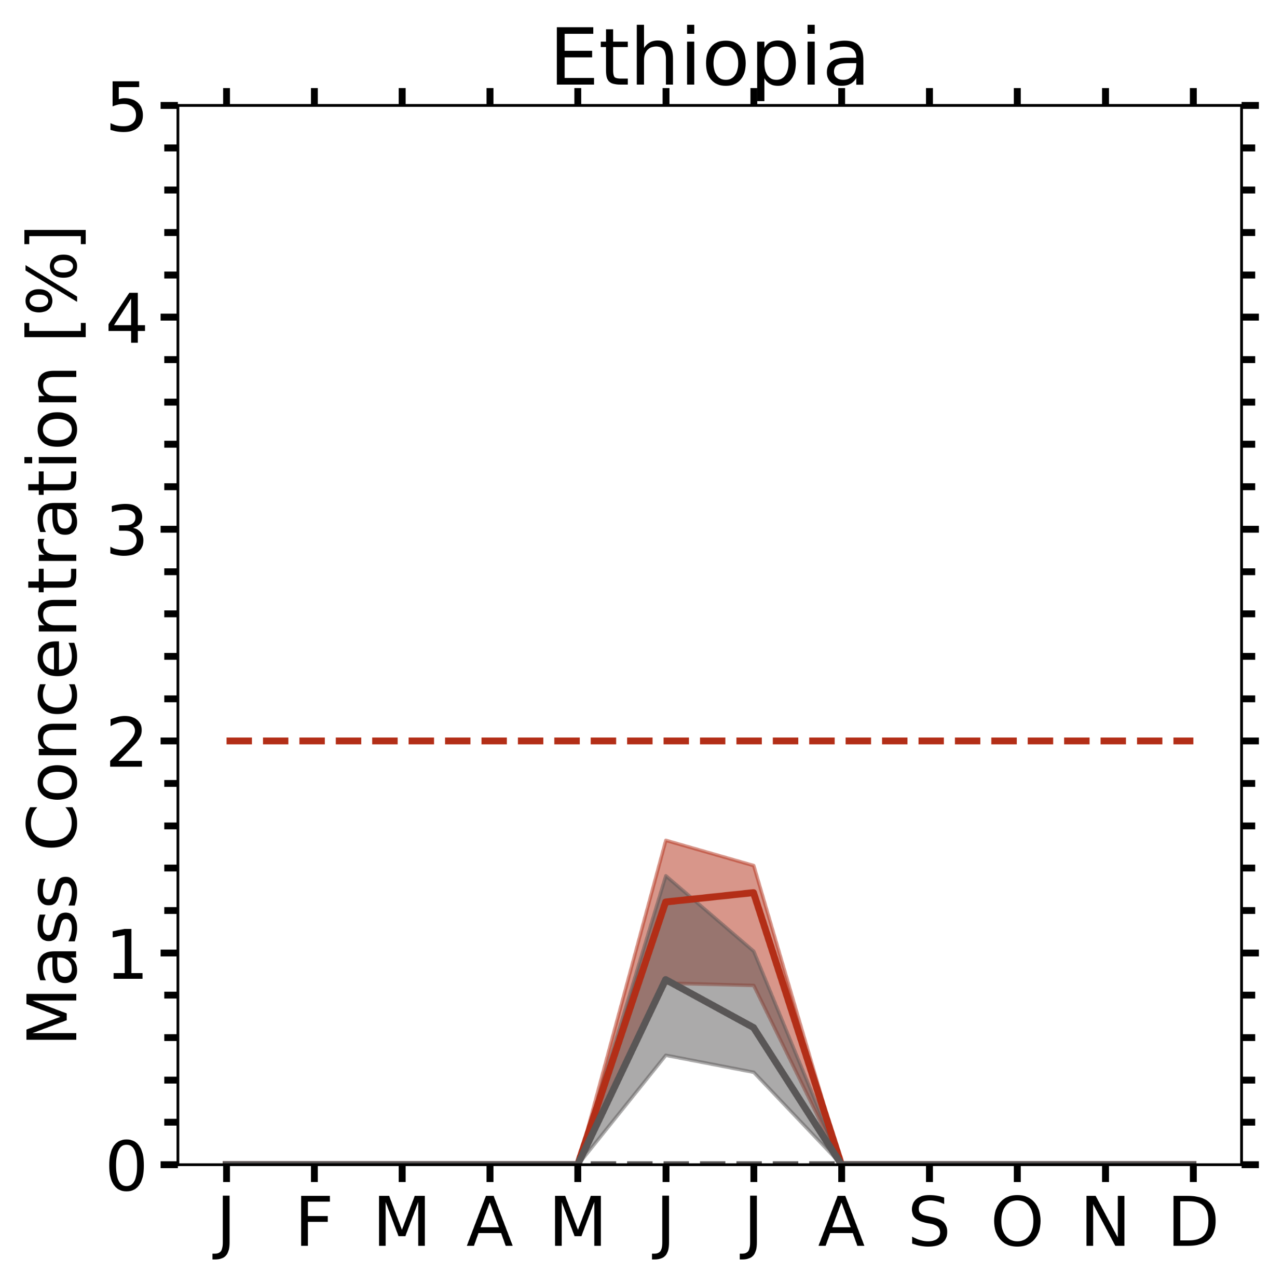
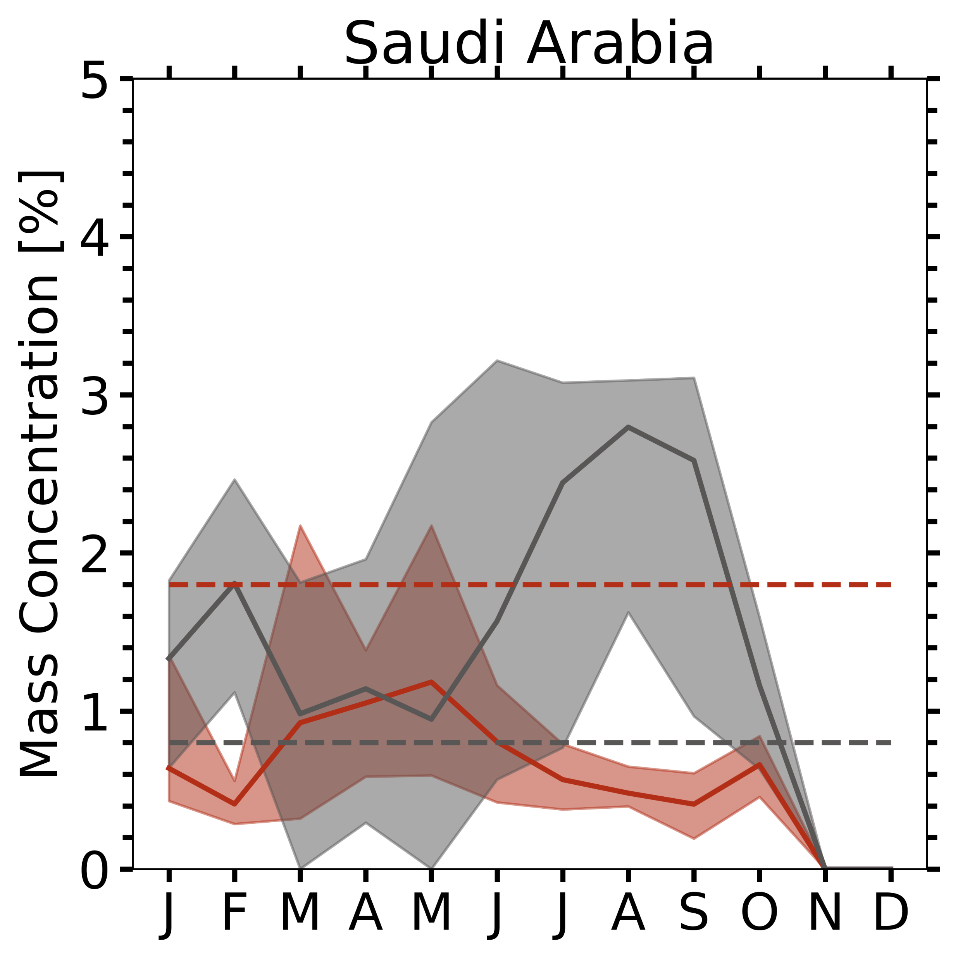
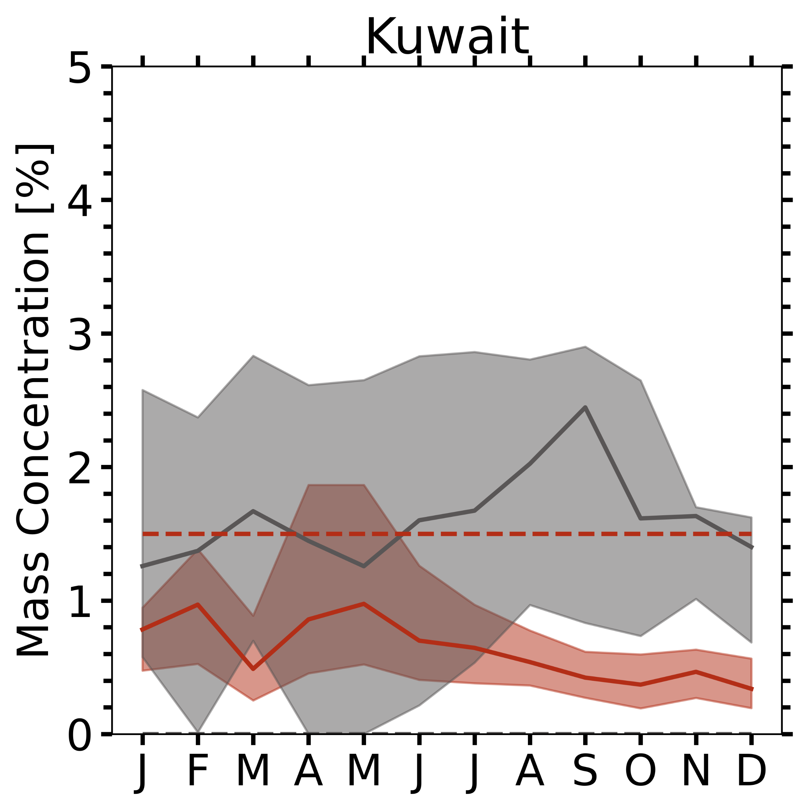
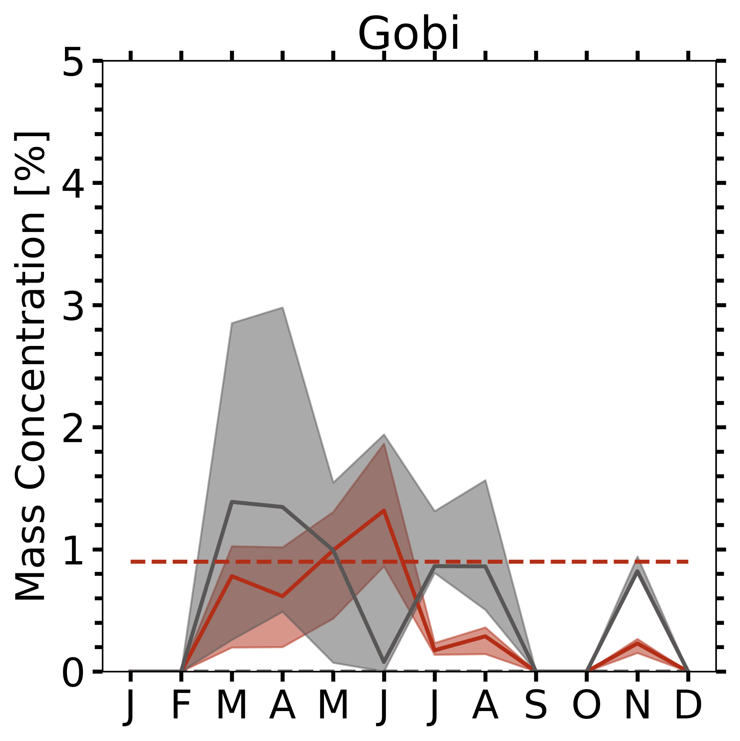
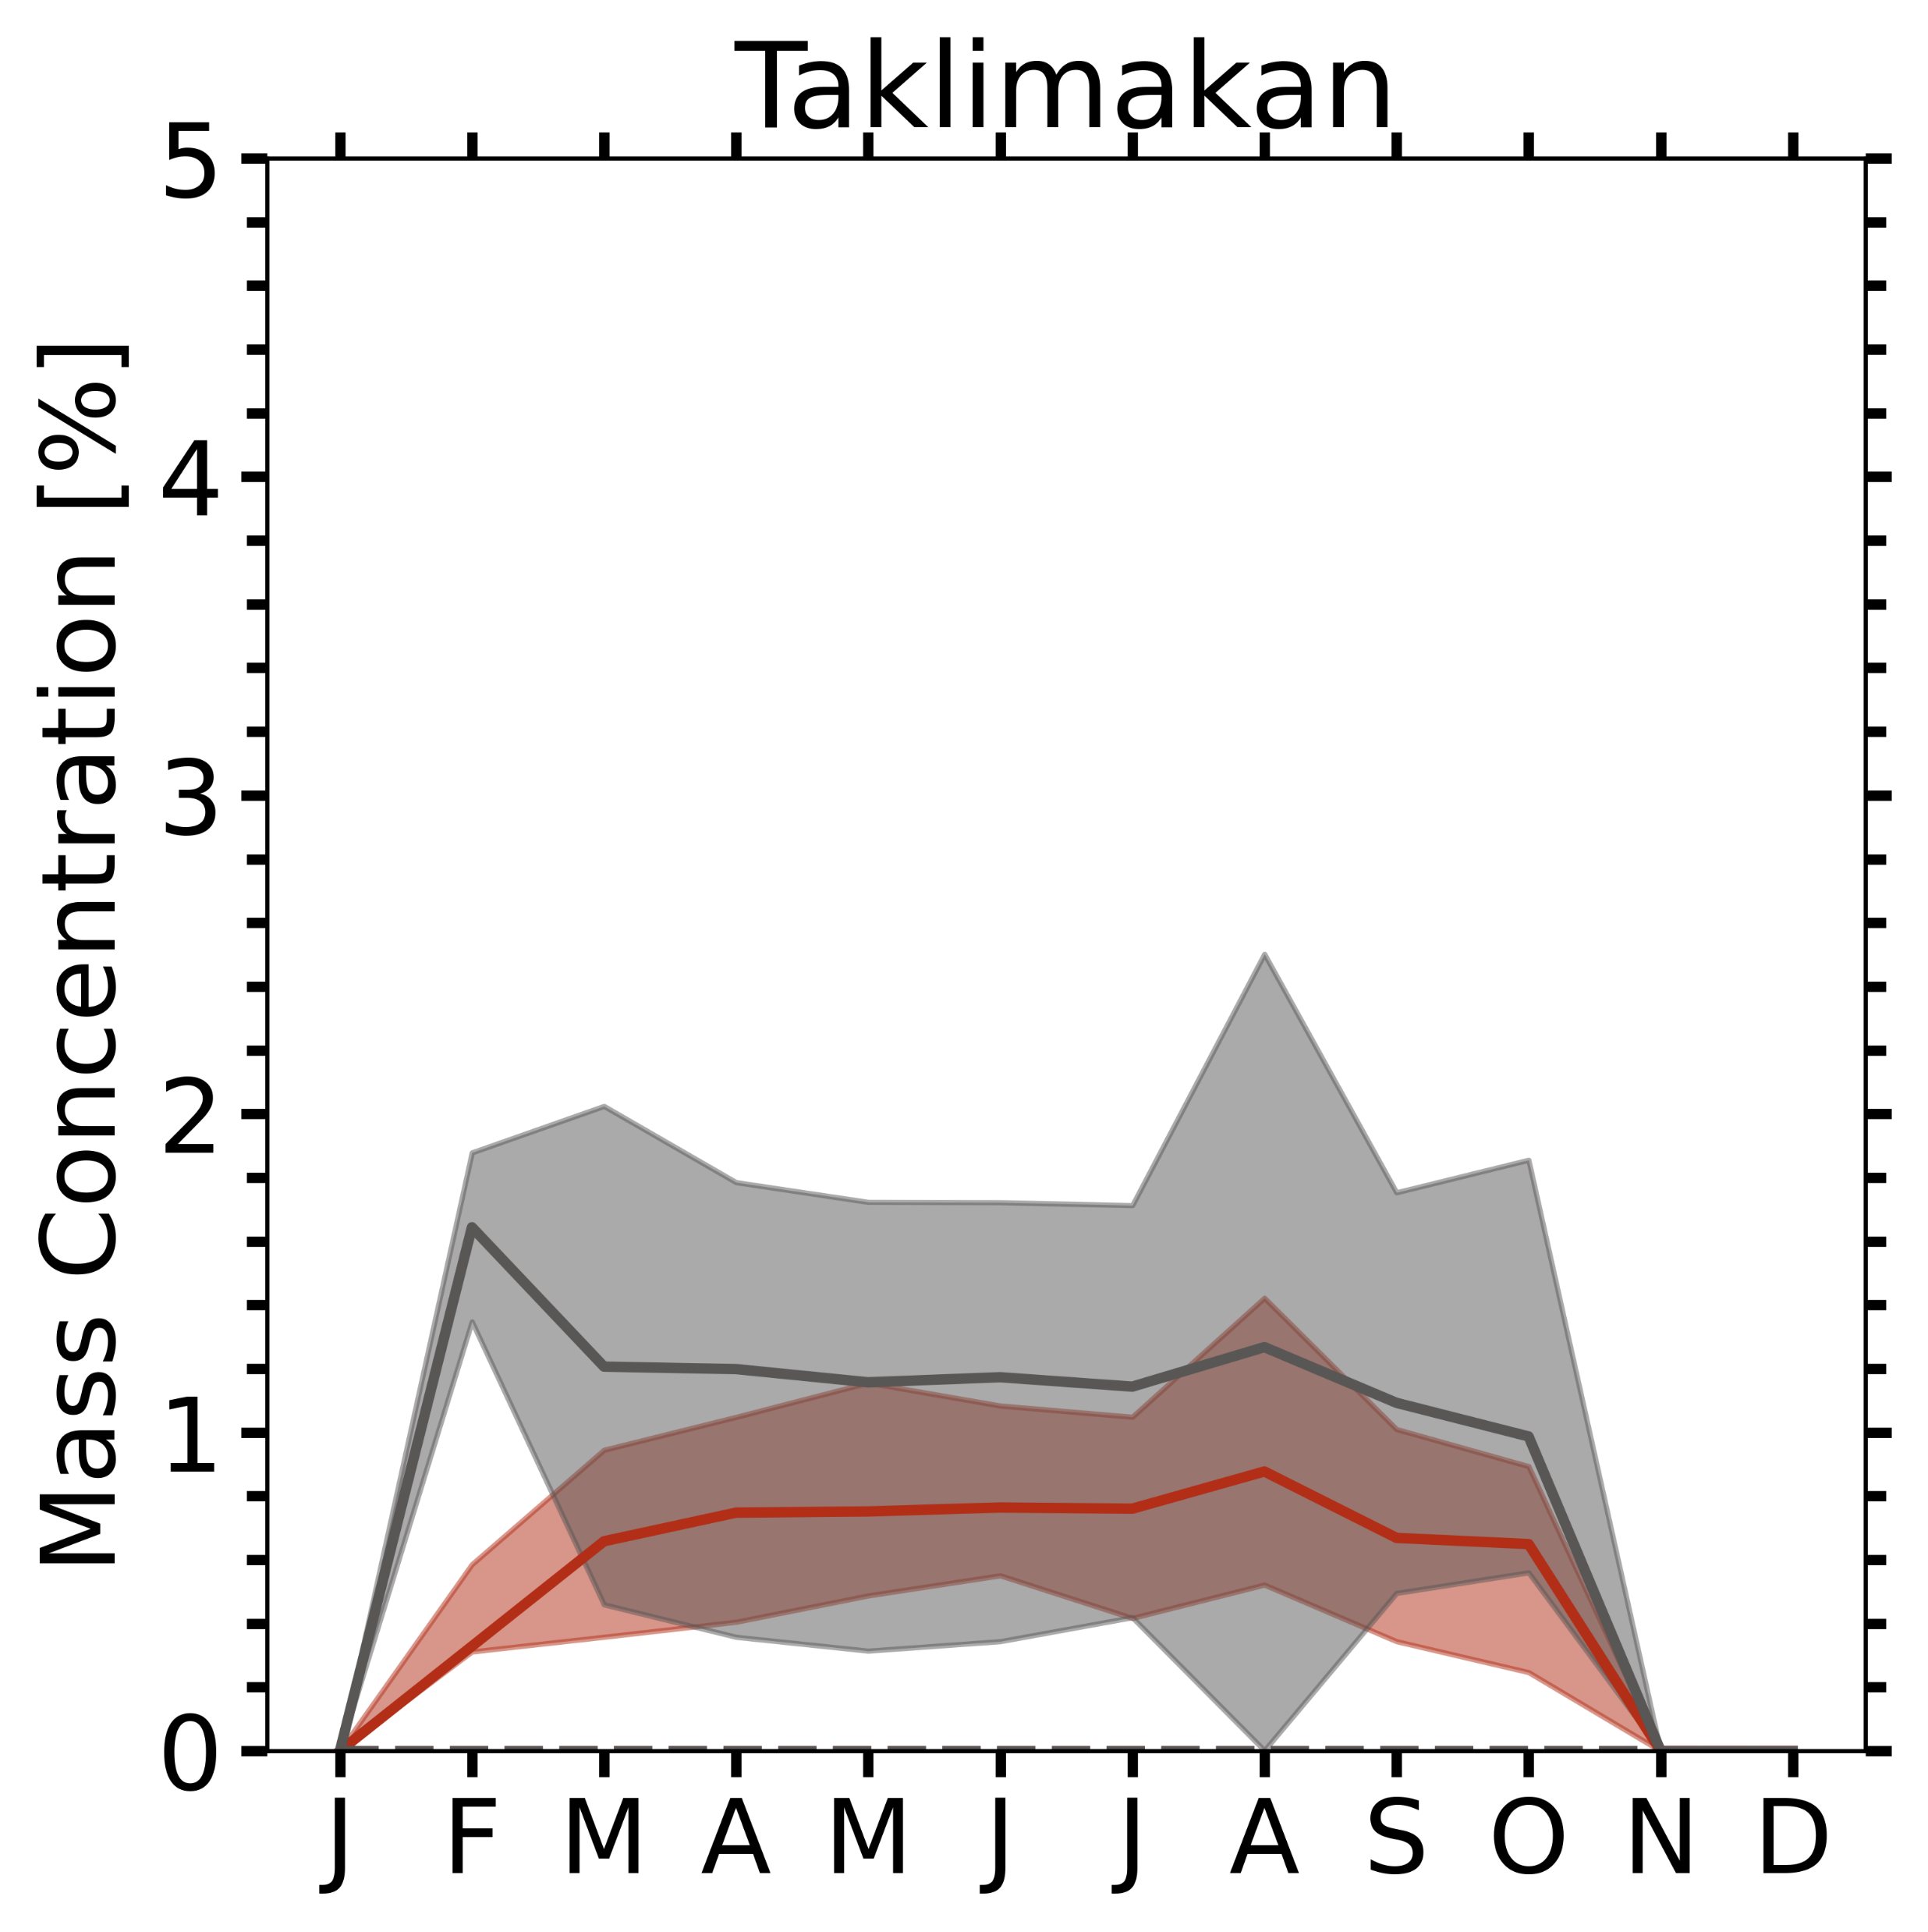
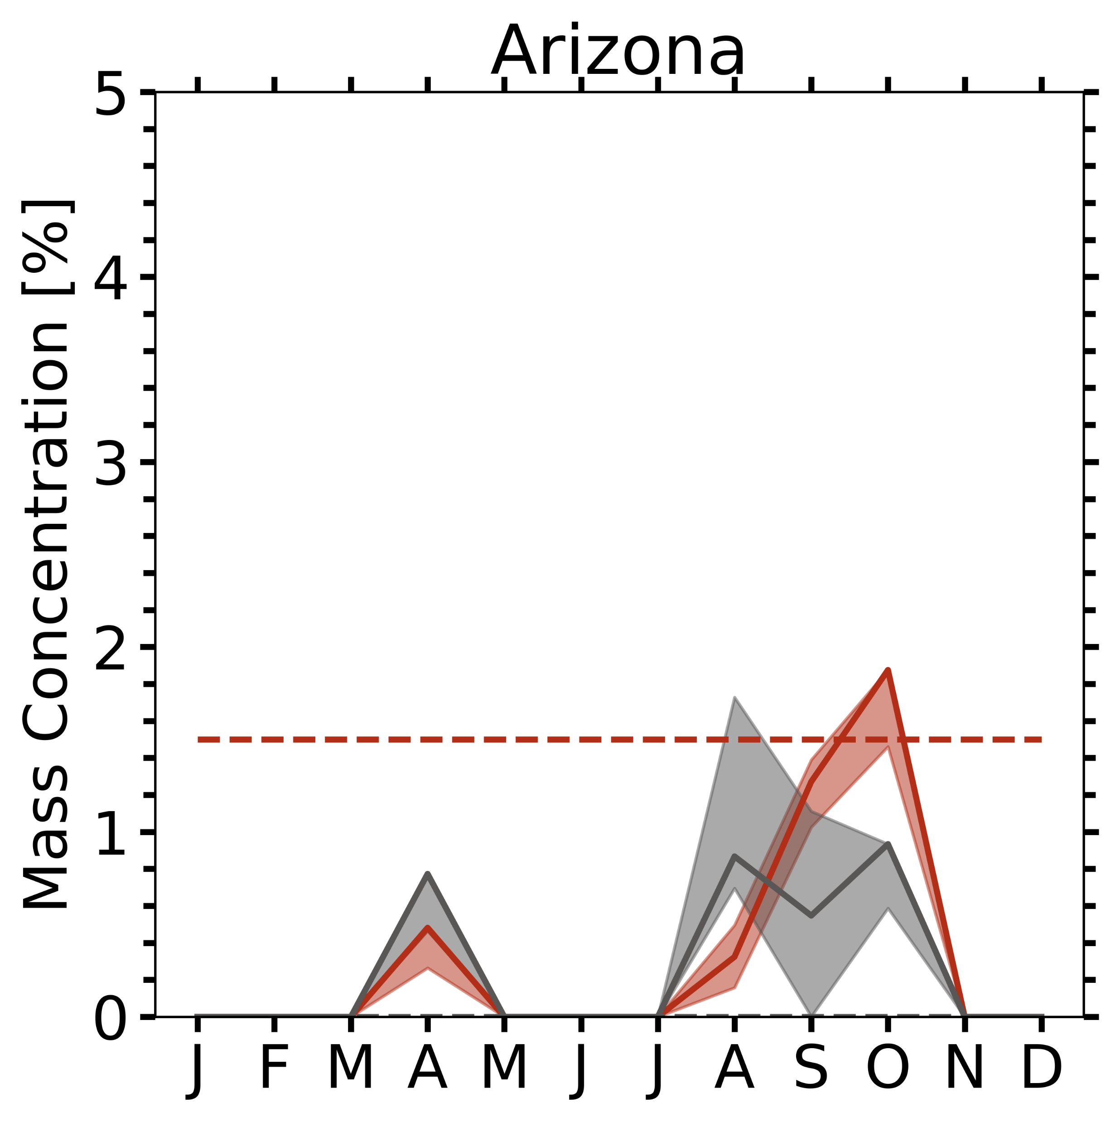
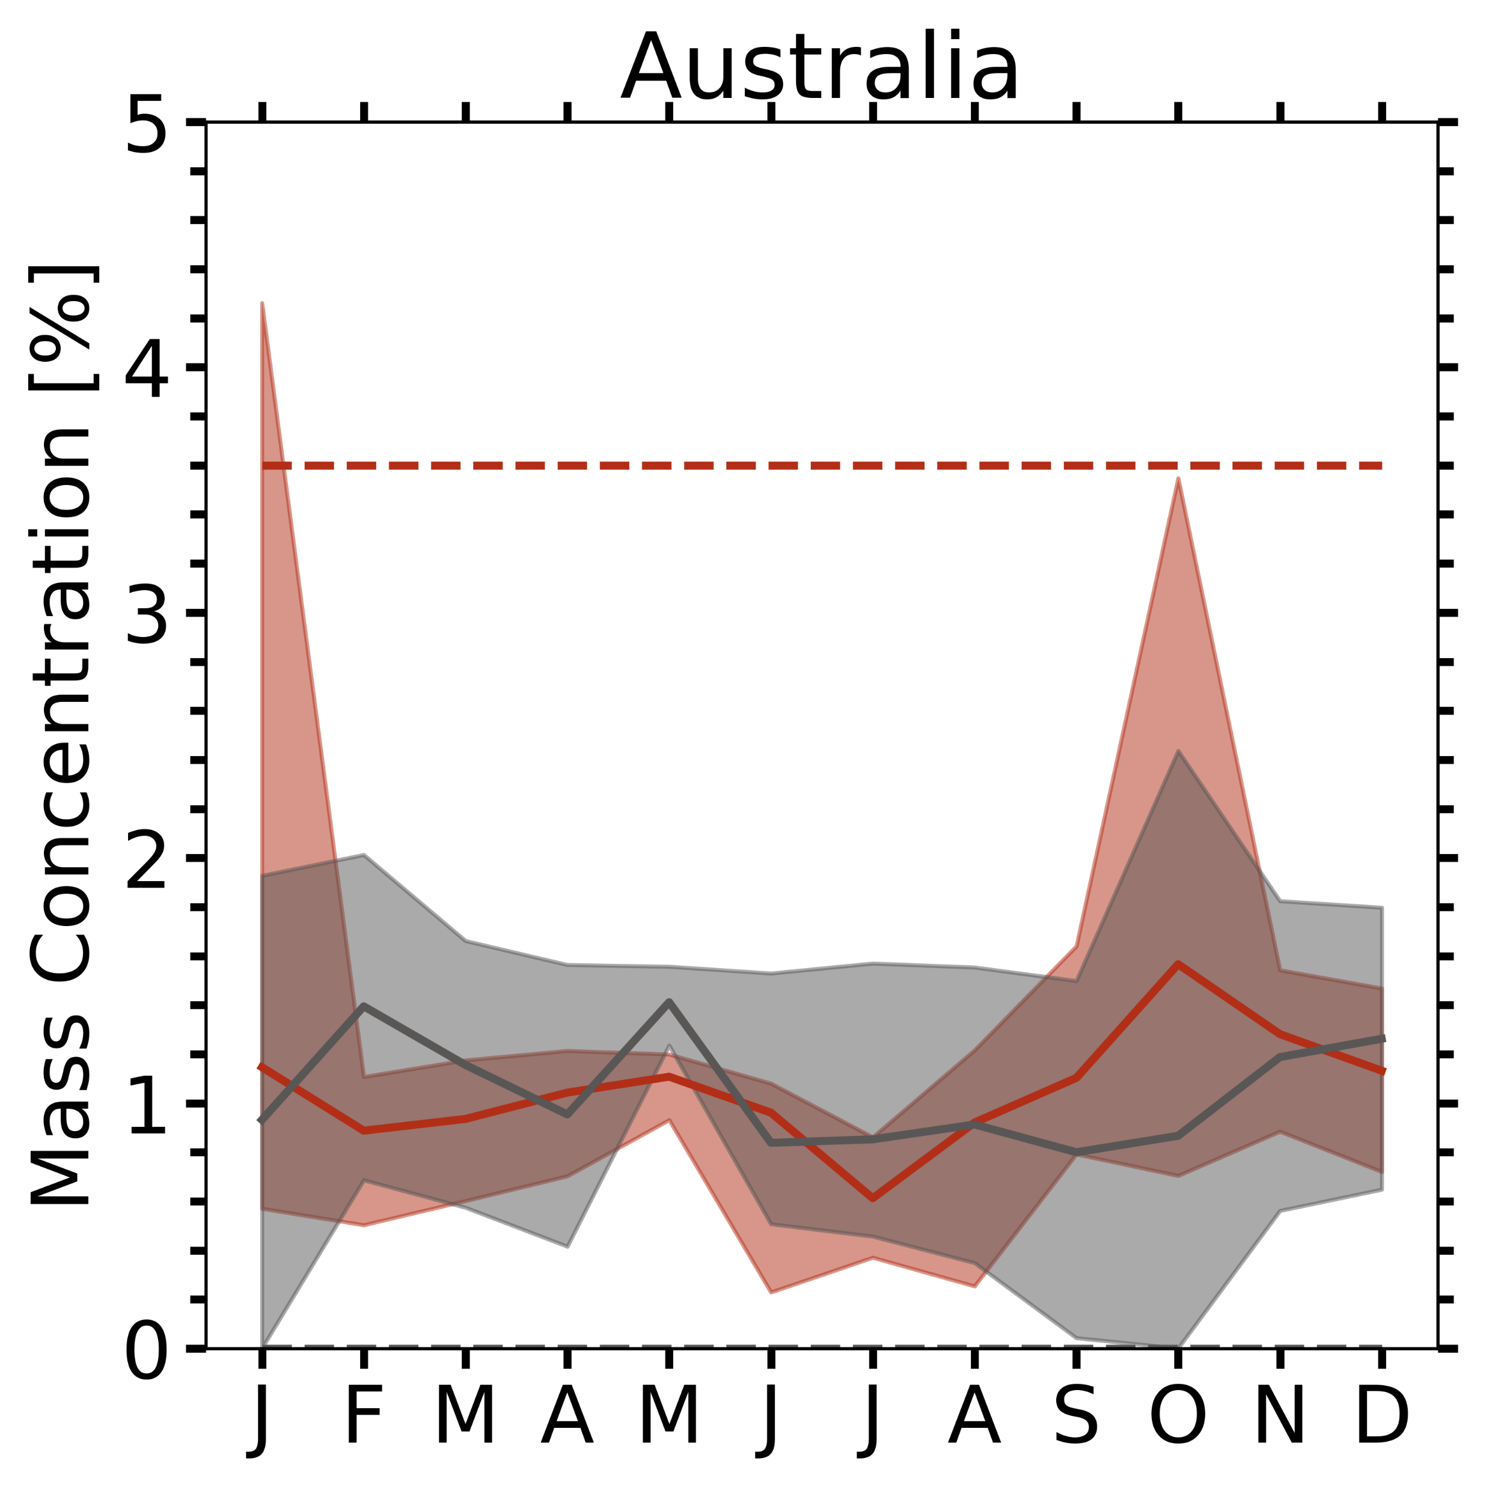
means no EPIC data
Hematite = Goethite
Sahara, Sahel, Middle East → large variability
Sahel line (~20°N) hematite tendency
  EPIC: Mauritania > Niger > Mali > Bodélé
  Di Biagio: (3.3%) > (2.3%) > (2.0%) > (0.7%)
Niger (Lafon et al., 2004)
  Harmattan (11-3): 2.8% iron oxide → agrees
  Local erosion (5-7): 5.0% (±0.4) iron oxide
    → Possibly due to rain, MAIAC did not catch
Bodélé:
  EPIC: consistently low hematite (<1.4%)
  Di Biagio: 0.7% hematite
Saudi Arabia, Kuwait:
  Shamal season (6-9): northwesterly wind
    → hematite, goethite reversed
Gobi, Taklimakan:
  Hm/Gt ratio ~ 0.55 observed (Shen et al., 2006)
Arizona, Australia: may contain smoke cases, but case study agreed with dashed line range.
* Invisible dashed line of Goethite = 0.0
Shaded (EPIC)
Dashed (Di Biagio)
Hematite, Goethite

Slide 10
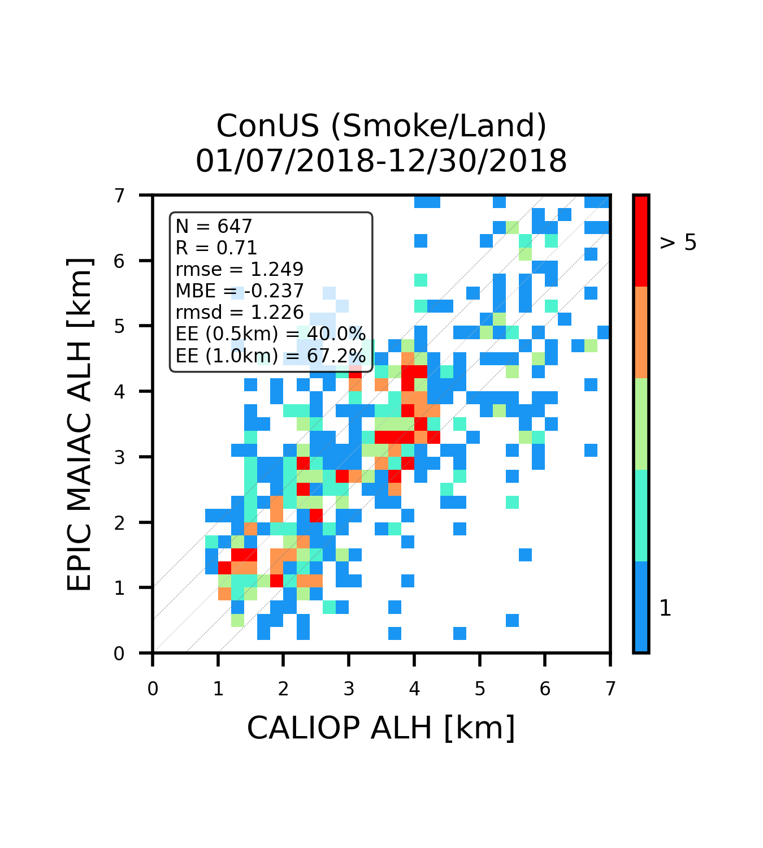
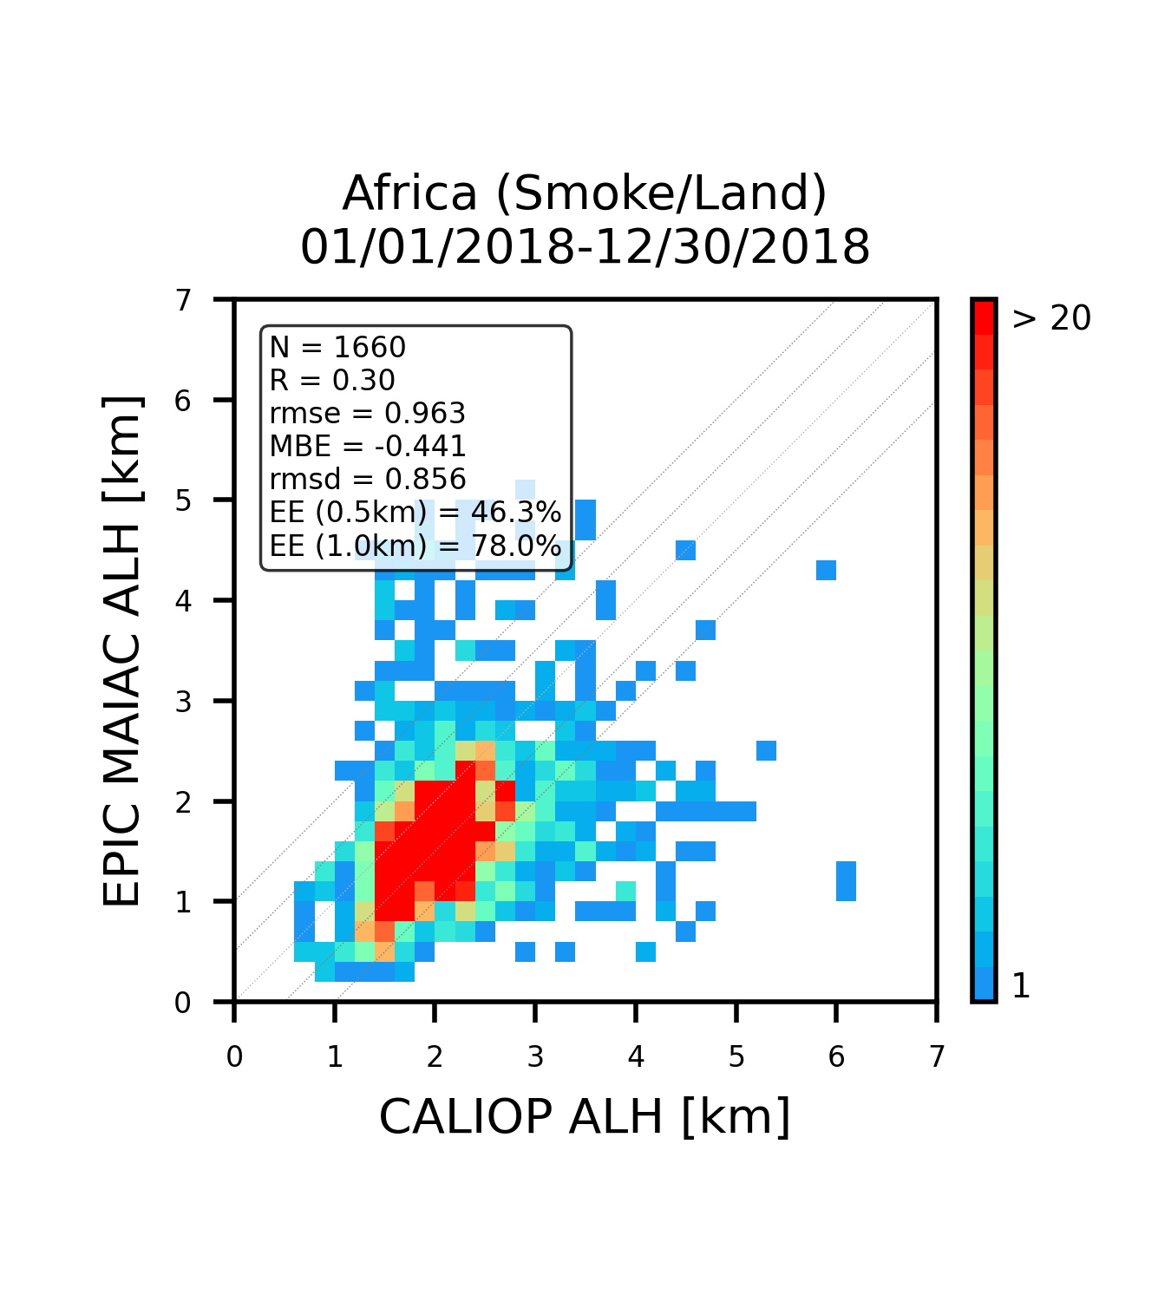
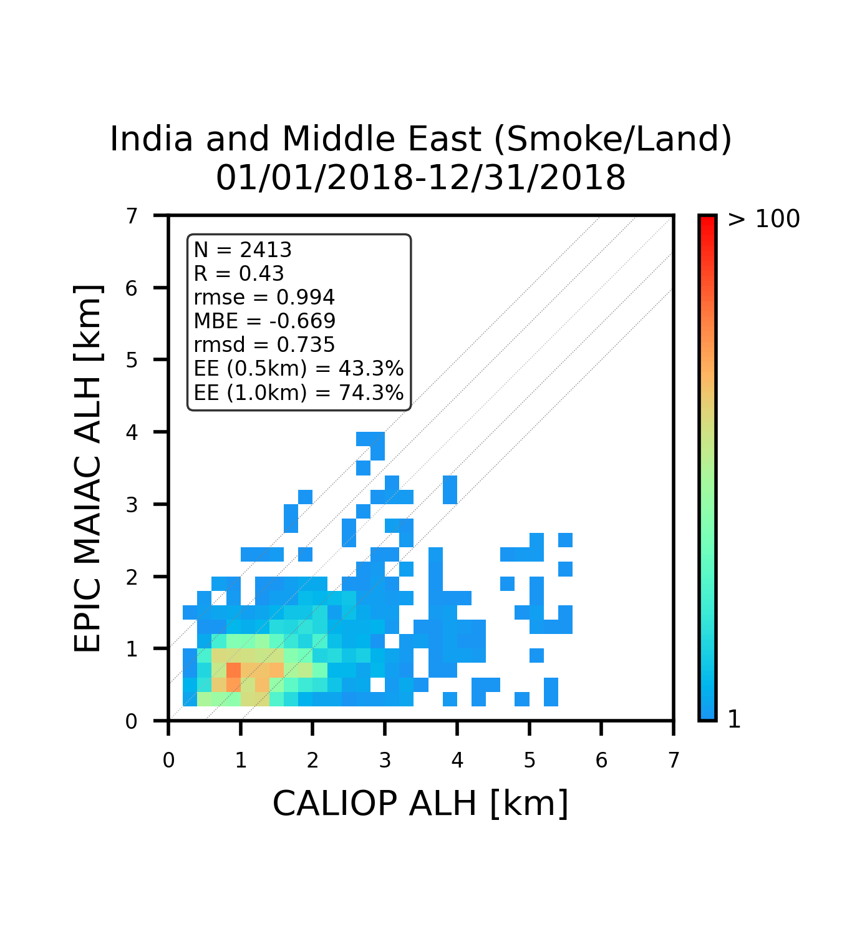
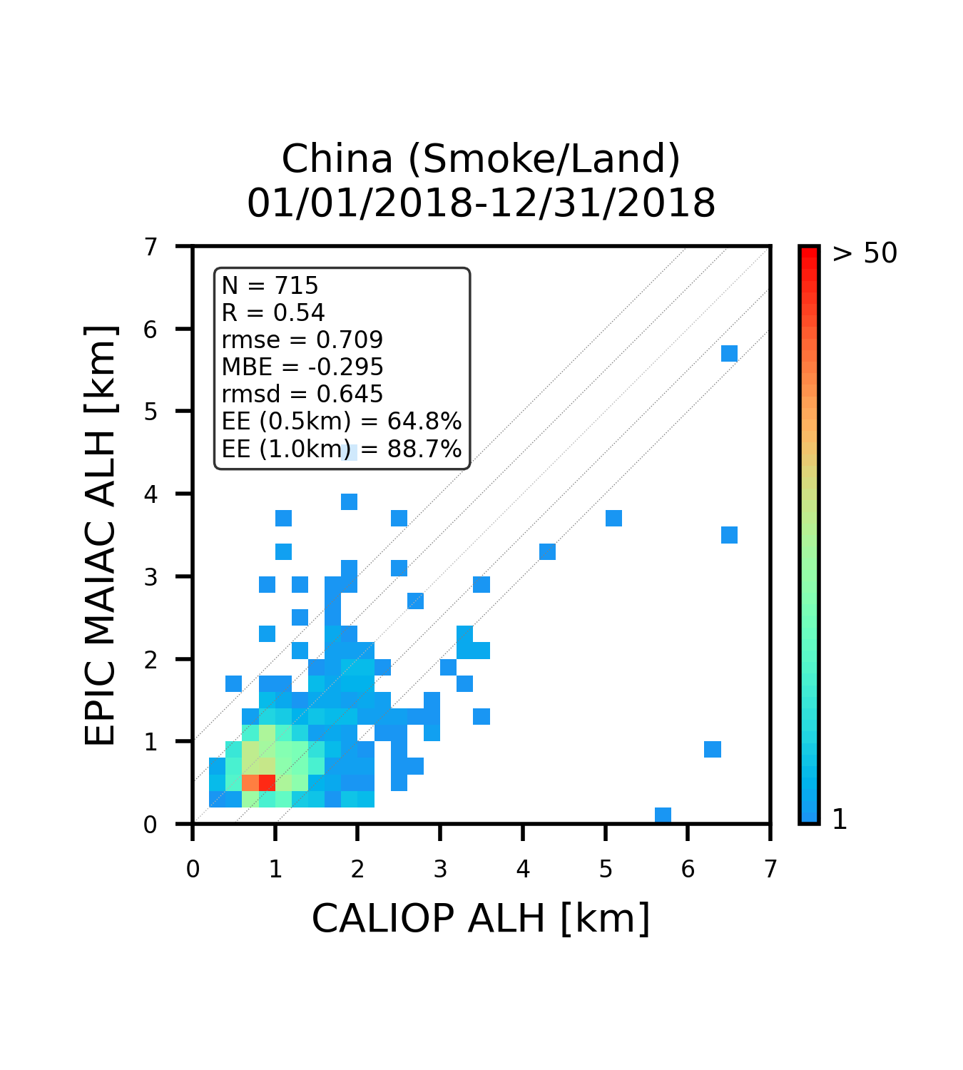
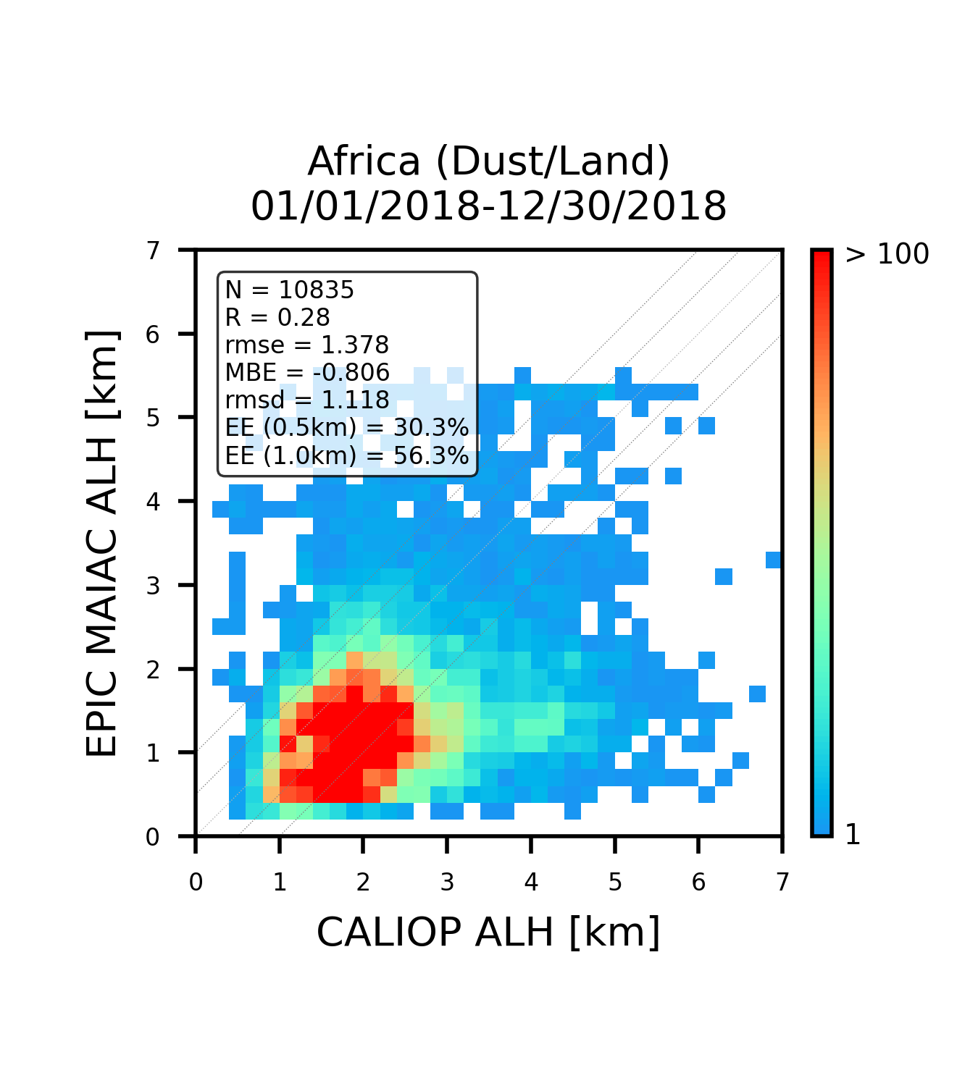
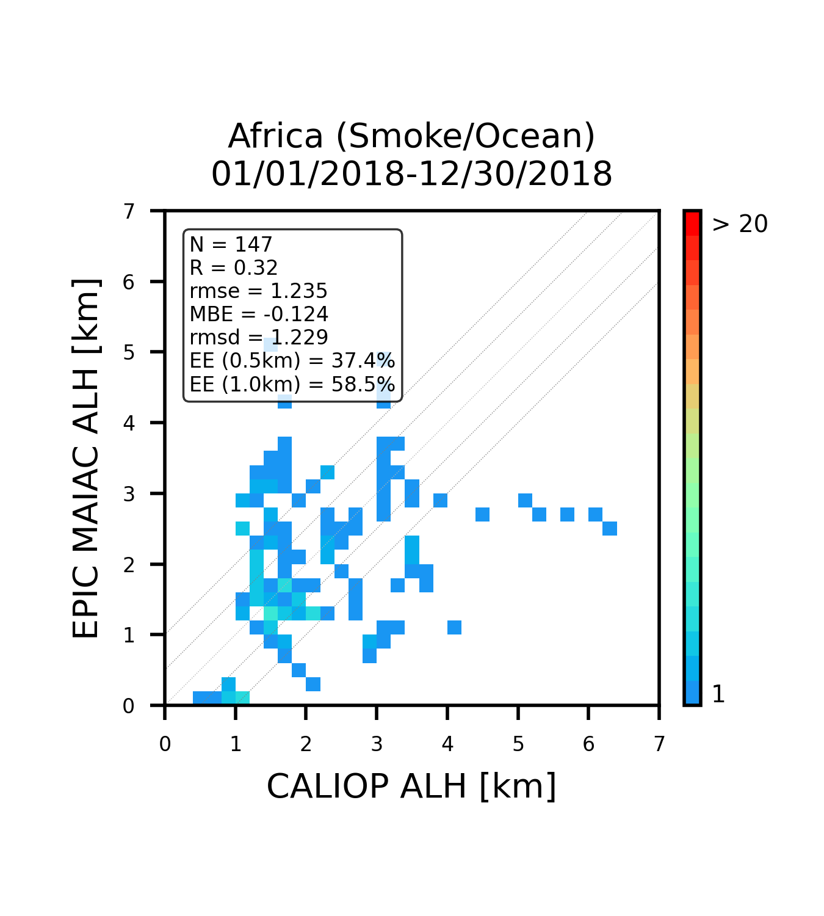
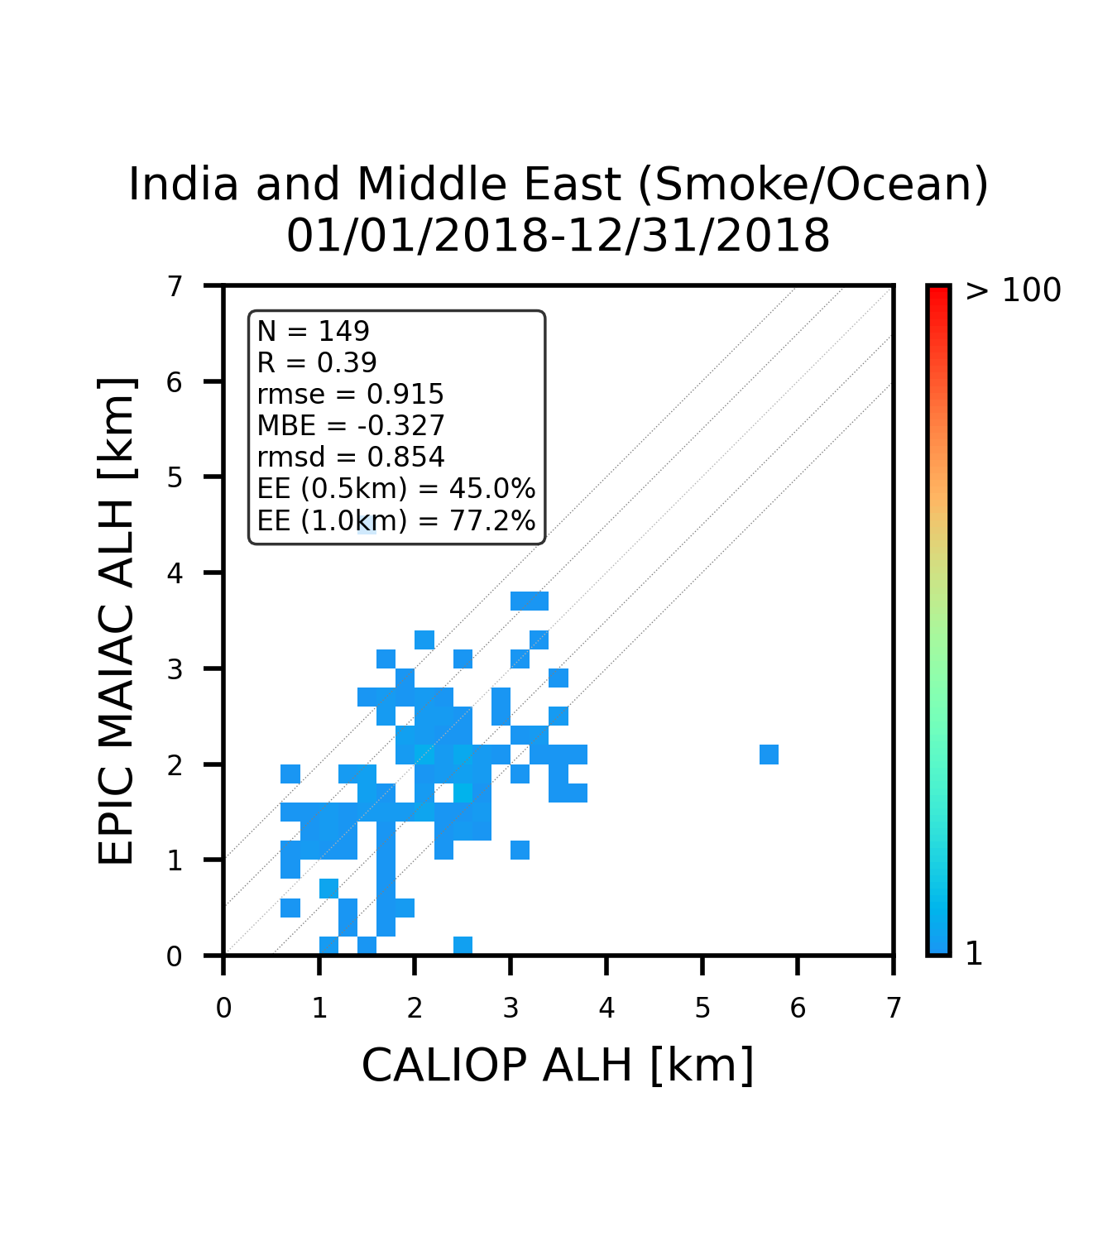
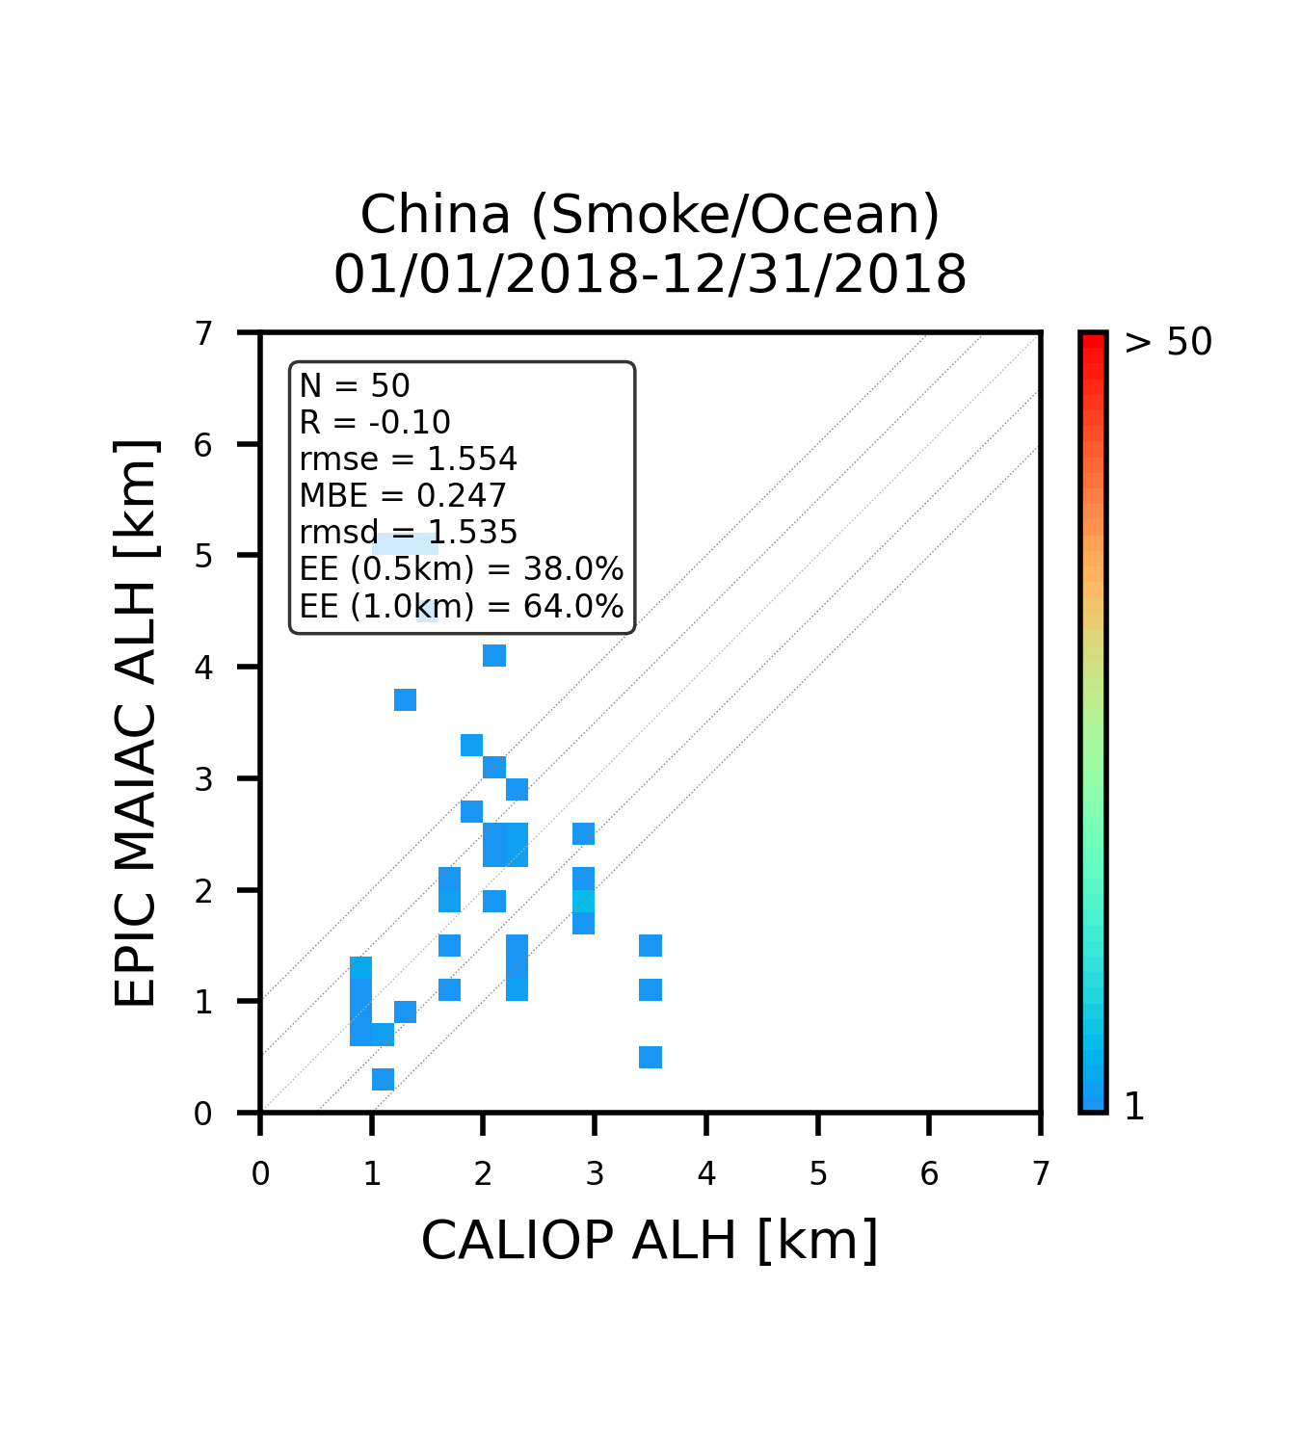
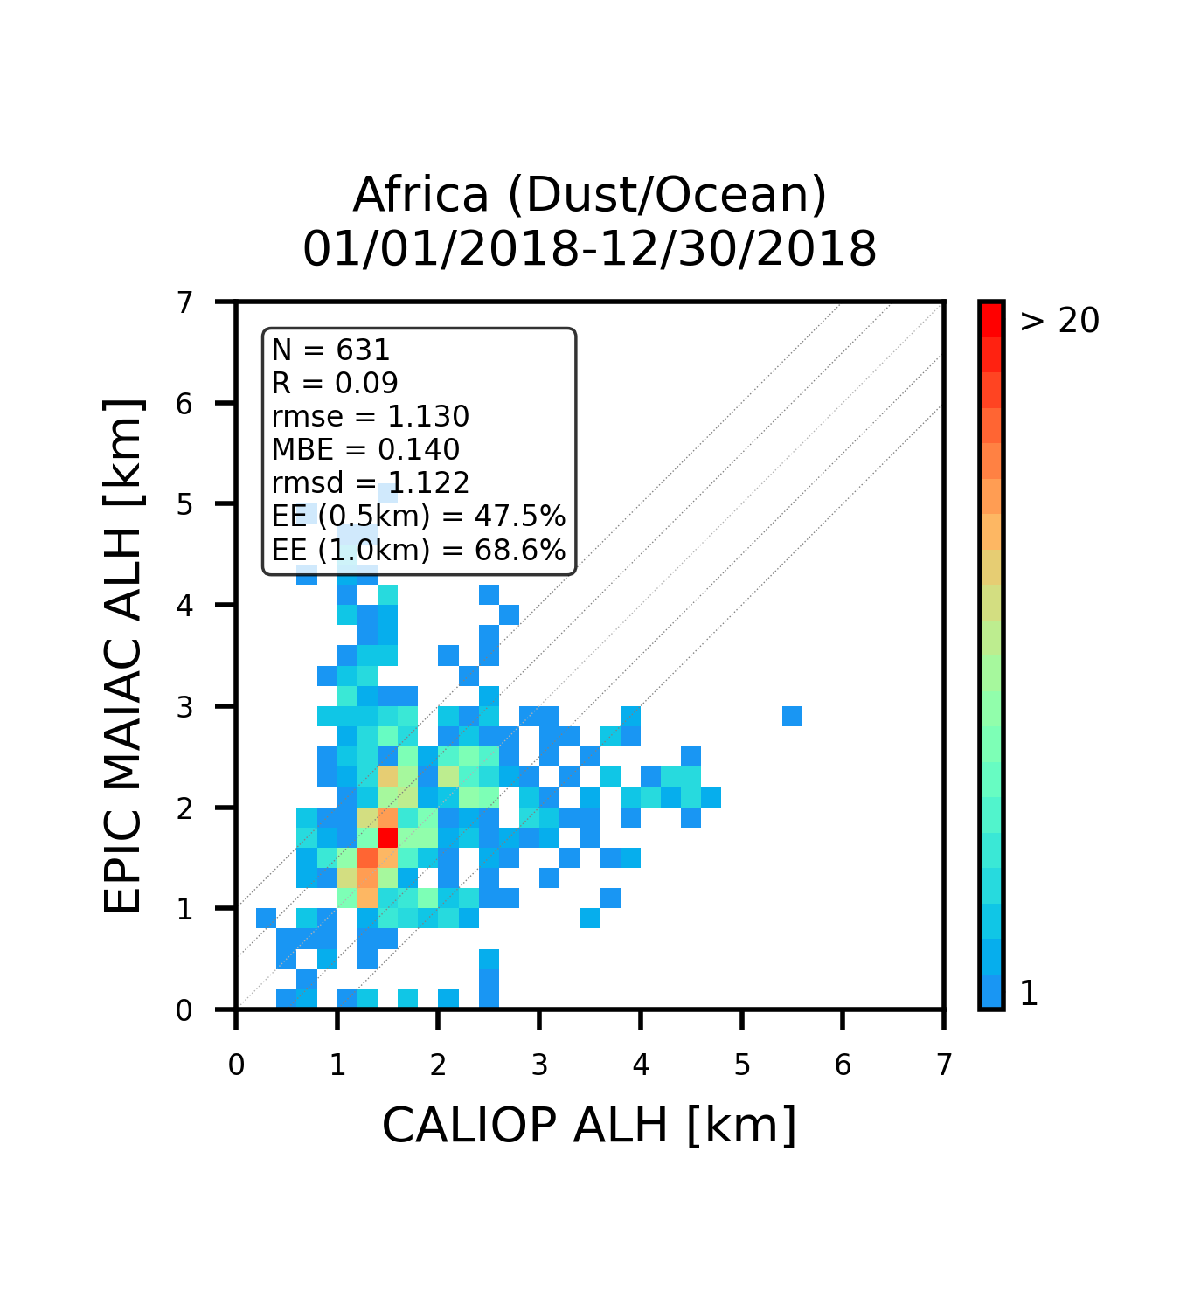
Status of validation of EPIC MAIAC ALH using CALIOP (2018)
Smoke
Dust
Land
North America
Central Africa
India/Middle East
Northeast Asia
Central Africa
Ocean
1-year integrated; collocation only when CALIOP AOD > 0.6
Currently, ALH validation results show good accuracy with RMSE of ~1.2km. The climatology of absorption (including SSA and speciation) will be updated with the full 2015-now record soon, and the seasonal climatology will be provided.
Notes:
We will need a bias Figure for both SSA and AOD_4D (if not now, then in future).
The relatively low R for AOD_4D over some locations can be explained by 1) excluding low AODs (using AOD>0.4) and so reducing the range of variation; 2) insufficient stats. – this is expected to improve with the multi-year stats.; and 3) still existing regional biases where we need to adjust aerosol model (e.g., size distribution). One example of such bias is China where we overestimate absorption.

Slide 11
Conclusions & Future work
Absorbing aerosols have the largest associated uncertainty in climate projections. Knowledge of spectral aerosol absorption is a path to aerosol speciation.
Reprocessed 2020-2023 with 4D algorithm (AOD-k₀-SAE-ALH), followed by aerosol speciation algorithm for biomass burning smoke (black carbon, brown carbon) and mineral dust (hematite, goethite); re-processing of 2015-2019 is ongoing, data will be released this month.
Generally, climatology of smoke showed more black carbon (BC) contents over Central Africa and India, and more brown carbon (BrC) contents over South Africa, North America and North Eurasia (Siberia) region which may be the reflective of the burning fuel and type of fire.
Retrieved iron oxides enveloped the overall range of Di Biagio et al. (2019) soil measurement data of iron oxides 0.7-5.8% and were in line with the previous published results generally. The ratio between hematite and goethite over Sahel was different between Harmattan and summer season, thereby implying considerable seasonal and temporal variation attributed to different source regions. Likewise, the ratio between hematite and goethite over the Middle East tends to change before and after the shamal season. Globally, the Sahel region represented higher iron oxides than Sahara, especially in April. Lower iron oxide content over Bodélé due to its diatomic sediments with high AOD were clearly observed throughout the year.
We are finalizing tuning and validation of ALH. Currently, ALH validation results show good accuracy with RMSE of ~1.2km. The climatology of absorption (including SSA and speciation) will be updated with the full 2015-now record soon, and the seasonal climatology will be provided and investigated.
Notes:
-

